Slide 1
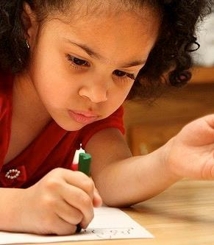
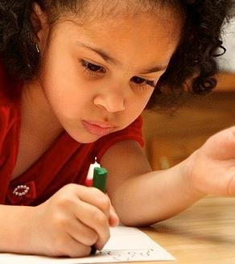
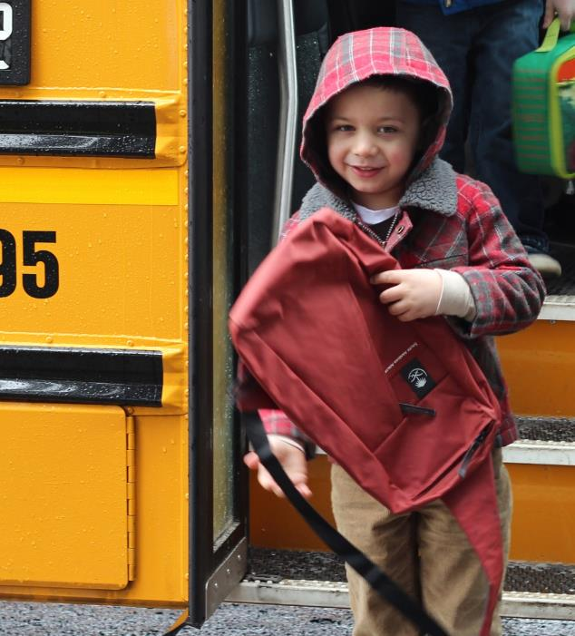
Who is ready for kindergarten?
Effective Transitions to Enhance School Readiness
Effective Transitions to Enhance School Readiness
Notes:
Why we are concerned about early transition experiences
The nature of the kindergarten transition
Building successful transition experiences

Slide 2
Agenda
Welcome and connect to content and how you can use it
Recent research & renewed focus: Why we are concerned about Kindergarten transition experiences?
Conceptualizing effective transition and partnership building
Sharing ideas of how you are building successful transition experiences
Notes:
What to say:
Here is what we’ll be doing today –
We will start with an opening activity that will help us connect to today’s content, and we will do that in just a minute with an opening question.
Then we will talk about recent research focused transitions to kindergarten and why we care about this transition experience.
We will also talk about how we conceptualize effective transitions for children and families.
And of course we will share ideas about building successful transitions.
Presenter Note: The slide deck can be tailored to your audience depending on how much time you have. You can hide some slides or rearrange the order of slides to meet your audience’s needs but, in our experience with delivering this content, these are the key issues and topics that should be included to cover this content and promote the importance of supporting effective kindergarten transitions.

Slide 3
What was your first day of school like?
Notes:
What to say:
Take a moment to connect with the content by remembering what your first day of school was like. This can be a first day of kindergarten, or first grade, or any other first day of school that they want to reflect on or think about. You might think about the first day of school for your own children. The aim of this exercise is to help connect to the content we will talk about today.
Presenter note:
Give people time to share and then ask a few people if they heard a good story or if there was something sticking with them that they want to share out with the larger group.
Usually in this activity, there are some fun and positive stories that get shared out and then some stories that are more negative or more of a traumatic experience. And this is the point – that those stories of positive transitions were likely supported transitions and the harder or more negative sorties were likely not supported in the ways that we will talk about today. You can unpack that with the group. You might have people popcorn around and share their stories and then unpack while making connections to the presentation content. And of course, there are always some funny stories that help to lighten the mood.

Slide 4
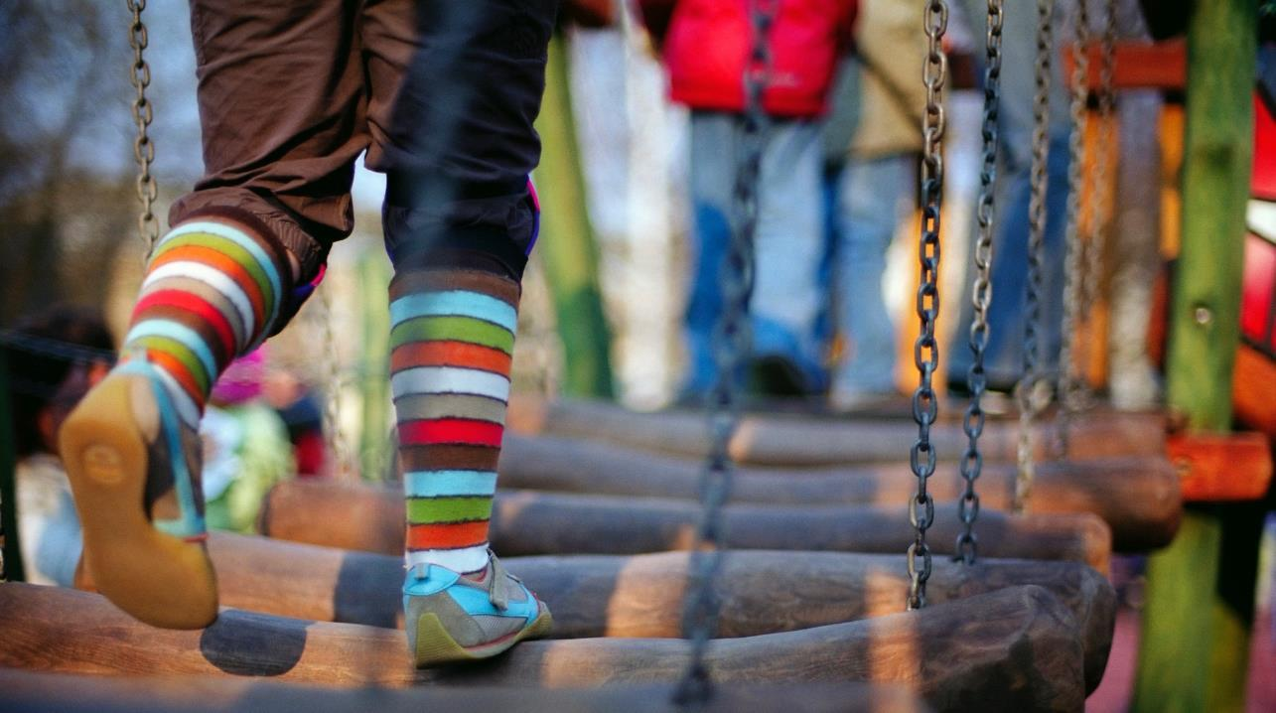
Why we are concerned about early transition experiences
Notes:
Presenter Note:
Transition to talking about why we are concerned about early transitions.
What to say:
So why are we concerned when some transitions are traumatic or rocky for children, or when transitions are challenging for families? When that first day doesn’t go well or that first week is really rocky, why are we concerned? Let’s take a look at some of the research on this:
We know that experiences in the early days of kindergarten matter, and that developing positive teacher-child relationships is really important.
We also know that:
Effective early learning experiences can close opportunity gaps.
Stability and consistency between settings is crucial to children’s continued success.

Slide 5
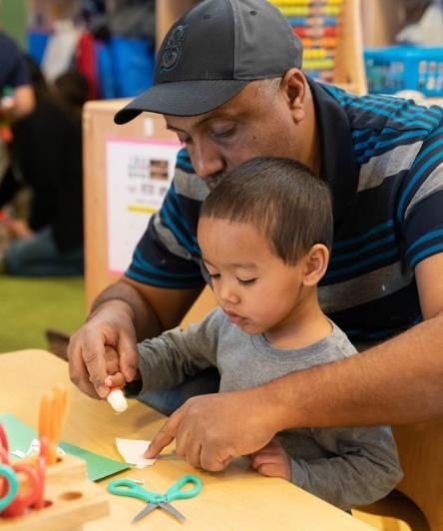
Early School Experiences Matter: Teacher-Child
Kindergarten teacher-child relationships predict:
Academic and behavior outcomes through eighth grade, particularly for children with behavior problems in kindergarten.
Notes:
What to say:
One of the things we know is that early school experiences matter and that that teacher-child relationship is incredibly important. And that teacher child relationship between a kindergarten teacher and a child predicts not only the social-emotional or learning experience for that child in kindergarten or how that first day goes but researchers have followed children and have found that it actually predicts behavioral and academic outcomes through 8th grade. That’s as far as they have followed it in these studies.
Now, the concern about children who might have some challenging behaviors in the preschool as they move to kindergarten should be enough for us to pay attention and care about these transitions. This really matters. That first relationship in the K-12 experience is incredibly important and we want that child arriving on the first day with a very supportive experience.
Some examples of having a supportive experience:
The child was able to meet the teacher before hand.
The teacher was given some information about the child’s strengths and needs before they even arrived. Some of their favorites are shared so they are sprinkled around the room, maybe their favorite book or toy.
The new educator had some assessment data and had met the family, the family knew what to expect, maybe there were some warm-up sessions before the first day, so that the first day and that first relationship is really strengthened.
And then you can imagine, that this persists. I know this child well, the child is getting to know me, I have a strong relationship with the child and that gets passed on.
But you can also imagine, that if you are a kindergarten teacher and the child and the family don’t know the school, they don’t know you, they don’t know the classroom, they don’t know the routines, they don’t know where they are going to get their lunch that day, or where they are supposed to catch the bus. There are lots of unknowns and the child walks in and could be pretty terrified and not know how to express that, so they express it with challenging behavior. If you are one teacher and you have 25 children (or more, or a few less) and there are some children who are having challenges, you can imagine that the relationship may get a little bit strained.
As the teacher you may be experiencing some stress as well, and then perhaps some determinations are made about the child’s school readiness can start to come into play and then that child might be placed in a lower academic grouping, where expectations might be lower because the child was not able to display her readiness because of the trauma or stress of the transition. You can see how it makes sense that some of these experiences can end up predicting later outcomes for children. And this is why we are so concerned about these transitions.
Presenter Notes:
Key Ideas:
Effective early school experiences can close opportunity gaps. But we also know that
Stability and consistency between settings is crucial to children’s continued success.
Reminder of the compelling reasons to focus on this
Successful transition practices also promote early child-teacher and family-school connections, which benefit children.
REFERENCE
Hamre, B. K., Pianta, R. C., Hamre, B. K., & Pianta, R. C. (2001). Early teacher-child relationships and the trajectory of children’s school outcomes through eighth grade. Child Development, 72(2), 625–638.
Jerome, E. M., Hamre, B. K., & Pianta, R. C. (2009). Teacher–Child Relationships from Kindergarten to Sixth Grade: Early Childhood Predictors of Teacher-perceived Conflict and Closeness. Social Development, 18(4), 915–945.

Slide 6
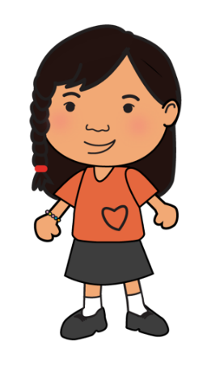
Transition Activities and Positive Outcomes
At the beginning of kindergarten:
Greater frustration tolerance
Better social skills
Fewer conduct problems
Fewer learning problems
More positive approaches to learning
More kindergarten transition practices
=
NCEDL, 1,000 children, 250 schools
Notes:
What to say:
We can also see in this very large-scale preschool study that more transition practices result in better outcomes for children from low-income families.
Successful transition practices mean a less stressful transition and better adjustment to the new environment, which translates into children being more ready to learn instead of being distracted by adjustment problems.
The slide shows some examples of positive social-emotional outcomes and general adjustment.
Presenter Notes:
Key Ideas:
Reminder of large-scale study demonstrating that more transition practices result in better outcomes for children.
The slide shows the transition activities that were mostly helpful for children from low-income families.
Successful transition practices mean a less stressful transition and better adjustment to the new environment, which translates into children being more ready to learn instead of being distracted by adjustment problems.
The slide shows some examples of positive social-emotional outcomes and general adjustment.

Slide 7
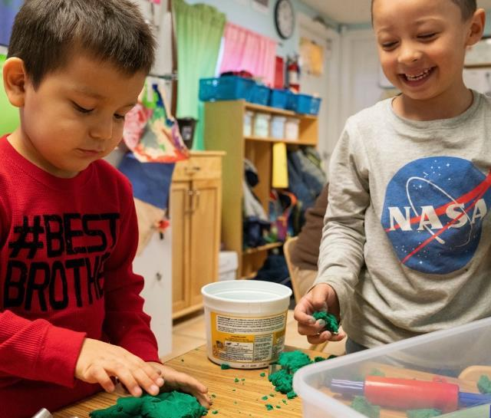
Social Emotional Development in Kindergarten
Social-emotional skills in kindergarten are related to key young adult outcomes:
Education,
Employment,
Criminal activity,
Substance use, and
Mental health.
Jones, Greenberg & Crowley, 2015
Notes:
Trainer Notes:
Optional Slide including additional ways that social emotional skills predict better outcomes for young adults. This is from a 2015 study.
REFERENCE
Jones, D. E., Greenberg, M., & Crowley, M. (2015). Early Social-Emotional Functioning and Public Health: The Relationship Between Kindergarten Social Competence and Future Wellness. American Journal of Public Health, 105(11), 2283–2290.

Slide 8
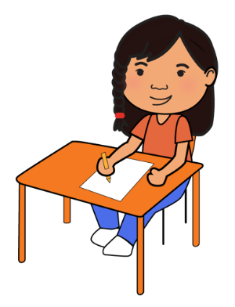
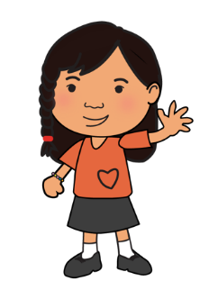
Transition Practices and School Success
Early Childhood Longitudinal Study
17,212 children, 992 schools
Kindergarten Transition
Practices
Spring Kindergarten Academic Skills
=
Schulting, Malone, & Dodge, 2005
Notes:
What to say:
We also know from another large, nationally representative sample pf children. that the more transition practices that are put in place at the beginning of the preschool year, that also predicts end of Kindergarten year academic skills. And those are also really important.
Trainer Notes
Key Ideas:
Reminder that more transition practices also improve children’s success academically
As we see from a different study, transition activities also affect academic skills.
This study found that more transition activities in the fall translated into higher academic performance in the spring.
REFERENCE
Schulting, A. B., Malone, P. S., & Dodge, K. A. (2005). The Effect of School-Based Kindergarten Transition Policies and Practices on Child Academic Outcomes. Developmental Psychology, 41(6), 860–871.

Slide 9
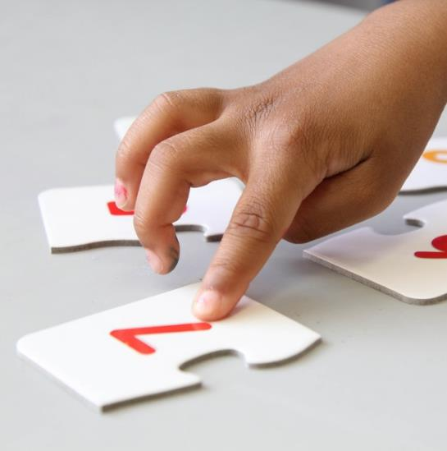
Kindergarten Achievement
Kindergarten achievement scores are highly correlated with:
Earnings at age 27,
College attendance,
Home ownership, and
Retirement savings
Raj Chetty, John N. Friedman, Nathaniel Hilger, Emmanuel Saez, Diane Whitmore Schanzenbach, and Danny Yagan
NBER Working Paper No. 16381 September 2010
Notes:
What to say:
End of year kindergarten academic skills are also important because some studies have shown that these are highly correlated with important life skills and achievements as you can see on this slide.
Presenter note: you can read the bullets aloud or allow participants to read them.
Kindergarten achievement scores are highly correlated with:
Earnings at age 27,
College attendance,
Home ownership, and
Retirement savings
So, again, we see why kindergarten transitions matter.
Presenter note:
Key Points:
Kindergarten transitions predict end of year academic skills and those are correlated with longer term positive life events.
REFERENCES
Raj Chetty, John N. Friedman, Nathaniel Hilger, Emmanuel Saez, Diane Whitmore Schanzenbach, and Danny Yagan
NBER Working Paper No. 16381 September 2010

Slide 10
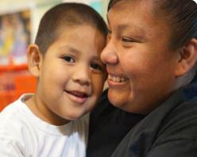
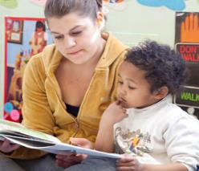
Early Experiences Matter: Family Engagement
It’s never too early to support family engagement and transitions to Kindergarten
Begin at Birth: Stimulating play interactions between mothers or fathers and their toddlers has been shown to predict children’s fifth-grade math and reading abilities.
Support Home-School Connections: Adults who partner to support young children help them develop the skills related to later school success—early language, literacy, attention, and self-regulation.
Create Family Friendly Environments: When ECE programs and schools actively engage families and support family participation in transitions, families show increased involvement during the kindergarten year.
Support Family Wellbeing: ECE programs that engage community partners to offer comprehensive family supports have a better chance of promoting family well being and improving children’s readiness for kindergarten.
Engage Parents as Leaders: When families have a real role in decision-making, they know they can make a difference, and their leadership grows.
(Cook, Roggman, & Boyce, 2011; Ayoub, Vallotton, & Mastergeorge, 2011; Schulting et al., 2005; Rouse & Fantuzzo, 2009; Langford & Weisbourd, 1997)
Notes:
What to say:
From the beginning, ECE programs have a role to play in supporting transition to Kindergarten even at the earliest months and years of life.
Through targeted activities, ECE programs support reinforcement of curricular goals at home and these practices set a foundation for future continuity between home and school.
When families perceive environments as welcoming and inclusive, this invites participation and can set a course for future involvement/engagement in welcoming school environments. Family engagement can be more effective when tailored to the unique interests, strengths, and needs of families from diverse cultural groups.
Family wellbeing is an important predictor of school readiness so strengthening family wellbeing can contribute to more successful transitions to kindergarten.
Continuity around parent leadership activities from ECE to Kindergarten can foster parents social capital. Engaging parents in decision making roles and in reviewing child assessment data in ECE programs, for example, helps set parents on an advocacy path as they make the transition to kindergarten.
REFERENCES
Cook, G. A., Roggman, L. A., & Boyce, L. K. (2011). Fathers’ and mothers’ cognitive stimulation in early play with toddlers: Predictors of 5th grade reading and math. Family Science, 2(2), 131–145.
Ayoub, C., Vallotton, C. D., & Mastergeorge, A. M. (2011). Developmental pathways to integrated social skills: The roles of parenting and early intervention. Child development, 82(2), 583-600.
Schulting, A. B., Malone, P. S., & Dodge, K. A. (2005). The effect of school-based kindergarten transition policies and practices on child academic outcomes. Developmental Psychology, 41(6), 860-871.
Rouse, H. L. & Fantuzzo, J. W. (2009). Multiple risks and educational wellbeing: A population-based investigation of threats to early school success. Early Childhood Research Quarterly, 24, 1–14.
Langford, J., & Weisbourd, B. (1997). New directions for parent leadership in a family-support context. In S. L. Kagan, & B. T. Bowman (Eds.), Leadership in early care and education (pp. 147-153). Washington, D.C.: National Association for the Education of Young Children.

Slide 11
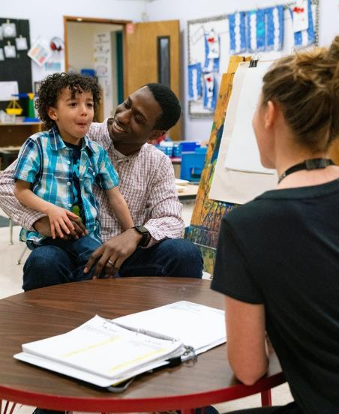
Early School Experiences Matter: Family Engagement
Kindergarten family involvement is associated with:
More cooperative, self-controlled, and socially engaged children.
Lower rates of high school dropout, increased on-time high school completion, and higher grade completed.
Higher achievement in language and math, and higher ratings on peer interactions.
Hamre and Pianta, 2001 and Jerome, et al., 2009
Notes:
What to say: We want to talk about when families get involved because we are not only talking about transitioning that child from a Head Start classroom to a Kindergarten classroom, but we are transitioning the family too. We are hoping that all of that family engagement that we have achieved in our Head Start program continues with them to the Kindergarten classroom because with more family involvement, we see great social emotional and academic outcomes for children. SO all of these things should make us really excited to focus on kindergarten transitions.
REFERENCE
Hamre, B. K., Pianta, R. C., Hamre, B. K., & Pianta, R. C. (2001). Early teacher-child relationships and the trajectory of children’s school outcomes through eighth grade. Child Development, 72(2), 625–638.
Jerome, E. M., Hamre, B. K., & Pianta, R. C. (2009). Teacher–Child Relationships from Kindergarten to Sixth Grade: Early Childhood Predictors of Teacher-perceived Conflict and Closeness. Social Development, 18(4), 915–945.

Slide 12
Kindergarten Transitions
Difficult
16%
Successful
52%
Ease of
Transition
Some
problems
32%
Notes:
What to say:
So how well are children transitioning into kindergarten?
This chart is from Karen LaParo’s study. She surveyed Kindergarten children’s parents and teachers to get a sense of how well children were adjusting, including social and emotional skills, behavioral regulation skills, is the child happy to go to school, is the child leaving the classroom a lot? Is the child talking positively about kindergarten at home or is the child not liking kindergarten? And we see how well the child’ is adjusting and how well their behavior is manifesting in the classroom.
The good news is that many children successfully and joyfully transition to kindergarten, but unfortunately, almost half do not. And this number disproportionately represents children of color and children from low income backgrounds.
Presenter note: if you have a short anecdote to share about a positive or negative adjustment, you can share it here.
We see this in these data from Karen LaParo’s survey, but let’s think about the children in your programs.
Pose the question:
How well are children adjusting to or from your programs and how do you know that?
(provide time for tables/groups to share their ideas about this)
Presenter note: If time allows, plan for an extended period for this – because just asking this question gets people really starting to recognize, well I’ve got this data, but not that data, or that’s something I never thought of, we could survey our families after the transition to learn how it is going. This starts a lot of ideas churning because it is usually a fairly simple process to ask a few questions about the transition process to learn about how these are going.
Also – if groups share that they are collecting quite a bit of data, encourage them to disaggregate it – If looking at population data – are their pockets of children by demographics that are not doing as well? Are there specific schools within a district? Are their parts of the state where children are not doing as well? This can help states, districts and schools target supports for those children where data indicate transitions are not as positive or successful.
Key Ideas:
The good news is that many children successfully and joyfully transition to kindergarten, but unfortunately, almost half do not. And this number disproportionately represents children of color and children from low income backgrounds
Even if children from Head Start are transitioning with success – they may be in classrooms with many other children who are not – and this can ultimately affect all of the children in the classroom.
For example, if Head Start children are displaying skills at the kindergarten entry level and adjusting well – but some other children are not – the teacher may adjust their teaching to children with the lowest skill set in order to catch them up – then HS children could be undertaught.
So, if you are doing great things with connections and transition practices – consider challenging yourself to partner with childcare and FFN networks and community organizations to help raise all ships!
REFERENCE
LaParo, K. M., Hamre, B. K., LoCasale-Crouch, J., Pianta, R. C., Bryant, D., Early, D., & Burchinal, M. (2009). Quality in kindergarten classrooms: Observational evidence for the need to increase children’s learning opportunities in early education classrooms. Early Education and Development, 20(4), 657-692.

Slide 13
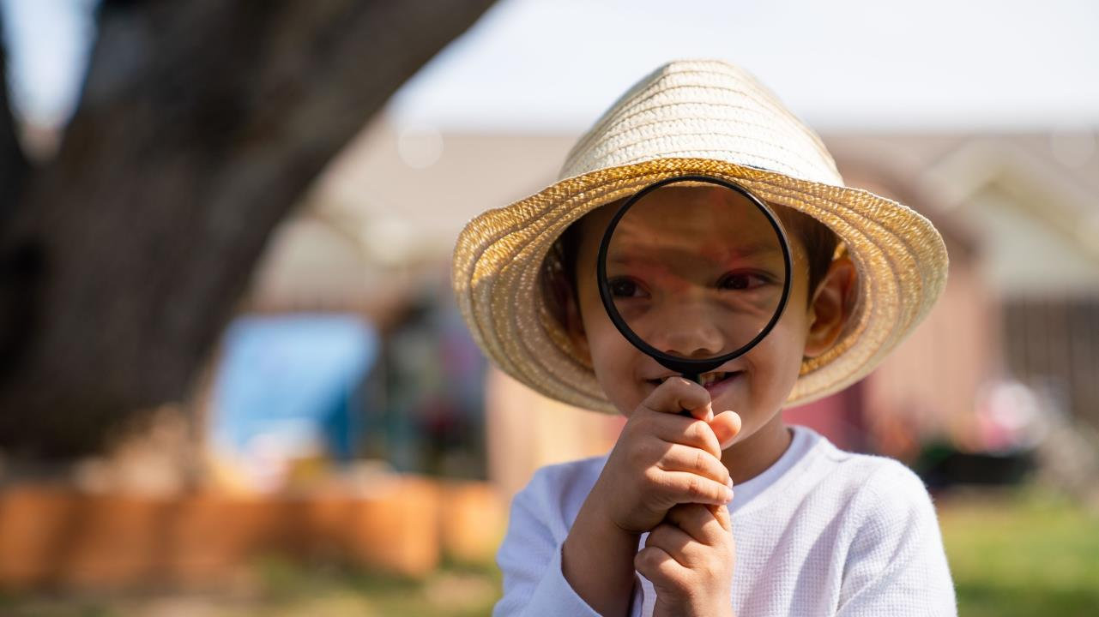
The Nature of Kindergarten Transition
The Nature of Kindergarten Transition
Notes:
What to say:
So why do some children have a difficult time adjusting to kindergarten? This next slide is one reason that children might have a difficult time.

Slide 14
Preschool vs. Kindergarten
Early Learning Setting
Kindergarten
37%
33%
23%
20%
10%
6%
4%
6%
Free Choice/Centers
Individual
Small Group
Whole Group
LaParo et al., 2009
Notes:
What to say:
Some of the reasons are here in this visual.
One the bottom of this chart are the activities children spend their time in each day – free choice or learning centers, small group times, whole group times, or individual. The orange bar is the amount of time they spend in preschool doing these things and the green bar indicates the amount of time they spend in kindergarten doing these same things. You can see in the graph that it is totally mismatched. You have completely different experiences across the preschool and public school settings.
We need someone to update these data because it may even be a greater differential now. We have Daphna Bassok who looked at what K classrooms look like now and they are starting to see that K classrooms look more like first grade classrooms. So it is possibly that this differential is even greater now.
The learner’s prior experiences and current capacities are the starting place for developing new knowledge, and teaching must build upon those prior experiences and current capacities to make learning more meaningful and effective. Therefore, when shifts in children’s experiences are abrupt and do not align with their developmental needs, children struggle.
Between 1998 and 2006, US Kindergarteners’ classrooms evolved to include more interactions that focused on literacy and fewer on social sciences, art, and physical education, moved from spending 56% of instructional time on child-directed activities to 33%, and changed to focus more on supporting children in skills that had previously been in the first grade curriculum, such as conventional spelling (Bassok et al., 2016).
REFERENCE
Bassok, D., Latham, S., & Rorem, A. (2016). Is Kindergarten the New First Grade? AERA Open. https://doi.org/10.1177/2332858415616358
LaParo, K. M., Hamre, B. K., LoCasale-Crouch, J., Pianta, R. C., Bryant, D., Early, D., & Burchinal, M. (2009). Quality in kindergarten classrooms: Observational evidence for the need to increase children’s learning opportunities in early education classrooms. Early Education and Development, 20(4), 657-692.

Slide 15
From the Child’s Perspective
Transitions: From the Children’s Perspective
Notes:
What to say:
We’ve been talking a lot about what we know from the research and what adults say, but it is always nice to hear it from children. A few years ago, we interviewed kindergarten children to ask them about their perceptions of coming to kindergarten. What was kindergarten like and what did they think of the transition. We talked to a few preschoolers as well, so you can also see that developmental difference. So let’s listen to how children are perceiving their experience.

Slide 16
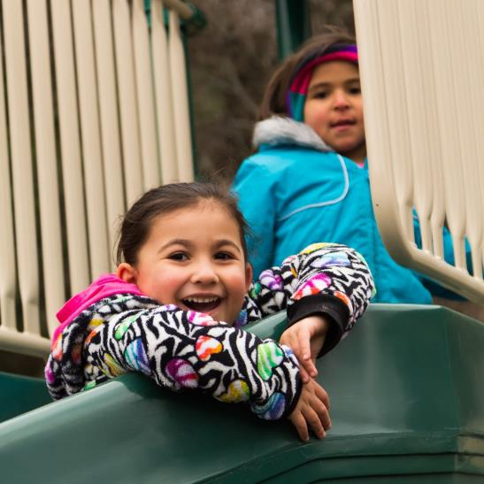
Kindergarten Changes
Changes in academic demands and curricula
Complexity of social environment
Less time with teacher(s)
Fewer direct family connections with the learning setting
Pianta & Kraft-Sayre, 2003
Notes:
Presenter note:
This slide can be added back in if time allows
What to say:
The problem is that this developmental period is rife with change in context and experiences, creating disconnects and misalignment.
Kindergarten entry marks the transition from a less-structured preschool environment to a formal school setting with different demands and increased expectations (Rimm-Kaufman and Pianta, 2000).
These include:
Changes in academic demands
Less family engagement with school
More complex social environments
Less one-on-one time with teachers
These changes can lead to misalignment between preschool and kindergarten and put successful adjustment at risk.
REFERENCE
Pianta, R.C., & Kraft-Sayre, M. (2003). Successful kindergarten transition. Baltimore, MD: Paul H. Brookes Publishing Co., Inc.

Slide 17
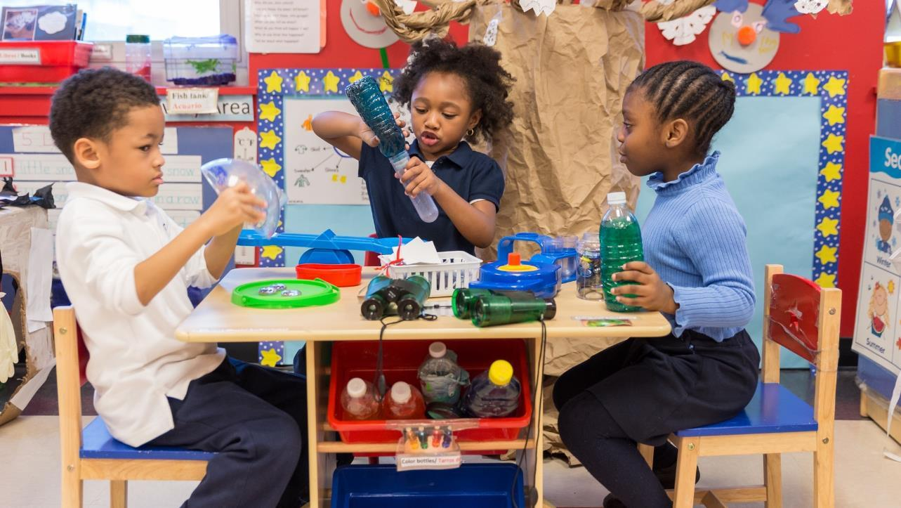
Conceptualizing Effective
Transition
Notes:
What to say:
What we have noticed is that even when children are having a positive experience in kindergarten, if someone asks them how it is going, the first thing they mentioned is what they are or were worried about. The children in the video we just showed were able to describe what they were feeling, but what if a child doesn’t have the language to do that? Or doesn’t understand how to share those feelings or regulate those feelings? That is where we see some challenging behaviors and adjustment challenges. We have noticed that lunch in particular is very different and can be a challenging time.
Presenter note: this might be a time to have participants start thinking about strategies for the transition process. For example, around meals, some programs might have children visit a lunchroom or start practicing with a tray.
Now we will talk about a model to help us better understand the transition process.
Note that we will focus on the transition to kindergarten here, but the principles for successful adjustment that we’ll examine are the same principles that will promote successful transitions to other settings,

Slide 18
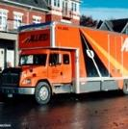
Transitions Across the Lifespan
What creates successful adjustment?
Information
Relationships
Alignment
Transition = Change = Hard
Children need our help to manage these changes.
Pianta & Kraft-Sayre, 2003
Notes:
Objective
To have participants think about transitions they have gone through themselves
What to say
We talk about this in the context of transition to kindergarten, but this is the secret sauce for any transition a person might make.
Presenter note: you could stop at this moment and have people reflect on any recent transition that they have gone through. Maybe they recently retired.. Moved.. Got a new job.. Became a new parent or a new grandparent.. Any big life transition experience. You can ask them to talk about what made it successful – or not.
Discussion debrief: Usually what comes out is that they have had (on screen) information – they knew what was happening and what to expect, relationships – they had positive relationships where they started and where they ended, and alignment. There was some consistency that they could rely on. If these topics don’t come out in the debrief, you can bring them up here.
What to say
Transitions are hard, but we actually know a lot about how to facilitate effective transitions – we do it everyday! These three ingredients are what make a transition successful for children as well.
As adults, we can make these things happen on our own, but children need our help.
REFERENCE
Pianta, R.C., & Kraft-Sayre, M. (2003). Successful kindergarten transition. Baltimore, MD: Paul H. Brookes Publishing Co., Inc.

Slide 19
School Readiness And Transition
Inadequate View
Cognitive Readiness & Intelligence
Language Abilities
Temperament
Poverty Status
Gender
Preschool
Kindergarten
Notes:
Objective
To convey that only a child-focused view of school readiness is inadequate
What to say
This is what we would call an inadequate view of transition. It’s getting the child from this program to that program.
Often school readiness, and its measurement, is thought of as simply a set of skills that kids need, such as knowing the alphabet. However, this perspective ignores the fact that children’s learning is dynamic and heavily influenced by what’s happening and available around them in the classroom or at home.
Relationships and alignment between settings are important. The old way of thinking about transitions is inadequate.

Slide 20
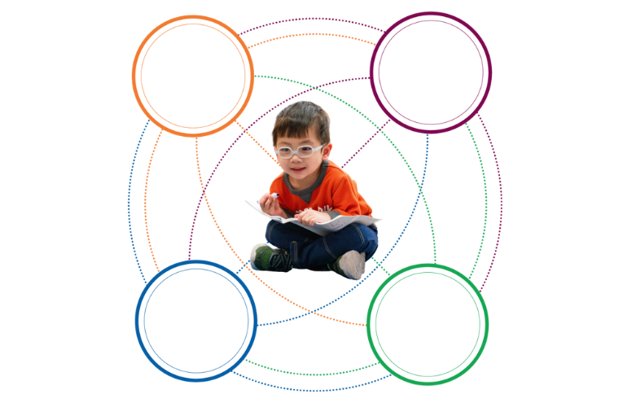
When Connections Are The Focus
Rimm-Kaufman & Pianta, 2000
Teachers
Peers
Community
Family
Early Experiences
Kindergarten
The changing dynamics of these relationships during transitions influence child outcomes.
Notes:
Objective
To convey the complexity of the factors that all contribute to school readiness for children and the resources that are needed. Also, to tie in examples from participants’ exercise about transitions from their own lives.
What to say:
Research has found that it is more useful to take an interactive and connected view of transitions.
In other words, there are both relational and informational links between children and the people and community around them, just like the examples from adult life.
There is a great web of potential supports that we as educators can tap into. We want to think about the people involved and how they can connect with each other. We want to think about the educators, for example, in a head start program connecting with the educators in a school. We want to think about families in your Head Start or child care, and connecting them with families in their kindergarten classrooms. You might find out which children from your program are going to the same kindergarten classroom and try to connect their families.
There was a great study by Brian Vaughn out of Vanderbilt many years ago where he showed that if a child transitions from preschool to kindergarten with just one other child that they know and could be a friend, that that would be a predictor for social emotional and even academic success. We really want to underscore those peer relationships as well.
This framework, and not the child-focused framework, should then guide best practices for transition planning.
REFERENCE
Rimm-Kaufman, S. E., Pianta, R. C., & Cox, M. J. (2000).Teachers’ judgments of problems in the transition to kindergarten. Early Childhood Research Quarterly, 15(2), 147–166.

Slide 21
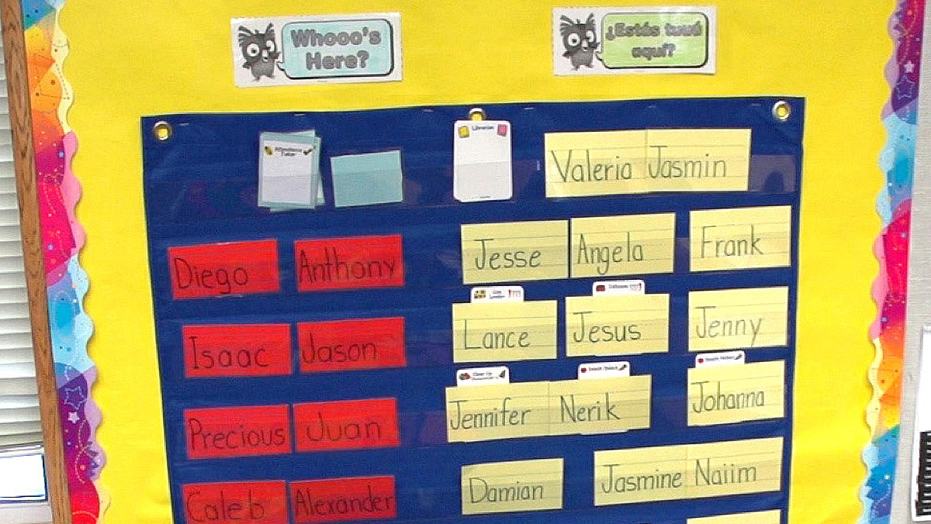
Transition Connections
Transition
Connections
Notes:
What to say:
We will talk about four key sets of connections today, all of which contribute to the transition process. Then, we will discuss examples of how these connections can be used within this transition framework.

Slide 22
Transition Connections
Child–School
To foster children’s familiarity with the classroom setting and people
Family–School
To foster family collaboration and engagement with the school
Program–School To provide children with stable, high quality classroom experiences
Community–School
To facilitate the transition process within the community
Notes:
Objective:
Introduce participants to the four types of transition connections that should be fostered for successful transition planning
What to say
So this is where the real work starts, where teams will start brainstorming ideas and thinking about where they are strong and where they could use some work. These are the four types of transition connections that should be fostered for successful transition planning. Some examples of each are:
Child-School
Making a video for children about kindergarten
Taking a field trip to a kindergarten classroom
Reading books about kindergarten
Family-School
Sending home learning activities to prepare for kindergarten
Having a kindergarten open house for families
Sending home transition information to families
School-School
Teachers or administrators talking to one another about aligning curricula between preschool and kindergarten
Teachers or administrators communicating about assessments that will help inform kindergarten teachers
School personnel communicating about individual students
Community-School
“Getting the word out”
PSAs
Bulletins in community areas such as directors’ offices or libraries
Working with social services to get information to families
One key goal of the community-school relationship is disseminating information to populations who may be somewhat out of touch with school. This could be information on kindergarten registration, activities families can do to prepare their children for kindergarten, etc.

Slide 23
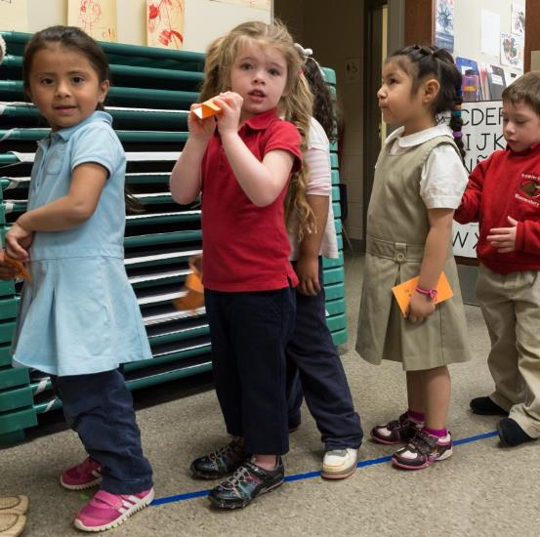
Child-School
Positive learning experiences that are developmentally appropriate, high quality, and increase in complexity over time
Read books about kindergarten
Visit kindergarten classrooms
Invite a kindergarten teacher to visit the early learning setting
Create social stories about going to kindergarten
Talk about and practice kindergarten routines (line up, bathroom breaks, lunchtime, etc.)
Notes:
What to say:
Here are a few ideas. You may have already thought of a few, but hopefully you can find some new ideas. Some are overarching things like developing positive experiences but other are more concrete actions like reading books. More is always better.

Slide 24
Consistency is Key
Consistency in instructional practice across Head Start and kindergarten settings is associated with children’s academic and social-emotional skills development during kindergarten
Mashburn & Yelverton, 2019
Notes:
What to say:
Overall, when instruction is consistently high-quality and builds on itself with increasing complexity to match children’s developing skillsets across multiple
years, children’s learning benefits.
The study noted here looked at what seemed to be the determining factor for children and it really was a lot about that alignment piece and consistency between settings. That requires connections between schools and programs.
REFERENCE
Mashburn, A. J., LoCasale-Crouch, J., & Pears, K. C. (2018). Kindergarten transition and readiness: Promoting cognitive, social-emotional, and self-regulatory development. New York, NY: Springer Science Business Media.

Slide 25
Family-School
Kindergarten enrollment events
Jointly hosted curriculum nights
Summer activity calendar
Connect families to other families going to the same school
Head Start parent ambassadors
Systematic surveys and check-ins to find out how the transition is going and what families found to be helpful
Notes:
What to say:
Some of the transition activities in the studies we have discussed today included examples such as having an enrollment night at the head start program and including other local early childhood programs. The earlier we can get children enrolled in kindergarten, the more likely we can use transition practices because the schools can create their class lists and do a lot more if they have that enrollment earlier.
Joint curriculum nights held by early childhood and kindergarten educators and inviting families.
One example I have liked is a head start program that didn’t start the children until two weeks after the school district. In those two weeks the head start teachers’ job was to support the children that had just transitioned out and contact the kindergarten teachers to see how they were doing and offer any input as needed.
Presenter note: you can read through the bullets and give more context to the remaining examples as appropriate.

Slide 26
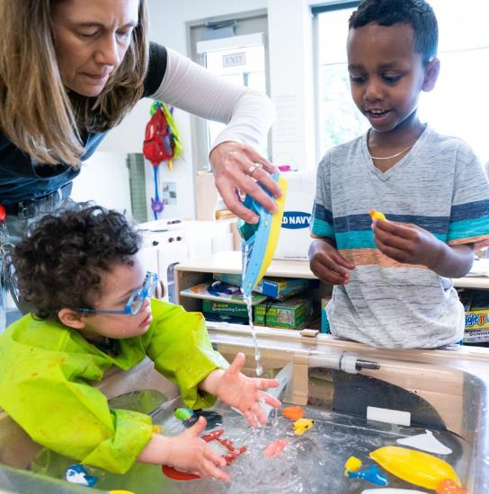
Looking at Transitions Through Inclusive Lenses
How do you modify transition practices for:
Children who are dual language learners?
Children with disabilities?
Children who are experiencing homelessness or who have experienced other trauma?
Notes:
Presenter note: You also stop before this slide and have people brainstorm all the transition practices they have been doing or want to do and then review them again with the lenses described below and discuss how to individualize.
What to say:
When we think about all those transitions and all those transition practices, we want to ensure to introduce equity into the conversation. We can do that by discussing strategies for:
How we modify the practices for:
Children who are dual language learners
Children with disabilities
Children who are experiencing homelessness or who have experienced other trauma

Slide 27
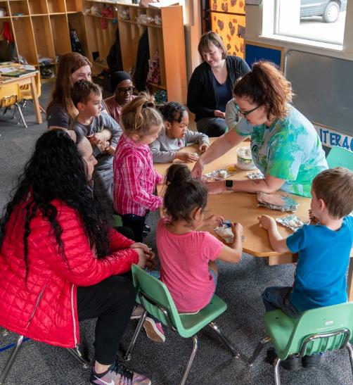
Program-School
Joint PD for teachers and leaders
Align curriculum, assessment information
Visit each other schools/programs
Data sharing agreements and feedback loops
Universal enrollment forms
Principal visit days – Head Start 101
Notes:
What to say:
Now we will brainstorm ideas for program-school.
Joint PD for teachers and leaders
Align curriculum, assessment information
Visit each other schools/programs
Data sharing agreements and feedback loops
Universal enrollment forms
Principal visit days – Head Start 101
Ask participants: Are there any other ideas/strategies that you use that we haven’t mentioned yet?

Slide 28
Community-School
Kindergarten registration announcements
Public programs such as libraries, parks, and community centers hosting kindergarten-themed events
Kindergarten registration support
Community organizations offering free or low-cost:
Meals
School supplies
Haircuts
Physical examinations
Language and translation services
Notes:
What to say:
The final connection we are talking about today is community-school. The big question is: how do we get community organizations interested and engaged in helping with successful kindergarten transition as well?
Examples:
PSAs about Kindergarten registration
Connecting with parks and rec and other community-based organizations about school readiness
Kindergarten registration events with businesses/non-profits offering:
Free meals
Free school supplies
Free haircuts (sometimes local cosmetology schools are willing to do this!)

Slide 29
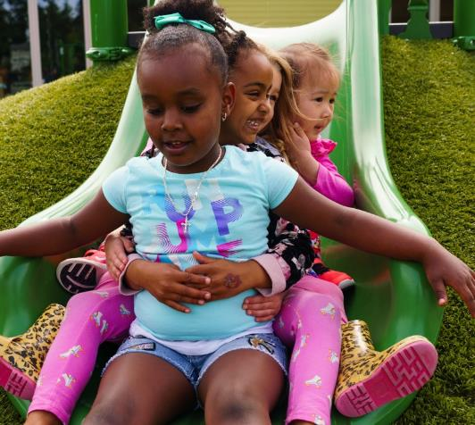
A Smooth Transition
When children are a part of a quality transition process, they have an easier time and enjoy:
Improved academic achievement
More positive social and emotional competencies and fewer behavioral problems
Rapidly developing skills
Caspe Lopez & Chattrabhuti, Harvard Family Research Project, March 2015
Notes:
Presenter note: this slide can be shown if time allows to reinforce strategies for effective transitions.
What to say:
When children are a part of a quality transition process, they have an easier time and enjoy:
Improved academic achievement
More positive social and emotional competencies and fewer behavioral problems
Rapidly developing skills
REFERENCE
Caspe, Lopez & Chattrabhuti, Harvard Family Research Project, March 2015

Slide 30
Leaders Supporting the Transition to Kindergarten
Notes:
What to say:
The three key strategies for supporting successful transitions to kindergarten include information sharing, relationship building, and alignment between early childhood and kindergarten settings. Head Start and elementary school leaders can implement a variety of practices to support these three strategic areas. In this video, Head Start and elementary school leaders share specific, collaborative practices that they implement during the transition to kindergarten, and how those practices support children.

Slide 31
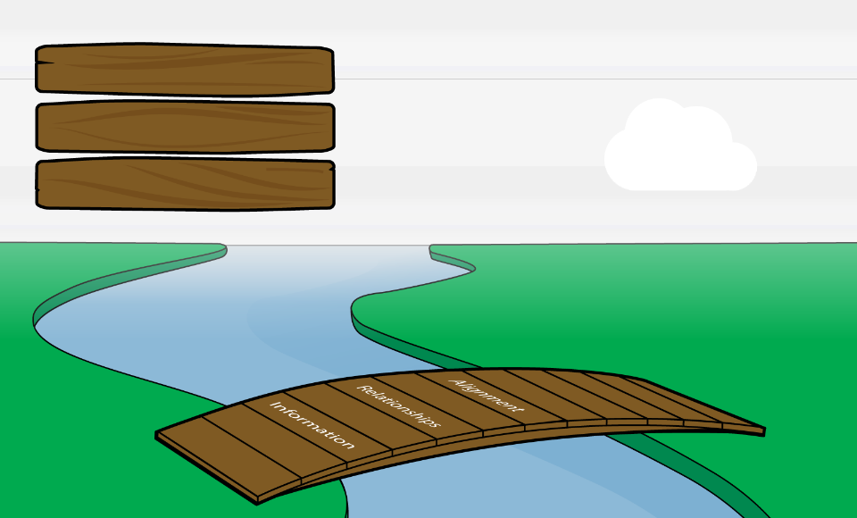
Building Bridges for Children and Families
Information
Relationships
Alignment
Successful Adjustment
Pianta & Kraft-Sayre, 2003
Notes:
Presenter Note: This slide can be hidden or used in place of the video
What to say:
Information Sharing
Communicate with families in their home languages
Prepare children for what to expect
Share data between early learning and elementary school settings
How is information shared with families about the transition to kindergarten? What other information might be helpful to families?
Do children in your area know what to expect in the transition to kindergarten? What other experiences or information would further support them?
Do Head Start programs and elementary schools share data about the development, expectations, and unique considerations of children? What additional information would be useful to each setting? How can leaders support the sharing of this information?
Building Relationships
Sustain community relationships
Support relationships with families
What partnerships already exist within your program, school, and greater community?
What relationships could be formed or developed to support the transition process?
How are relationships and trust established with the children and families who are transitioning?
Program Alignment
Participate in joint professional development
Partner around transition activities
Coordinate aligned assessments, standards, and curricula
What joint professional development and planning opportunities exist for educators? What opportunities would further support collaboration between educators?
How do local Head Start programs and elementary schools work together to plan transition activities? What other activities could be valuable partnership opportunities?
How do local Head Start programs and elementary schools share their expectations and norms? Are there any areas of misalignment to discuss?

Slide 32
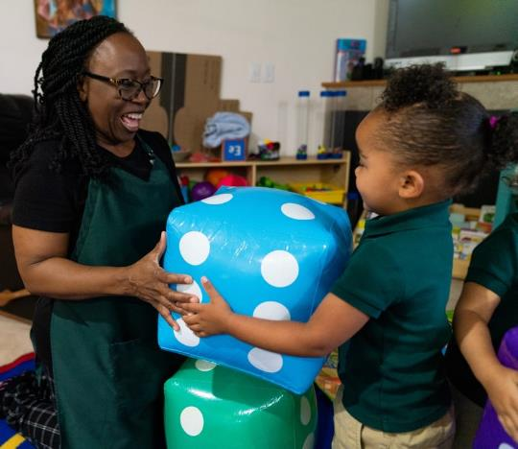
Summary
Effective transitions support:
children’s social and emotional and academic success
family engagement
Effective transitions rely on:
Information
Relationships
Alignment
Effective transitions include four key connections:
Child-School
Family-School
Program-School
Community-School
Notes:
What to say:
To summarize what we have discussed today:
Supported transitions support children’s social and emotional and academic success
Supported transitions improve family engagement in kindergarten and beyond
Supported transitions include:
Information
Relationships
Alignment
And this is relevant across multiple connections, not just into kindergarten

Slide 33
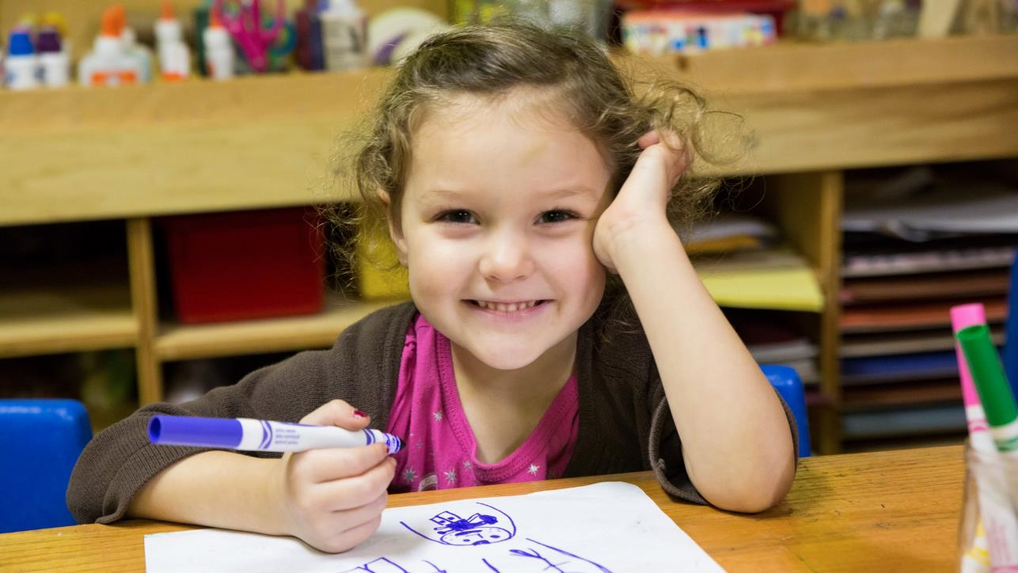
Thank
You

