Slide 1

Head Start A to Z, 2.0
Human Resources (HR)
Notes:
Slide 1
Facilitator Notes:
Welcome participants to the session and introduce
yourself and any co-facilitators. Begin the session with an introductory activity to create a positive group climate.
Say to Participants: “The National Center on Program Management and Fiscal Operations, or PMFO, has updated Head Start A to Z to align with the revised Head Start Program Performance Standards that became effective November 2016. Head Start A to Z was originally designed to support new leaders in their Head Start roles. The term ‘leaders’ ensures that anyone at the management level, or in some cases the governing body, Tribal Council, or Policy Council level, can attend the sessions or use the materials for independent learning.
“The updated Head Start A to Z, 2.0, learning modules provide baseline-level information primarily through a leadership and management systems lens. The presentations are modeled on ‘learning organization’ concepts. In each of the modules, we recognize key characteristics of learning organizations, including a supportive learning environment, openness to new ideas, and time dedicated for reflection.
“Each attendee has an important role to play in the success of this session. Those with experience remind us where we’ve come from and what we must do to maintain our identity and uniqueness. New members bring a fresh perspective and remind us what we must do to prepare for the future. All roles are essential for Head Start to be a learning organization that continues to grow and flourish.
“Head Start A to Z, 2.0, is most successful when it helps us share the best of what we have to offer with a strengths-based focus. As you engage in this session, we hope you will support one another in the learning process by generously sharing your knowledge, experience, and perspective.”

Slide 2
Learning Objectives
As a result of this session, participants will:
Explore seven key functions of HR
Identify how HR builds and retains a diverse, high-quality workforce
Understand how HR systems contribute to programs' stability and capacity to meet their goals
Learn how HR can help build a healthy organizational culture
Notes:
Slide 2
Facilitator Notes:
Distribute the Reflective Practice Tool handout.
Say to Participants: “In this module participants will:
Explore seven HR focus areas
Identify how HR builds and retains a diverse, high-quality workforce
Understand how HR contributes to programs’ capacity to meet their goals and helps drive continuous quality improvement
Learn how compliance with applicable labor laws and early childhood workforce regulations is a cornerstone of HR’s work
Learn how HR can help build a healthy organizational culture”
Guide participants to the Reflective Practice Tool handout.
Say to Participants: “At the end of our session, you will be asked to use this Reflective Practice Tool to write down some key thoughts based on what you’ve learned. We encourage you to jot down some preliminary thoughts as we move through the session.”

Slide 3
Six Guiding Principles for A to Z, 2.0
1
3
4
Successful programs are learning organizations.
Sound decision-making is informed by quality data.
Relationship-building is at
the heart of transformational leadership.
2
5
6
The effective delivery of services grows out of strong systems.
School readiness for all is our driving goal.
Culturally and linguistically diverse organizations rely on intentional, specific, and coordinated approaches.
Notes:
Slide 3
Facilitator Notes:
Distribute the Head Start A to Z Guiding Principles handout.
Say to Participants: “Head Start A to Z, 2.0, is based on six guiding principles. These guiding principles are foundational to the design of the modules and have been aligned with the HSPPS.
“Head Start directors and managers come from all walks of life with a wealth of employment experiences. However, we all share a commitment to a comprehensive, high-quality early childhood experience. We recognize that, to promote school readiness and be responsive to the needs of our communities, we must engage in ongoing professional development. Head Start A to Z, 2.0, was created to support professional growth and development for Head Start leaders.”
Guide the participants to the Head Start A to Z Guiding Principles handout. Review the six principles below. You may paraphrase or slightly summarize.
Successful programs are learning organizations. Head Start is a dynamic organization with high expectations, values, and traditions. Programs are constantly responding to changing community needs and evolving best practices. To cultivate a learning organization that thrives in this environment, program leaders must support all staff in becoming
life-long learners who embrace challenges as opportunities for collective problem-solving and innovation.
The effective delivery of services grows out of strong systems. Program leaders must regularly refine their program’s management and fiscal systems. To target community needs and deliver comprehensive services, leaders need to understand systems thinking and view their program through a systems lens. They also need to recognize the relationship between systems, services, and child and family outcomes.
Sound decision-making is informed by quality data. Used in planning, evaluating, and communicating information, quality data is integral to cultivating a culture of continuous quality improvement. To this end, it is critical for leaders to establish efficient processes for collecting, aggregating, analyzing, and synthesizing data. This involves training teachers, home visitors, family advocates, health services workers, and other staff how to integrate data management into their day-to-day work.
Relationship-building is at the heart of transformational leadership. Robust Head Start communities build on authentic relationships between all of their stakeholders, from children, families, staff, and managers to governing bodies, Tribal Councils, and Policy Councils. To cultivate these communities, leaders need to communicate effectively, empower others, foster teambuilding, and nurture collaboration.
School readiness for all is our driving goal. Head Start leaders play an integral role in conceiving and promoting an inclusive vision of school readiness. To support children with diverse abilities and backgrounds to develop the skills, knowledge, and attitudes needed to be successful in school, effective leaders must stay informed on developments in early childhood education. They also must actively collaborate with parents, staff, governing bodies, local education agencies, and community partners in embedding these best practices into services and programming.
Culturally and linguistically diverse organizations rely on intentional, specific, and coordinated approaches. To ensure the full and effective participation of dual language learners and their families, Head Start leaders must coordinate program-wide plans that involve all service areas and multiple staff. This includes staying connected to the communities served, implementing targeted strategies, and articulating how programs and services address specific linguistic and cultural needs.
Say to Participants: “In addition to anchoring the content in Head Start A to Z, 2.0, you will revisit these guiding principles in all of the trainings offered by PMFO.”

Slide 4
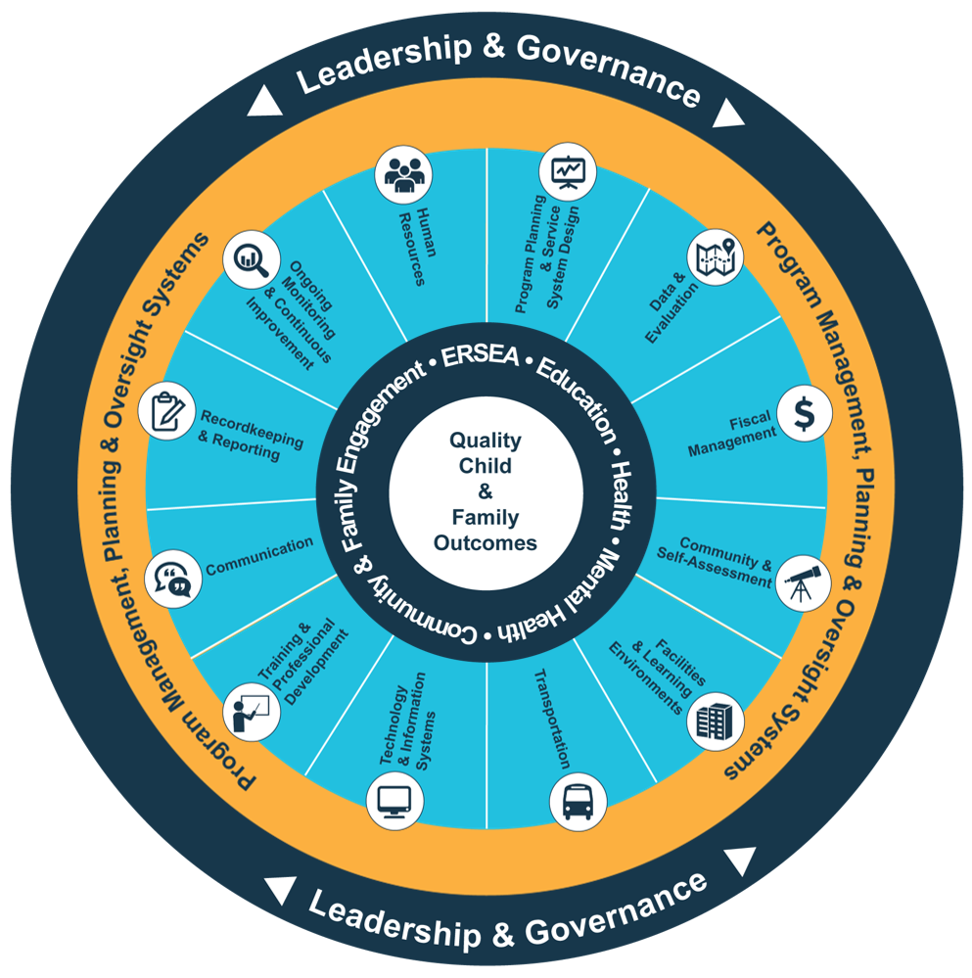
Head Start Management Systems Wheel
Five-Year
Project Period
Notes:
Slide 4
Facilitator Notes:
Deliver the following material as a mini-lecture.
Say to Participants: “The Head Start Management Systems Wheel can help us understand how HR fits into the overall picture.”
In your own words, explain the graphic on the slide by pointing to its various elements and describing each,
basing your descriptions on the bullet points below.
The dark blue outer circle includes the functions of leadership and governance. They are the bedrocks of effective management, encompassing and informing the 12 management systems.
The yellow circle outlines the scope of these systems.
The segmented aqua blue ring outlines each of the 12 management systems. These systems work together to inform and influence the program’s service delivery. These services include education, health, mental health, community partnerships, family engagement, and eligibility, recruitment, selection, enrollment, and attendance (ERSEA).
Say to Participants: “You see that one of the aqua blue wedges is labeled ‘Human Resources.’ That’s the management system we’re looking at in this module. In Head Start, all of these systems work together to inform and influence the program’s service delivery, which you see in the dark blue inner circle. When innovative leadership, strong management systems, and well-designed services are working together, we produce quality child and family outcomes.”

Slide 5
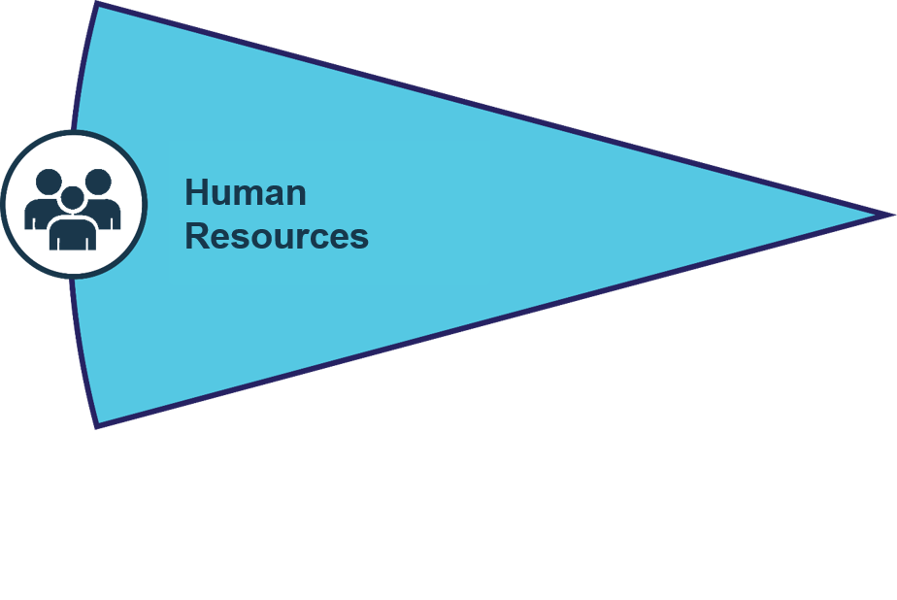
Human Resources System
Reminds us that a Head Start program is only as good as its people
Ensures staff and volunteers have the credentials and competencies needed to fulfill responsibilities
Personnel policies, 45 CFR §1302.90
Staff qualifications and competency requirements, 45 CFR §1302.91
Notes:
Slide 5
Facilitator Notes:
Review the slide with participants.
Say to Participants: “The HR system reminds us that any Head Start program is only as good as its people.
It ensures staff members and volunteers have the credentials and competencies they need to fulfill their responsibilities.”

Slide 6
HR Focus Areas
HR strategic planning
Talent acquisition
Employee engagement and retention
Learning and development
Culture, diversity, inclusion, and equity (CDIE)
Employee and labor relations
Organizational effectiveness and development
Notes:
Slide 6
Facilitator Notes:
Introduce the seven focus areas of HR covered in this module.
Say to Participants: “This module draws on research from The Society on Human Resource and Management (SHRM), a nonprofit that works to develop best practice standards for the HR field.¹
“SHRM organized its standards into 15 categories. In this module, we’re going to look at seven categories we consider particularly relevant to Head Start and Early Head Start programs. We’re going to call them ‘focus areas.’ Each has been adapted to the Head Start program environment.
“We’re going to talk about these focus areas one by one as we move through this session.”
¹Society for Human Resource Management. Introduction to the SHRM Body of Competency and Knowledge™. 2018. https://www.shrm.org/certification/recertification/Documents/18-1534%202019%20BoCK_WEB.pdf

Slide 7
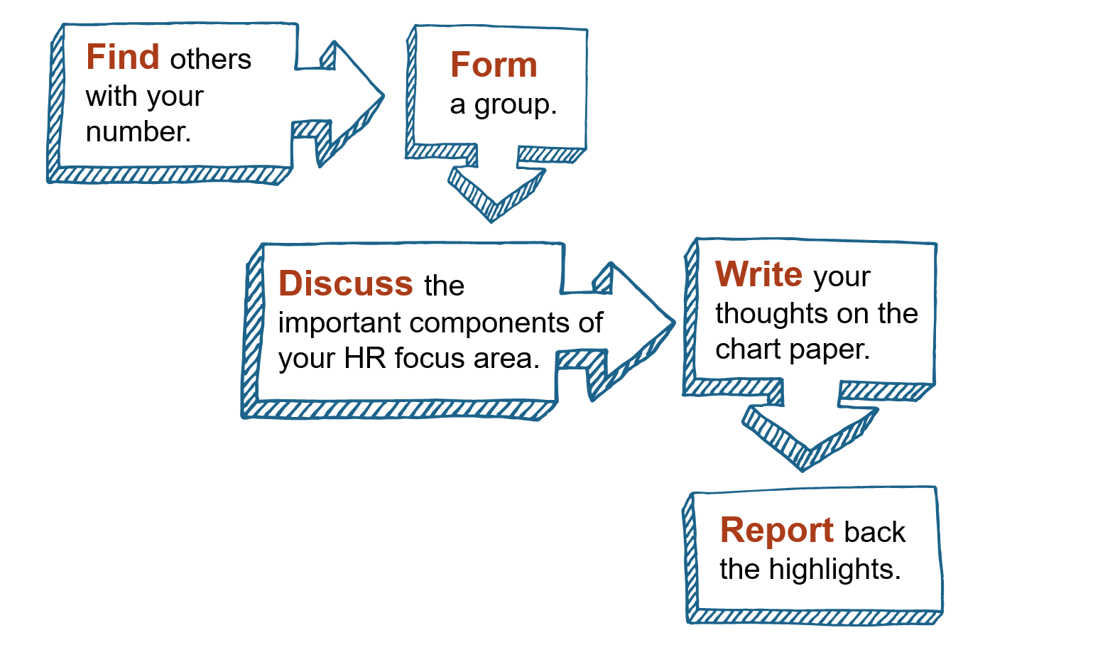
Activity: Finding Our Baseline
Notes:
Slide 7
Facilitator Notes:
Write one of the focus areas below on each of seven sheets of flipchart paper and post them around the room. As each participant walks in, hand them a small piece of paper marked with a number between one and seven.
Say to Participants: “As you entered the room, you received a number between one and seven. Each of the numbers corresponds to one of the focus areas.”
Read the list below, pointing out each accompanying flipchart sheet as you go.
HR strategic planning
Talent acquisition
Employee engagement and retention
Learning and development
Culture, diversity, inclusion, and equity
Employee and labor relations
Organizational effectiveness and development
Say to Participants: “Find others in the room with the same number. Then, gather together at the flipchart sheet that matches that number. You’re going to form a group.”
Allow a few minutes for participants to find their places.
Say to Participants: “Please discuss the key components of your focus area and write them on the flipchart paper. You may not be sure of them all, so make your best guess. You have 15 minutes.”
After 15 minutes, ask the participants to come back together. Ask each group to spend 45 seconds sharing the key components they identified.

Slide 8
HR Strategic Planning
The program's mission, vision, and values inform strategic management and planning
Project leadership, governance, and structures
The strategic planning process
(e.g., formulating objectives, setting goals, implementing ideas, and evaluating progress)
Strategic analysis tools, such as SWOT Analysis and scenario planning
Source: Society for Human Resource Management. Introduction to the SHRM Body of Competency and Knowledge™. 2018. https://www.shrm.org/certification/recertification/Documents/18-1534%202019%20BoCK_WEB.pdf
Notes:
Slide 8
Facilitator Notes:
Introduce the first focus area, which is HR strategic planning.
Say to Participants: “We’re going to start by talking about HR strategic planning. Strategic planning at the HR level involves developing skills and carrying out activities that will help the program achieve its goals.
HR staff must understand:
The program’s mission, vision, and values inform strategic management and planning
Project leadership, governance, and structures
The strategic planning process (e.g., formulating objectives, setting goals, implementing ideas, and evaluating progress)
Strategic analysis tools, such as SWOT (Strengths, Weaknesses, Opportunities, and Threats) analysis and scenario planning²
²Society for Human Resource Management. Introduction to the SHRM Body of Competency and Knowledge™. 2018. https://www.shrm.org/certification/recertification/Documents/18-1534%202019%20BoCK_WEB.pdf

Slide 9
HR Planning Inputs
How other child-serving organizations function and perform
Staff training and professional development needs
How program staff's skills are evolving over time
Compensation and turnover rates per position
Which activities may expose the
organization to legal risk
Number of work-related
illnesses and injuries
Policies promoting CDIE
Notes:
Slide 9
Facilitator Notes:
Continue mini-lecture on HR strategic planning.
Say to Participants: “HR staff in Head Start programs use systems thinking to understand how the management systems work together and which resources are needed to implement plans effectively. Systems thinking helps us recognize how different parts of a system are related, depend on one another, and interact.
“HR informs strategic decision-making by sharing data that might include:
How other child-serving organizations function and perform, which helps us understand our competitive advantage
Staff training and professional development needs
How our program staff’s skills are evolving over time
Compensation and turnover rates per position
Which activities may expose the organization to legal risk
Number of work-related illnesses and injuries
Policies promoting culture, diversity, inclusion, and equity

Slide 10
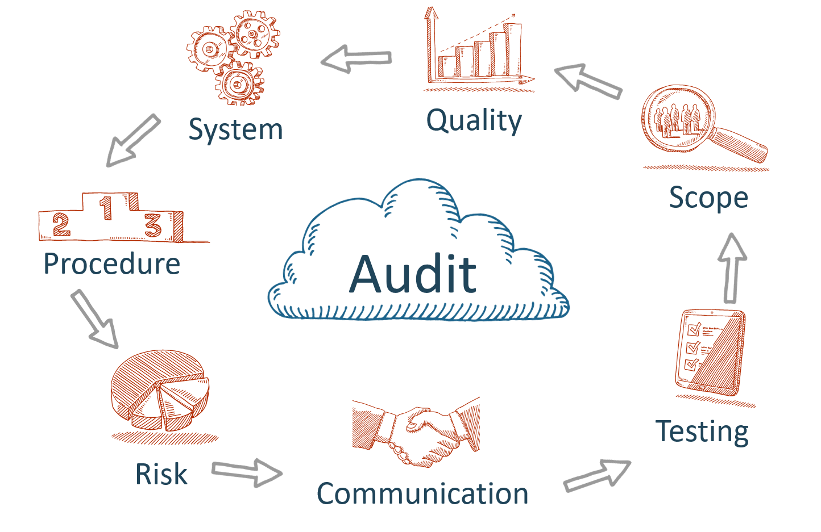
Human Resources System Audit
Notes:
Slide 10
Facilitator Notes:
Distribute the HR Systems Audit handout.
Say to Participants: “Head Start programs vary enormously in size and complexity. All need to continually monitor and improve their HR processes, however. An excellent way to do this is through an HR systems audit.
“An HR systems audit helps programs:
Examine workforce-related policies, procedures, and strategies
Understand which strategies are working well
Identify activities that could be done more efficiently or at reduced cost, perhaps by outsourcing
Protect the program from litigation³
“Take a look at the audit handout. It’s been created by your peers in Head Start programs across the country, so you should find it relevant to your own workplace.”
Ask participants at each table to spend 10 minutes reviewing the handout as a group. Then, they should discuss each of the following questions. You may wish to write them on flipchart paper for easy reference.
How can you use this resource in your program?
Which focus areas would you explore first?
Are there specific topics or actions within any of the focus areas that your program should be attending to right now?
Say to Participants: “Keep this handout available. As we move through each focus area of HR, look at the corresponding section and think about how you would rate your program. Be sure to take the handout back with you so you can fill it out as a team.”
³Society for Human Resource Management. Introduction to the SHRM Body of Competency
and Knowledge™. 2018. https://www.shrm.org/certification/recertification/Documents/18-1534%202019%20BoCK_WEB.pdf

Slide 11
Talent Acquisition
Create positive brand or employer identity
Clearly define positions
Use multiple paths for reaching
qualified applicants
Use appropriate tools for assessing competencies and fit
Have a well-defined process for making job offers
Establish and implement routine process for onboarding new hires
Track metrics
Adapted from Society for Human Resource Management.
Introduction to the SHRM Body of Competency and Knowledge™. 2018. https://www.shrm.org/certification/recertification/Documents/18-1534%202019%20BoCK_WEB.pdf
Notes:
Slide 11
Facilitator Notes:
Introduce the next focus area, which is talent acquisition.
Say to Participants: “We have talked about the importance of HR strategic planning and how HR is uniquely responsible for recruiting and training staff who can carry out the organizational strategic plan.
“The next topic we’re going to explore is talent acquisition.
Talent acquisition refers to two activities:
Attracting and recruiting skilled people to join the organization
Processes for selecting the best possible candidate for any given job opening
“In order to perform these two essential tasks, the HR system should:
Create and maintain a positive brand or identity as an employer
Clearly define each position, including the specific duties and hard and soft skills each job requires
Use multiple paths for reaching qualified applicants (e.g., ads, job fairs, social media, and partner outreach)
Use appropriate tools and methods to assess competencies and fit (e.g., interviews, checklists based on qualification standards in the HSPPS and Head Start Act, skills inventories, and referral checks)
Have a well-defined process for making job offers that includes procedures for conducting background checks
Establish and implement routine processes for onboarding
Track metrics, such as time spent recruiting, onboarding, and orienting new employees, and the resulting cost-per-hire”⁴
⁴Society for Human Resource Management. Introduction to the SHRM Body of Competency and Knowledge™. 2018. https://www.shrm.org/certification/recertification/Documents/18-1534%202019%20BoCK_WEB.pdf

Slide 12
Activity: The Perfect Hiring Formula
50%
of all hiring decisions are mistakes
- Peter Drucker.
https://www.wework.com/ideas/scale-growth/perfecting-the-hiring-formula/
Notes:
Slide 12
Facilitator Notes:
Continue with the talent acquisition section. Make sure each table has markers, half-sheets of paper, and masking tape. Alternatively, you can use large-size sticky notes. Prepare five sheets of flipchart paper with one of the following titles on each:
Sourcing
Interview process
Talent assessment
Offer and induction
Joining
Say to Participants: “Peter Drucker, known as the father of management theory, once said that 50% of all hiring decisions are mistakes. Do you agree or disagree?”
Solict reponses and facilitate a brief discussion.
Say to Participants: “Is there a perfect formula that can minimize hiring mistakes? Let’s do an activity. Imagine you are HR mad scientists. You need to hire a new manager for your Head Start program’s education staff. What is the perfect formula for hiring the best person? By ‘best,’ we mean someone with the right credentials who will be a good fit with your organizational culture. Your task is to work with your tablemates to identify the components of your perfect hiring formula. Think about each activity and write your thoughts about each one on its own half-sheet of paper. You will have 15 minutes.”
While the group is working, post the five sheets of flipchart paper, in order, on the wall with space between each sheet. After 15 minutes, bring the group back together.
Say to Participants: “Let’s find out what each group has included in its formula. Each of your ideas will go in one of the categories I’ve posted. Let’s take a look at them.”
Point out each flipchart sheet as you explain each category.
Say to Participants: “In any hiring process, you will have:
Sourcing, which means recruiting promising candidates
An interviewing process, which is screening applications to decide which ones best meet your needs
Talent assessment, which refers to assessing the skills of selected candidates
Offer and induction, which means offering the job and onboarding the new employee
Joining, which is about helping the new employee assimilate into the organization”
Call on one of the groups to approach the flipchart sheets. Ask someone to volunteer to read each activity aloud and place it in the category they think it belongs. If they have trouble deciding, invite other participants to help.
Say to Participants: “Now, everyone else come up and put each of your activities in the category you think it belongs. You have five minutes.”
After five minutes, read each posted activity aloud and position duplicates together. If any activity seems out of place, ask the group where they think it belongs and rearrange as you go.
Say to Participants: “This exercise tells us certain activities are common to the hiring process. Most groups have named a range of activities, most of which fit into our categories. Think about your program. Which of these categories does it excel in? In which could it improve? How could it improve?”
Say to Participants: “Now, let’s go back to our original question. Which group had the perfect hiring formula?”
Solicit a few responses.
Say to Participants: “By now, we know there is a basic framework to acquiring talent. We just created it. But a perfect formula doesn’t exist. If it did, no HR department would ever make a hiring mistake. The truth is, no matter how careful we are, to some extent we will always have to rely on hunch or intuition. The more experienced HR staff become, the better their intuition will become.”

Slide 13
Employee Engagement and Retention
How to develop and maintain a positive workforce culture
Factors that affect employees' attitudes toward work and how to improve job attitudes
Effective approaches to performance evaluation
How to measure HR's success at engaging and retaining employees
Adapted from Society for Human Resource Management.
Introduction to the SHRM Body of Competency and Knowledge™. 2018. https://www.shrm.org/certification/recertification/
Documents/18-1534%202019%20BoCK_WEB.pdf
Notes:
Slide 13
Facilitator Notes:
Introduce the next focus area, which is employee engagement and retention.
Say to Participants: “The next area we’re going to discuss is employee engagement and retention. Engagement and retention activities help employees feel excited about their work and connected to the organization. A primary goal of these activities is to retain high-performing staff over time.
“In order to meaningfully engage staff and retain high-performing employees, HR must:
Understand the factors that affect employees’ attitudes toward work
Prioritize staff performance and development
Develop opportunities to deepen staff’s relationship with the organization
Measure employee performance, engagement, and retention”⁵
⁵Society for Human Resource Management. Introduction to the SHRM Body of Competency and Knowledge™. 2018. https://www.shrm.org/certification/recertification/Documents/18-1534%202019%20BoCK_WEB.pdf

Slide 14
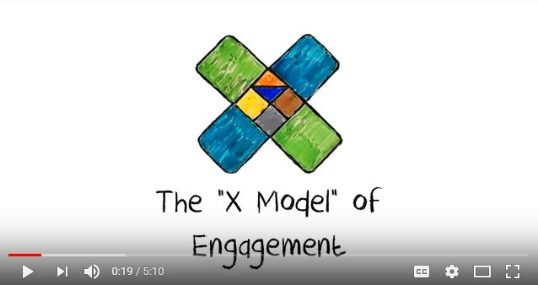
The X Model of Engagement
Source: BlessingWhite, The 'X' Model of Engagement, Short Version (Jan. 27, 2012), https://www.youtube.com/watch?v=66vXiCFbKBI
Notes:
Slide 14
Facilitator Notes:
Continue this section on employee engagement and retention. You will require internet access to watch a five-minute video, The X Model of Engagement: https://www.youtube.com/watch?v=66vXiCFbKBI
Say to Participants: “Employee engagement can be a fuzzy concept. We’re going to watch a short video to help us understand the different levels of employee engagement in organizations.⁶ The video was created by BlessingWhite, a leadership consulting firm. As you watch it, think about three key messages you could share with your programs. Jot down notes as you watch.”
Play the video. After it concludes, ask participants if it seemed to describe people in organizations in which they have worked. Then, ask volunteers to share some of the messages from the video they want to take back to their programs. Make sure the following points are covered:
Maximum employee engagement occurs when staff are contributing at high levels to the organization’s mission, and at the same time feel personally fulfilled by their work.
Staff people who are reasonably high-performing but not entirely satisfied with their jobs—the “almost-engaged” employees—are easy to overlook, but organizations should work hard to retain them.
Employees share responsibility for how engaged they feel at work.
Scattershot team-building exercises and periodic staff satisfaction surveys aren’t enough. Organizations need to work hard to create and continually nurture a positive culture.
⁶BlessingWhite. The ‘X’ Model of Engagement, Short Version. Jan. 27, 2012. https://www.youtube.com/watch?v=66vXiCFbKBI

Slide 15
Learning and Development
Group facilitation and knowledge-sharing techniques
Adult learning theory
How to measure changes
in knowledge, skills, and abilities
How to measure current and newly acquired knowledge
How leaders and managers can support learning and development
Notes:
Slide 15
Facilitator Notes:
Introduce the next focus area, which is learning and development.
Say to Participants: “We have just learned that professional satisfication is a key factor in employee engagement and retention. If your staff is happy in their jobs and performing them well, they’ll want to stay and you’ll want to keep them. Research has repeatedly shown that staff who receive job training and support tend to be the most satisified.⁷ This is why staff learning and development is so important to programs’ ability to retain high-quality workers.
“Learning and development includes any activity that improves job-related knowledge, skills, abilities, or behavioral competencies. To create learning and development opportunities, HR staff must understand:
Group facilitation and knowledge-sharing techniques
Adult learning theory (e.g., which experiences, teaching strategies, and formats are most effective for adult learners)
How to measure current and newly acquired knowledge, skills, and abilities
How leaders and managers can support continuous learning”
⁷Steven Schmidt. “The Relationship Between Satisfaction with Workplace Training and Overall Job Satisfaction.” Human Resource Development Quarterly (2007), 481–498. https://doi.org/10.1002/hrdq.1216

Slide 16
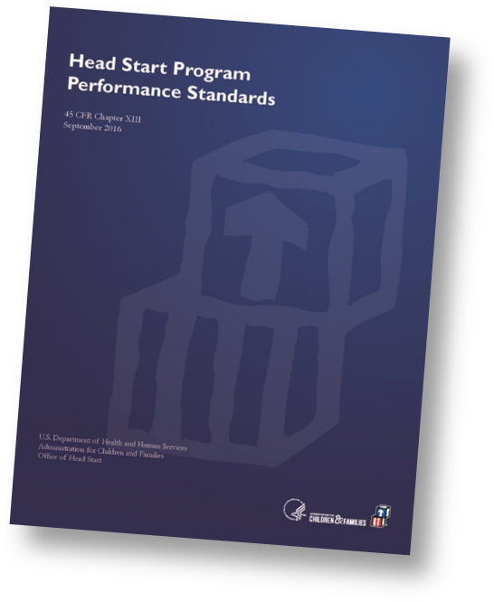
HSPPS and Head Start Act Requirements
    Orientation for new hires
    15 hours of professional development per year
    Training on how to handle child abuse and neglect cases
    Training for child and family services staff on best practices for implementing family engagement strategies and improving child and family outcomes
    Intensive, evidence-based coaching for education staff who need it
    Any additional training required to meet professional development needs of education staff
    A professional development plan for every full-time employee working directly with children
Professional development, HSPPS 45 CFR §1302.92
Head Start Act Sec. 648A
Notes:
Slide 16
Facilitator Notes:
Continue the section on learning and development.
Say to Participants: “According to the HSPPS, Head Start and Early Head Start programs must use a systematic approach to staff training and professional development.
“A systematic approach means identifying employees’ strengths and areas of challenge, and then working to increase their knowledge and skills over time using a variety of evidence-based techniques.
“HR staff developing learning opportunities for employees should take into consideration staff’s current capabilities; licensing and credentialing requirements; and individuals’ career development goals. They should also look at the program as a whole and direct development resources at areas that are struggling or underperforming.
“At a minimum, programs must provide:
Orientation for new hires
15 hours of professional development per year
Training on methods to handle suspected or known child abuse and neglect cases
Training for child and family services staff on best practices for implementing family engagement strategies and improving child and family outcomes
Intensive, evidence-based coaching for education staff who are identified through assessment to need it
Any additional training required to meet professional development needs of education staff
“Finally, Sec. 648A of the Head Start Act requires every full-time Head Start employee who works directly with children to have a professional development plan. Their progress through the plan must be monitored by the program.”

Slide 17

The 90% Solution
Source: Elaine Biech, “The 90% Solution,”
Training Development (December 2016),
Notes:
Slide 17
Facilitator Notes:
Distribute the 70-20-10 Checklist handout. Write the following two scenarios on flipchart paper where participants can see them.
Scenario A: As your program’s education manager, you were sent to a coaching training. Now, you need to transfer your new knowledge to your team.
Scenario B: You have just finalized a partnership with a local child care agency. Now, the two organizations need to learn about each other’s systems and daily work.
Say to Participants: “In the 1980s, the Center for Creative Leadership in North Carolina developed a framework called the 70-20-10 model. This model says that 70% of learning comes from hands-on experience; 20% from developmental interactions; and 10% from formal learning. This framework is now used widely throughout the business world. Its implications are profound, because according to the 70-20-10 model, a full 90% of learning occurs outside formal training settings.”⁸
Ask participants to work with their tablemates to complete the 70-20-10 Checklist handout based on one of the two scenarios you’ve posted. Remind them many of the activities they suggest should be outside the realm of formal training.
After 15 minutes, bring the group back together. Ask each table to describe some of the learning opportunities they designed.
Say to Participants: “Keep the concept of the 70-20-10 framework in mind when you are reviewing or planning professional development activities for staff.”
⁸Elaine Biech, “The 90% Solution,” Training Development (December 2016),

Slide 18
Culture, Diversity, Inclusion, and Equity
Culture is a complex whole that includes knowledge, beliefs, art,
morals, custom, and any other capabilities and habits acquired by a person as a member of society.
Diversity is the collective mixture of differences and similarities that include individual and organizational characteristics, values, beliefs, experiences, backgrounds, preferences, and behaviors.
Inclusion means all individuals or groups feel welcomed, respected, and have equal opportunity to contribute to the organization's success.
Equity means ensuring fair treatment of individuals; organizations dedicated to equity provide individual staff
with support tailored to their needs.
Notes:
Slide 18
Facilitator Notes:
Introduce the next topic, which is culture, diversity, inclusion, and equity.
Say to Participants: “The next area we’ll explore is culture, diversity, inclusion, and equity (CDIE). First, let’s define these terms as they relate to HR.
Culture is a complex whole that includes knowledge, beliefs, art, morals, custom, and any other capabilities
and habits acquired by a person as a member of society
Diversity is the collective mixture of differences and similarities that include individual and organizational characteristics, values, beliefs, experiences, backgrounds, preferences, and behaviors
Inclusion means all individuals or groups feel welcomed, respected, and have equal opportunity to contribute to the organization’s success
Equity means ensuring fair treatment of individuals; organizations dedicated to equity provide individual staff with support tailored to their need
“It’s clear from these definitions that addressing CDIE means considering all the ways employees differ, inside and out. A workplace is considered diverse when a wide range of groups or characteristics are represented. Promoting CDIE helps Head Start programs realize and leverage the unique strengths of all their employees.
HR can promote CDIE for staff by:
Hiring a diverse workforce
Acknowledging differences in positive ways
Offering relevant training (e.g., implicit bias training)
Applying a multicultural lens to policies and practices (e.g., new staff orientation and dispute resolution)

Slide 19
Activity: Facilitating Dialogues on CDIE
Notes:
Slide 19
Facilitator Notes:
Distribute the CDIE: Let’s Discuss and Guide to Facilitating Dialogues handouts.
Say to Participants: “Head Start and Early Head Start programs have long been expected to hire staff who reflect the cultural and linguistic diversity of their communities. Diversity among staff assists programs in meeting requirements in the HSPPS for ensuring:
Coordinated approaches to serving children who are dual-language learners
Inclusion of children with disabilities
Respectful, culturally responsive, and trusting relationships with families
“Yet, even programs with diverse staff may not understand how CDIE issues impact enrolled children and their families. In order to develop programming that promotes CDIE for all program participants, HR should encourage staff to:
Become conscious of personal biases and work to overcome them
Understand the child-rearing values held by each family
Structure some child experiences around materials contributed by parents
Reflect parents’ occupations and talents in the classroom, on home visits, in celebrations, and in other program activities
Avoid a ‘holiday-driven’ approach to curriculum
Develop activities in which groups of children can focus on ‘alikeness’ as well as difference⁹
If participants raise questions about the difference between equity and equality, explain that equality means treating everyone the same and equity means giving everyone what they need to be successful.
Direct participants’ attention to the Guide to Facilitating Dialogues.
Say to Participants: “The Guide to Facilitating Dialogues¹⁰ was developed as a free resource by the University of Missouri. Work with a partner and take 10 minutes to review its contents. Make note of which technique you feel most and least comfortable with. Think about what you would need to do to get better at the more challenging techniques.”
After 10 minutes, bring the group back together.
Say to Participants: “Now, we’re going to spend some time practicing strategies from the Guide to Facilitating Dialogues.”
Direct participants’ attention to the CDIE: Let’s Discuss handout. Ask volunteers to read each of the statements on the handout aloud and then introduce the next activity.
Say to Participants: “Please find two other people to form a triad. Take the two handouts—the Guide to Facilitating Dialogues and CDIE: Let’s Discuss—with you and find a place in the room to work. Select at least three different statements or questions from the handout and discuss them. One member of the triad should serve as facilitator, using strategies described in the dialogue handout. You have 20 minutes for this exercise.”
After 20 minutes, bring participants back together.
Say to Participants: “Reflect on the discussions you just had. Note where there was agreement and disagreement, and points where your triad needed more information. Think about whether there is a place in your program for this kind of conversation. What benefits could that conversation have? Take three minutes to discuss with your triad.”
After three minutes, solicit volunteers to share responses.
⁹U.S. Department of Health and Human Services, Administration of Children, Youth and Families, Office of Head Start. Planning for Linguistic and Cultural Diversity. n.d. https://eclkc.ohs.acf.hhs.gov/human-resources/article/planning-linguistic-cultural-diversity
¹⁰University of Missouri. Guide to Facilitating Dialogues. 2018. https://diversity.missouri.edu/wp-content/uploads/2018/07/facilitating-dialogue.pdf

Slide 20
Employee and Labor Relations
Employment rights and standards
Unfair labor practices
How to design and implement compliance and ethics programs
Approaches to grievance response, complaint resolution, and alternative dispute resolution
How to conduct disciplinary investigations and administer disciplinary actions
Adapted from Society for Human Resource Management. Introduction to the SHRM Body of Competency and Knowledge™. 2018. https://www.shrm.org/certification/recertification/Documents/18-1534%202019%20BoCK_WEB.pdf
Notes:
Slide 20
Facilitator Notes:
Introduce the next focus area, which is employee and labor relations.
Say to Participants: “The next focus area we’re going to discuss is employee and labor relations. This area refers to interactions between an organization and its employees about the terms and conditions of employment. HR’s role is to ensure fair treatment and protect management and staff’s rights while working to prevent and resolve problems.
“To effectively manage employee and labor relations, HR staff should understand:
Employment rights and standards
Unfair labor practices
How to design and implement compliance and ethics programs
Approaches to grievance response, complaint resolution, and alternative dispute resolution (e.g., mediation or arbitration)
How to conduct disciplinary investigations and administer disciplinary actions
¹¹Society for Human Resource Management. Introduction to the SHRM Body of Competency and Knowledge™. 2018. https://www.shrm.org/certification/recertification/Documents/18-1534%202019%20BoCK_WEB.pdf

Slide 21
Activity: Ethical Conversations and Scenarios
Notes:
Slide 21
Facilitator Notes:
Distribute the Ethics Conversation Starters and Addressing Ethical Issues handouts.
Say to Participants: “Program staff routinely face ethical challenges, and it is HR’s job to help them navigate these dilemmas in ways that promote the best interests of all parties. Many programs have a written code of ethics, and ethical guidelines should appear in programs’ standards of conduct, employee handbook, new staff orientation, and trainings.
“We probably all think we represent a program with a strong ethical culture. But what evidence do we have for this opinion? Take a look at the Ethical Conversation Starters handout.
“I’d like each of you to turn to a neighbor and fill out it out together. These are all yes-or-no questions, but think carefully about them before answering. If you’re from the same program, you can share the form. Take seven minutes for this exercise.”
After seven minutes, call the group back together.
Say to Participants: “Which of these questions do you think your program should be thinking about more closely?”
Solicit responses.
Say to Participants: “Now, let’s do one more exercise concerning ethics.”
Ask participants to break into four teams and assign each team a number between one and four.
Say to Participants: “Identify the scenario on the Addressing Ethical Issues handout that corresponds to your team number. Spend seven minutes discussing it and formulating actions you think the central characters should take.”
After seven minutes, call participants back together. Ask each team to summarize the ethical problem described in their scenario and share how they would resolve it.
Say to Participants: “Do your programs have policies or procedures that would provide guidance in your scenario? If so, what are they?”
Solicit responses and lead a brief discussion.

Slide 22
Resolving Grievances
Consult legal counsel (e.g., the legal representative on your governing
body or Tribal Council)
Attempt to resolve the problem
through discussion in line with organizational policies and procedures
Consider third-party arbitration if
the complaint remains unresolved
Don't forget about collective
bargaining agreements if the
grievance involves union members
Notes:
Slide 22
Facilitator Notes:
Continue this section on employee and labor relations by describing how HR should handle grievances.
Say to Participants: “Let’s move on to another one of HR’s jobs—dispute resolution.
“All workplaces want their employees to be happy. Complaints will sometimes arise, however. Depending on how serious they are, the HR department may need to help resolve them. When a complaint is formally filed, it becomes a grievance. To manage grievances, HR staff should follow their program’s written grievance procedure.
Typically, such procedures might suggest HR staff:
Try to resolve the problem through discussion
Consult the program’s legal counsel (e.g., the legal representative on the governing body or Tribal Council)
Consider third-party arbitration, if necessary
“Remember that in resolving grievances from employees or contractors who belong to unions, you will need to abide by whatever process was established in your collective bargaining agreement.”

Slide 23
Organizational Effectiveness and Development
Pros and cons of different organizational structures and approaches
Factors that influence organizational performance
Dynamics within and between groups
Succession planning
Source: Society for Human Resource Management. Introduction to the SHRM Body of Competency and Knowledge™. 2018. https://www.shrm.org/certification/recertification/Documents/18-1534%202019%20BoCK_WEB.pdf
Notes:
Slide 23
Facilitator Notes:
Introduce this section on organizational effectiveness and development.
Say to Participants: “Organizational effectiveness refers to the degree to which organizations meet their goals. Organizational development refers to the ongoing improvement of program procedures and structures to ensure goals can be attained. We can see how these concepts are related, with organizational development leading directly to organizational effectiveness.”
Make sure participants understand the distinction between organizational effectiveness and organizational development, leading a brief discussion if necessary.
Say to Participants: “The HR system engages in organizational development by measuring and analyzing employee performance and facilitating processes to improve it. We discussed how HR does this on an individual level in the section on learning and development.
“With regard to organizational effectiveness and development, HR looks beyond individual performance to how teams and service areas perform.
“To analyze the performance of groups, HR professionals must understand:
The pros and cons of different organizational structures and approaches
Factors that influence organizational performance
Dynamics within and between groups
Organizational culture
Succession planning”

Slide 24
Activity: Group Dynamics and Team-building
Trouble on the team?
Look for:
    Conflicts between team members
    Poor communication
    Inability to work collaboratively
    Resistance to change
    Tired or discouraged
Notes:
Slide 24
Facilitator Notes:
This activity requires one to two large balls of yarn, depending on your group size. Identify a space ahead of time that is large enough to bring the group together in a circle. Consider space outside the training room.
Say to Participants: “Let’s spend some time talking about group dynamics and organizational culture. Dynamics are about the interpersonal relationships that make up your team and set the tone for how it functions. Healthy relationships contribute to positive culture, and that’s why they are so important to HR.
“We’ve all heard of the concept of organizational culture. It can be hard to define. Does anybody want to try?”
Acknowledge contributions from participants, then continue.
“One way to define organizational culture is as the personality of the organization. That personality can be upbeat, hopeful, frustrated, or resigned. It can also change over time as factors inside and outside the program change.
“According to behavioral scientist Pragya Agarwal, organizational culture is determined by:
The values, belief systems, attitudes, and assumptions staff share
The personal histories of each employee
The larger social and cultural setting of the community
Leadership beliefs and practices¹²
“Agarwal and other researchers tell us that positive organizational culture improves teamwork, morale, productivity, and retention. Since positive culture is so important to program success, HR systems pay a lot of attention to it and work hard to improve it.
“All teams have their routine ups and downs. When do they actually need someone from HR to step in and help them improve the way they function?
“Managers and HR professionals should ask themselves these questions:
Are there conflicts between certain people that are creating divisions within the team?
Is poor communication affecting the team’s outcomes?
Do people need to learn to work collaboratively, instead of individually?
Is resistance to change among some team members affecting the team as a whole?
Is the group tired or discouraged? Could it use a morale boost?¹³
“Depending on the nature of the problem, HR professionals may decide on one or more interventions. They may facilitate conversations, deliver trainings on topics such as interpersonal communication, or conduct team-building exercises. Let’s do a team-building exercise to demonstrate what we mean.”
Guide the group to the space you identified earlier for the yarn toss activity and ask participants to form a circle. Hand a volunteer the ball of yarn and ask them to begin by stating their first name and one way they contribute to their program team. Then, ask them to hold the end of the yarn with one hand while tossing the ball to someone else in the circle. That person should then say their first name and how they contribute to their program team, then hold the yarn while tossing the ball to a third person. Toss the yarn from person to person until everyone has caught the ball of yarn once. Participants should hold the unfurling strand of yarn above the floor at all times. At this point, the yarn should begin to resemble a spider’s web.
Say to Participants: “We’ve created a web. Another word for web is ‘network’ or ‘team.’ We’re all connected to one another, and all depend on one another.”
Now, randomly select one person to pull their yarn tight.
Say to Participants: “What just happened?”
Responses might be that a single person’s actions, positive or negative, has a big effect on the team.
Now, ask everyone to pull their own yarn tight until the spider’s web is taut.
Say to Participants: “What’s happening now?”
Responses might be that when everyone is pulling in their own direction, the network becomes strained.
Now, holding a pair of scissors, walk around the outside of the circle. Randomly reach in and cut the yarn. Initially, the cut will affect only the two people who are holding each end of the segment.
Say to Participants: “Now what’s happening?”
Responses might be that there’s been an interruption in the relationship between the two people holding the ends of the segment. Ask participants what the implications of that severed relationship might be for the team’s overall functioning.
Continue walking around the outside of the circle. Reach in and cut the yarn three or four more times, each time stopping to ask which relationships have been hurt and how the team as a whole will be affected.
End the exercise and direct participants back to their tables.
Say to Participants: “What do you think this exercise says about our relationship to one another and how they affect our overall team?”
Make sure the following are mentioned:
We are all connected in an intertwined network of relationships
A single broken relationship can affect everyone on the team
The less connected we are, the weaker the team as a whole
Teams should work to identify and repair problems early, before
they damage the team’s overall performance
Organizations are only as effective as teams’ or individuals’ abilities to work together to accomplish program goals
¹²Pragya Agarwal. “How to Create a Positive Workplace Culture.” Forbes, April 29, 2018. https://www.forbes.com/sites/pragyaagarwaleurope/2018/08/29/how-to-create-a-positive-work-place-culture/#30e6ae5a4272
¹³Mind Tools. Team Building Exercises and Activities: Making Team Building an Everyday Priority. n.d. https://www.mindtools.com/pages/article/newTMM_52.htm

Slide 25
Key Messages
HR contributes to programs' capacity to meet their goals and helps drive continuous quality improvement.
HR plays a key role in informing organizational strategic planning.
Compliance with applicable labor laws and early childhood workforce regulations is a cornerstone of HR's work.
A program is only as good as its staff.
HR helps develop and maintain a healthy organizational culture.
Notes:
Slide 25
Facilitator Notes:
Review key messages with participants.
Say to Participants: “As we wrap up this session, let’s review key takeaways:
A program is only as good as its staff
HR plays a key role in informing organizational strategic planning
HR contributes to programs’ capacity to meet their goals and helps drive continuous quality improvement
Compliance with applicable labor laws and early childhood workforce regulations is a cornerstone of HR’s work
HR systems help develop and maintain a healthy organizational culture

Slide 26
Closing Reflections
What have
I learned?
What excites or concerns me about what I learned?
What will I do with what I've learned?
Adapted from Professional Development Guides for Implementing PFCE
Notes:
Slide 26
Facilitator Notes:
The final exercise is intended to help participants reflect on and reinforce what they have learned. Guide participants to the Reflective Practice Tool handout.
Say to Participants: “Now, let’s take some time to turn inward, to digest and reflect honestly on what we’ve learned and how we will use this information to benefit our Head Start work after we leave.”
Using the handout, direct participants to take a few minutes to reflect and write down their thoughts about the following questions:
What have you learned?
What excites or concerns you about what you have learned?
What will you do with what you’ve learned?
If time permits, allow volunteers to share their responses aloud and process the activity using the following questions:
What themes are emerging?
What insights do you need to remember?
How can you use these insights?
Ask Participants: “What themes did you hear? What insights do you need to remember? How can you apply these insights?”

Slide 27
Related ECLKC Resources
About Us
https://eclkc.ohs.acf.hhs.gov/about-us/article/office-head-start-ohs
Head Start Programs
https://eclkc.ohs.acf.hhs.gov/programs/article/head-start-programs
Head Start Act
https://eclkc.ohs.acf.hhs.gov/
policy/head-start-act
Notes:
Slide 27
Facilitator Notes:
Direct participants’ attention to the slide.
Say to Participants: “Here are several resources on the Early Childhood Learning and Knowledge Center website that can help you learn more about some of the topics we’ve discussed in this session. To learn more about HR, type ‘HR’ into the search bar.”

Slide 28






Contact PMFO
pmfo@ecetta.info
https://eclkc.ohs.acf.hhs.gov/ncpmfo
888-874-5469
Notes:
Slide 28
Facilitator Notes:
Review PMFO contact information.

