Slide 1


Head Start A to Z, 2.0
Program Planning and
Service System Design
Notes:
Slide 1
Facilitator Notes:
Welcome participants to the session and introduce yourself. If you have co-facilitators, invite them to introduce themselves, too. Begin the session with an introductory activity to create a positive group climate and begin the engagement process. In your own words, offer the following beliefs, ideas, and contextual information about Head Start A to Z, 2.0.
The National Center on Program Management and Fiscal Operations (PMFO) updated Head Start A to Z to align with the HSPPS that became effective Nov. 7, 2016. Head Start A to Z was originally designed to support new Head Start leaders in their roles. Anyone at the management level, or even the governing body/Tribal Council and Policy Council levels, can attend the sessions or use the materials for independent learning.
The updated learning modules, called Head Start A to Z, 2.0, provide baseline information through a leadership and management systems lens. It is modeled on "learning organization" concepts. In each of the modules, we recognize key characteristics of learning organizations, including a supportive learning environment, openness to new ideas, and time dedicated for reflection.
Say to Participants: "Each attendee has an important role to play in the success of this learning module. Those with experience remind us where we've come from and what we must do to maintain our identity and uniqueness. New members bring a fresh perspective and remind us what we must do to prepare for the future. All roles are essential for Head Start to be a learning organization that continues to grow and flourish.
"Head Start A to Z, 2.0, is most successful when it helps us share the best of what we have to offer with a strength-based focus. As you engage in this session, we hope that you will support one another in the learning process by generously sharing your knowledge, experience, and perspective."

Slide 2
Learning Objectives
In this module, participants will:
Identify references to program planning and service system design in the Head Start Program Performance Standards (HSPPS)
Understand the relationship between the Head Start Planning Cycle and Management Systems Wheel
Practice using strategic thinking to link program planning and service system design to decisions and implementation strategies for the five-year grant
Recognize the skills needed to lead a team through the program planning and service system design processes
Notes:
Slide 2
Facilitator Notes:
Distribute the Reflective Practice Tool handout. Review the following learning objectives with the group, reading from the slide or from the bulleted list below.
Say to Participants: "As a result of this training, you will be able to:
Identify references to program planning and service system design in HSPPS
Understand the relationship between the Head Start planning cycle and Management Systems Wheel
Practice using strategic thinking to link program planning and service system design to decisions and implementation strategies for the five-year grant
Recognize the skills needed to lead a team through the program planning and service system design processes"

Slide 3
Six Guiding Principles for Head Start A to Z, 2.0
1
3
4
Successful programs
are learning organizations.
Sound decision-making is informed by quality data.
Relationship-building is at the heart of transformational leadership.
2
The effective delivery of services grows out of strong systems.
5
6
School readiness
for all is our driving goal.
Culturally and linguistically diverse organizations rely on intentional, specific, and coordinated approaches.
Notes:
Slide 3
Facilitator Notes:
Distribute the Head Start A to Z Guiding Principles handout.
Say to Participants: "Head Start A to Z, 2.0, is based
on six guiding principles. These principles are foundational to the design of the modules, and have been aligned with the HSPPS.
"Head Start directors and managers come from all walks of life with a wealth of employment experiences. However, we all share a commitment to a comprehensive, high-quality early childhood experience. We also recognize that to promote school readiness and be responsive to the needs of our communities, we must engage in ongoing professional development. Head Start A to Z, 2.0, was created to support professional growth and development for Head Start leaders."
Guide the participants to the Head Start A to Z Guiding Principles handout. Review the six principles below. You may paraphrase or slightly summarize.
Successful programs are learning organizations. Head Start is a dynamic organization with high expectations, values, and traditions. Programs are constantly responding to changing community needs and evolving best practices. To cultivate a learning organization that thrives in this environment, program leaders must support all staff in becoming lifelong learners who embrace challenges as opportunities for collective problem-solving and innovation.
The effective delivery of services grows out of strong systems. Program leaders must regularly refine their program's management and fiscal systems. To target community needs and deliver comprehensive services, leaders need to understand systems thinking and view their program through a systems lens. They also must recognize the relationship between systems, services, and child and family outcomes.
Sound decision-making is driven by quality data. Used in planning, evaluating, and communicating information, quality data is integral to cultivating a culture of continuous quality improvement. To this end, it is critical for leaders to establish efficient processes for collecting, aggregating, analyzing, and synthesizing data. This will involve training teachers, home visitors, family advocates, health services workers, and other staff on how to integrate data management into their day-to-day work.
Relationship-building is at the heart of transformational leadership. Robust Head Start communities build on authentic relationships among all of their stakeholders, from children and families to staff, managers, governing bodies/Tribal Councils, and Policy Councils. To cultivate these communities, leaders need to communicate effectively, empower others, foster team building, and nurture collaboration.
School readiness for all is our driving goal. Head Start leaders play an integral role in conceiving and promoting an inclusive vision of school readiness. To support children with diverse abilities and backgrounds to develop the skills, knowledge, and attitudes needed to be successful in school, effective leaders need to stay informed on developments in early childhood education. They also must actively collaborate with parents, staff, governing bodies, local education agencies, and community partners in embedding these best practices into services and programming.
Culturally and linguistically diverse organizations rely on intentional, specific, and coordinated approaches. To ensure the full and effective participation of dual language learners and their families, Head Start leaders must coordinate program-wide plans that involve all service areas and multiple staff. This includes staying connected to the communities served, implementing targeted strategies, and articulating how programs and services address specific linguistic and cultural needs.
Say to Participants: "You will continually revisit these guiding principles in all of the trainings offered by PMFO."

Slide 4

Head Start Program Performance Standards
HSPPS References to Types of Planning In Which Programs Must Engage
45 CFR §1302.101(b)
"At the beginning of each
program year, and on an
ongoing basis throughout the
year, a program must design
and implement program-wide coordinated approaches."
Notes:
Slide 4
Facilitator Notes:
Distribute the HSPPS: Summary of Regulatory Requirements handout.
Say to Participants: "The concepts of program planning and service system design are embedded in the HSPPS. Take a look at the Summary of Regulatory Requirements handout. You'll see it lists references to specific types of planning that all grantees must do. Let's take a few minutes to review that.”
Briefly highlight references to plans and planning that appear on the slide:
Calendar planning
Community-wide strategic planning
Data use planning
Disaster preparedness plan
Emergency preparedness and response planning
Lesson plans
Plans related to the purchase, construction, or renovation of facilities
Quality improvement plan
Suspension and expulsion response plan
Transition services planning
Use the mouse to activate animation. Language about Management system, 45 CFR §1302.101(b) will appear. Review that language with participants.
Say to Participants: "The Head Start Program Performance Standards require organization-wide coordinated approaches. As a leader, you will need to reinforce the message that everyone plays a critical role in helping the program achieve its goals. An inclusive planning process will result in strong services to children and families."

Slide 5
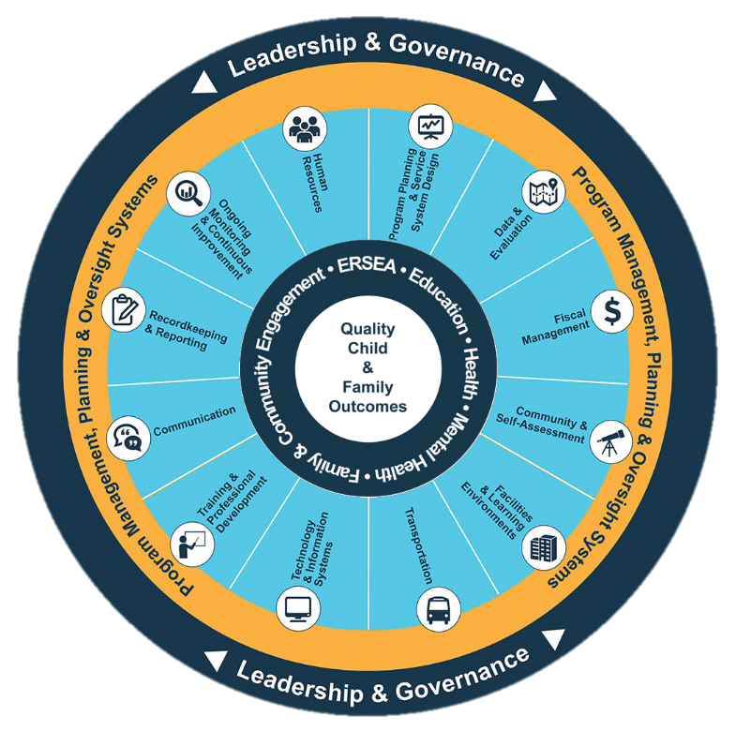
Head Start Management Systems Wheel
Community assessment review and update
Goal and objective development and review
Coordinated approaches
Action planning
Ongoing monitoring
Self-assessment
Notes:
Slide 5
Facilitator Notes:
Deliver the following material as a mini-lecture.
Say to Participants: "The Head Start Management Systems Wheel can help us understand how program planning and service system design fit into the overall picture."
In your own words, explain the graphic on the slide by pointing to its various elements and describing each, basing your descriptions on the bullet points below.
The dark blue outer circle includes the functions of leadership and governance. They are the bedrocks of effective management, encompassing and informing the 12 management systems.
The yellow circle outlines the scope of these systems.
The segmented aqua blue ring outlines each of the 12 management systems. These systems work together to inform and influence the program's service delivery. These services include education, health, mental health, community partnerships, family engagement, and eligibility, recruitment, selection, enrollment, and attendance (ERSEA).
Say to Participants: "You see that one of the aqua blue wedges is labeled 'Program Planning and Service System Design.' Notice the activities that come under program planning and service system design are things that every program does, including:
Community assessment review and update
Goal and objective development and review
Coordinated approaches
Action planning
Ongoing monitoring
Self-assessment
These are all part of the Head Start planning cycle. We'll talk about the planning cycle in more detail shortly."

Slide 6
Definitions
Program Planning
  A strategic and systematic process used to envision a desired future, identify program goals with measurable objectives, and develop an action plan with a series of action steps.
  Service System Design
  Emerges from program planning to organize and activate people by creating an infrastructure to support high-quality programs for children and families.
Notes:
Slide 6
Facilitator Notes:
Direct participants' attention to the slide and give a mini-lecture on these two foundational definitions.
Say to Participants: "Together, the HSPPS and the Head Start Management Systems Wheel provide some of the context that influences program planning and service system design. But what do the terms 'program planning' and 'service system design' really mean? Let's look at their definitions."
Point out the slide again.
Say to Participants: "Program planning is a strategic and systematic process that helps us envision a desired future. It is used to identify program goals with measurable objectives and an action plan with a series of action steps. Program planning begins with either a community or self-assessment. Existing programs begin at the self-assessment and combine their community assessment data with the findings of their self-assessment. New programs that have not delivered services begin with the community assessment.
"Service system design comes from program planning. It focuses on organizing and activating our staff, our infrastructure, and the Head Start systems in order to provide quality services.
"Note that program planning and service system design are not two separate processes. They are complementary and interrelated. We'll be seeing just how connected they are as we work through the upcoming exercises.”
After reviewing the definitions with participants, prompt them to share what they understand these definitions to mean.

Slide 7
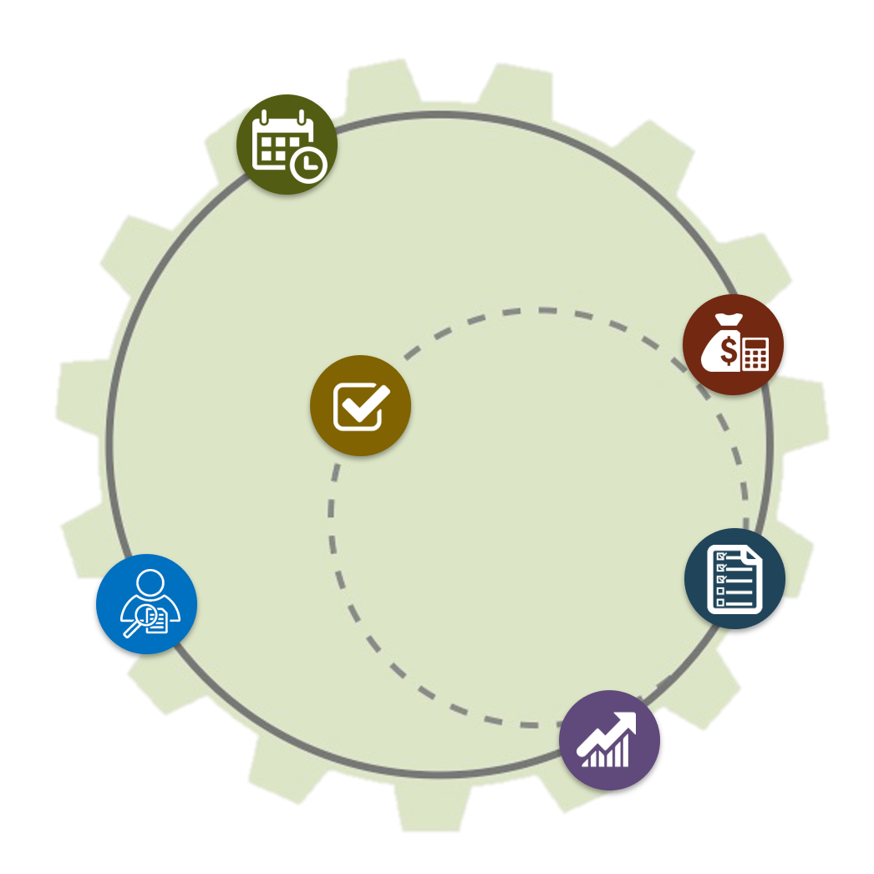
Phases of the Program Planning Cycle
Service Delivery Design
Operationalization
Compliance
Self-Assessment
Notes:
Slide 7
Facilitator Notes:
Distribute the Program Planning Cycle handout. Deliver the material on this slide as a mini-lecture.
Say to Participants: "Program planning and service system design are the engines that guide each Head Start program's five-year planning cycle.
"Let's do a quick review of all four phases here; then we'll look more closely at
each one.
"As you can see on the slide, Phase 1 is Service Delivery Design. During this phase, grantees conduct or update their community assessment. The findings are used to establish long-term goals and measurable objectives. Those goals and objectives are truly long-term; they are meant to span the entire five years of the program.
"Phase 2 is Operationalization. In this phase, grantees create an action plan and budget. It outlines the steps they will take to accomplish their long-term goals and objectives. Once complete, grantees implement their action plan and start collecting the data that ensures they are complying with the HSPPS and making progress toward their goals and objectives.
"Phase 3 is Compliance. Grantees monitor their performance and make corrections as needed to ensure compliance during this phase. Their monitoring procedures will include:
Collecting and using data
Working with the governing body/Tribal Council and Policy Council to address issues as they come up
Making corrections as quickly as possible
Implementing procedures to prevent reoccurring problems
"Phase 4 is Self-assessment. Grantees conduct an annual self-assessment to evaluate the progress they have made toward meeting their long-term goals and objectives. In this final phase, they also evaluate their compliance with the HSPPS throughout the year and how effective their professional development and family engagement systems have been in promoting school readiness."

Slide 8
Phase 1: Service Delivery Design
Conduct or update community assessment
Every five years: Establish long-term goals and measurable objectives
Annually: Review goals and objectives
Notes:
Slide 8
Facilitator Notes:
Distribute the Key Concepts and Considerations and Program Planning and Service System Design Activity Worksheet handouts. These will be used for each of the next four exercises—one for each phase of the planning cycle. Direct participants' attention to the slide.
Say to Participants: "Let's look more closely at Phase 1: Service Delivery Design.
"This is the phase in which grantees are conducting or updating their community assessment and using its findings to establish long-term goals and measurable objectives.
"The community assessment is the collection and analysis of data related to the needs and characteristics of Head Start-eligible children and families in the grantee's service area. It identifies program and community resources available to meet their needs and specifies where there are gaps. The community assessment also identifies issues and trends in the service area having the greatest impact on families with young children.
"Community assessment data is used for designing and implementing comprehensive services that meet the needs of eligible children and families in a culturally competent manner. Programs are required to use it to make decisions about program options, the program schedule, types of services, center locations, recruitment areas, and recruitment and selection priorities.
"For baseline grant applications, the community assessment data is the basis for establishing strategic long-term goals with measurable objectives that are linked to expected outcomes. These identify what will be accomplished during the five-year grant period and include school readiness goals, which specifically focus on child development and early learning outcomes.
"Each year, during the planning process, these goals and objectives are reviewed and adjusted as needed based on findings from the community assessment, the annual self-assessment, and related child, family, and community data. Because planning is a cyclical process that relies upon locally collected data, the planning process will result in each grantee having a unique service design.

Slide 9
Phase 1: Key Concepts & Considerations
The community assessment must be done every five years and reviewed annually. It is used to establish long-term strategic goals and measurable objectives.
There are five steps to community assessment:
  1. Plan and organize
  2. Design the work
  3. Gather data
  4. Analyze data and make decisions
5. Communicate and incorporate
Notes:
Slide 9
Facilitator Notes:
Direct participants' attention to the slide, and review the information on it.
Say to Participants: "The community assessment must be done every five years, and be reviewed and updated annually.
"Let's look at what goes into a community assessment. Five key steps are involved.
"The first step is to plan and organize. You'll need to answer questions like:
Who will do the assessment?
What information and resources are needed?
When will it happen?
How will the plan be communicated?
"Then, you have to design the work. Before you start this step, you'll need to understand the HSPPS requirements for the community assessment. Think about what internal and external data is needed. How will you gather this information and how will it be used?
"As a third step, you need to gather data. Consider what methods and tools you will use to collect data. What cultural issues do you need to address?
"After you've collected the data, you'll need to analyze it and make decisions based on that analysis. Ask yourself:
What does the data identify as trends, strengths, and needs in the community?
What decisions need to be made based on the trends, strengths, and needs you've found?
What long-term strategic goals has the data helped you identify?
What measurable objectives will you use to document the progress you are making toward your goals?"
"We won't cover the development of goals and objectives in this module. However, you can find extensive details in Foundations for Excellence: A Guide for Five-Year Planning and Continuous Improvement, 2nd Edition, on the Early Childhood Learning and Knowledge Center website, or ECLKC. I have that URL if anyone would like it: https://eclkc.ohs.acf.hhs.gov/program-planning/article/foundations-excellence-guide-five-year-planning-continuous-improvement-2nd
"Finally, in the last step, you need to communicate the plan to your stakeholders and incorporate it into your ongoing strategic planning. So ask yourself:
What will you put in the community assessment report?
With whom will the report be shared?
How will you assure the report is reviewed annually and
updated as needed?
How will the community assessment be incorporated into ongoing program and strategic planning?”
As you finish reviewing the slide, point out that the community assessment is used to establish long-term strategic goals and measurable objectives.
Say to Participants: "Now, we're going to do an activity for this first phase of the planning cycle. Let's look at the Activity Worksheet handout.”
Review the handout briefly. Point out that the column on the left includes questions to guide participants as they work through the five steps you just discussed to conduct a community assessment.
Say to Participants: "Turn to your neighbor and, for the next 15 minutes, work together to fill in the column for Phase 1. We will take time for questions and discussion after we've worked through all four phases of this activity, so make a note if something comes up.”
If the pairs working on the handout are from the same program, they can fill out just one handout. If they are from different programs, they should discuss the questions together but fill out separate handouts. Let participants know they will probably not complete the entire first column during the exercise, but can finish when they are back in their programs.

Slide 10
Phase 2: Operationalization
Conduct or update community assessment
Every five years: Establish long-term goals and measurable objectives
Annually: Review goals and objectives
Create an action
plan and budget
that reflect goals
Implement an action plan
Notes:
Slide 10
Facilitator Notes:
Deliver the material on this slide in the form of a mini-lecture.
Say to Participants: "Now let's look more closely at Phase 2: Operationalization.
"As you may recall, during this phase, grantees create an action plan and budget outlining what steps they will take to accomplish the long-term goals and measurable objectives they developed from their community assessment. Once they have an action plan and budget, they begin implementing the action plan and collecting data to ensure compliance and demonstrate they are making progress toward their goals and objectives.
"Remember that the action plan is a set of steps the program will take to accomplish the goals and objectives established at the end of Phase 1 of the planning cycle. Annual action plans break down the goals and objectives from the five-year plan. They are broken down into a series of steps to be carried out over a one-year period by assigned individuals in specific locations. You can think of action plans as road maps.
"Action plans vary, but generally they describe:
What steps will you take to achieve your goals and objectives?
Who is responsible?
When do you expect the steps to be completed?
"When developing the action plan, you will also want to consider what financial resources you will need. Each action plan must be supported by a budget that is aligned with the goals and objectives. It's important to make sure that financial supports are in place so that the program has the personnel, equipment, materials, and training and technical assistance (T/TA) it needs to carry out its plan and achieve its goals and objectives.
"Also, consider how you will measure progress. You will need to determine which data will be collected and how it will be recorded, reported, and used to inform decisions."
Let the participants know that, as they implement the action plan, they should think of it as a living document that is reviewed and updated as part of their program's ongoing monitoring process.
Say to Participants: "Reviewing your action plan regularly offers opportunities to identify bright spots, celebrate small and large accomplishments along the way, and consider how your successes can inform your efforts in other areas of your program."

Slide 11
Phase 2: Key Concepts & Considerations
Action plans are the road maps a program uses to accomplish goals and achieve objectives. They focus on what will happen in a one-year period.
Action plans operationalize the "why" of a program goal and identify:
What
Who
When
Costs
Measurement
Action plans should follow the "Plan, do, review, and revise as necessary" process.
Notes:
Slide 11
Facilitator Notes:
Again, review the slide with participants and then direct them to the Key Concepts and Considerations Program Planning and Service System Design Activity Worksheet handouts. This time, they will be filling out the column for Phase 2.
Say to Participants: "Let's take a look at some key concepts and considerations related to creating and implementing an action plan in Head Start.
"Action plans focus on what will happen in a one-year period, and should be reviewed and updated regularly. They identify:
What steps will be taken
Who is responsible
When steps will be completed
Which financial resources are needed
How progress will be measured
"Now we're going to repeat the same activity we did before, this time for the second phase of the planning cycle. Let's look at the Activity Worksheet handout. Turn to your neighbor and, for the next 15 minutes, work together to fill in the column for Phase 2."
As for the earlier exercise, if the pairs are from the same program, they can fill out just one handout. If they are from different programs, they should discuss the questions together but fill out separate handouts. Remind participants that they will probably not complete the entire second column during the exercise, but can finish when they are back in their programs. Tell the group that there will be time for questions and discussion after they have worked through all four phases of the planning cycle.

Slide 12
Phase 3: Compliance
Conduct or update community assessment
Every five years: Establish long-term goals and measurable objectives
Annually: Review goals and objectives
Create an action
plan and budget
that reflect goals
Respond regularly with course corrections
Implement an action plan
Analyze progress and compliance through ongoing monitoring
Notes:
Slide 12
Facilitator Notes:
Deliver the material on this slide in the form of a mini-lecture.
Say to Participants: "It's now time to look more closely at Phase 3: Compliance.
"In this phase, grantees are ensuring effective ongoing oversight and correction to confirm compliance with the HSPPS. To ensure effective implementation of the Performance Standards, grantees will develop ongoing monitoring procedures that include:
Collecting and using data
Working with the governing body/Tribal Council and Policy Council to address issues
Making corrections as quickly as possible
Implementing procedures to prevent reoccurring problems
"As we've said, it is important to note that monitoring is an ongoing process. If you use data gathered through ongoing monitoring, you'll be able to track progress toward goals and objectives. You'll also be able to ensure compliance and inform continuous improvement.
"During the monitoring process, you will:
Review goals and data for trends
Analyze data across services
Draw conclusions
Identify course corrections
Share your findings
"Based on the analysis of the data, you can continue to implement your action plan as originally written, or you can adjust it. If there is a need to course-correct, remember to plan for a follow-up so you can assess the impact of any changes."

Slide 13
Phase 3: Key Concepts & Considerations
Monitoring is an ongoing process.
It requires the collection and analysis
of data.
Monitoring is most effective and useful when:
Programs collect and analyze data to answer critical questions
Data turnaround is fast
Information is presented on an ongoing basis and responded to
in real time, ensuring course correction as needed
The monitoring process must involve governing body/Tribal Council members, Policy Council representatives, and other
key stakeholders.
Notes:
Slide 13
Facilitator Notes:
Review the slide with participants and, again, direct their attention again to the Key Concepts and Considerations and Program Planning and Service System Design Activity Worksheet handouts. This time, they will be filling out the column for Phase 3.
Say to Participants: "There are a number of key concepts and considerations related to ensuring compliance. Remember, ongoing monitoring:
Is a systemic process
Requires aggregating, analyzing, and comparing data
Is most effective and useful when:
It answers critical questions
Data can be turned around quickly
The information is presented and responded to in real time
"Governing body or Tribal Council members, Policy Council representatives, and other key stakeholders must be involved in the ongoing monitoring process.
"Now we're going to do an activity for the third phase of the planning cycle. Let's return to the Activity Worksheet handout. Turn to your neighbor and, for the next 15 minutes, work together to fill in the column for Phase 3."
As for the earlier exercise, if the pairs are from the same program, they can fill out just one handout. If they are from different programs, they should discuss the questions together but fill out separate handouts. Let participants know that will probably not complete the entire column during the exercise, but can finish when they are back in their programs.

Slide 14
Phase 4: Self-Assessment
Conduct or update community assessment
Every five years: Establish long-term goals and measurable objectives
Annually: Review goals and objectives
Create an action
plan and budget
that reflect goals
Respond regularly with course corrections
Evaluate progress through the annual
self-assessment
Implement an action plan
Analyze progress and compliance through ongoing monitoring
Notes:
Slide 14
Facilitator Notes:
Deliver the material on this slide in the form of a mini-lecture.
Say to Participants: "Now we're going to look more closely at Phase 4 of the planning cycle, which is Self-assessment.
"As we said earlier, during this phase, grantees conduct an annual self-assessment to evaluate their progress toward meeting their long-term goals and measurable objectives. They also assess their compliance with the HSPPS throughout the year and the effectiveness of their professional development and family engagement systems in promoting school readiness.
"Through the self-assessment process, you will:
Measure progress toward goals
Evaluate impact
Assess compliance
Identify strengths and areas for improvement
Develop and share recommendations with all stakeholders
"This will help you identify systemic issues related to the 'big picture' of how your program operates, and see if they have program-wide implications. Opportunities for innovations and cutting-edge practices that will benefit your program may also be revealed.
"Much of the data you will need will have already been gathered during the year. This data can be found in:
Ongoing monitoring reports
Your community assessment
Child assessment data
Family engagement data
Professional development data
"To ensure the data from the self-assessment considers information across all services and includes perspectives from all stakeholders, Head Start leaders should involve program staff, parents, Policy Council members, governing body or Tribal Council members, community leaders, content experts, and other interested people. Some programs will establish a self-assessment team in order to engage stakeholders.
"The Performance Standards related to program planning require programs, at the beginning of each program year and throughout the year, to 'design and implement coordinated approaches.' The self-assessment phase of the planning process helps to ensure the effective use of data to support coordinated approaches."

Slide 15
Phase 4: Key Concepts & Considerations
Self-assessment occurs once annually, usually near the end of the year. It looks at systems and focuses on the questions "Are we doing things right?" and "Are we doing the right things?"
There are five phases to the self-assessment process:
  Design the process
  Engage the team
  Analyze and dialogue
  Recommend
  Prepare report
During self-assessment, ongoing monitoring results and multi-year data
are reviewed to inform decisions.
Notes:
Slide 15
Facilitator Notes:
First, review the slide with participants. Then, direct their attention to the Key Concepts and Considerations and Program Planning and Service System Design Activity Worksheet handouts. This time, they will be filling out the column for Phase 4.
Say to Participants: "Let's review key concepts and considerations related to the annual self-assessment.
The self-assessment is completed once per year, usually near the end of
the year.
It focuses on:
Are we doing things right?
Are we doing the right things?
The five phases of evaluation are:
The design process
Engaging the team
Analyzing and discussing data
Making recommendations
Preparing the report
During self-assessment, you review multi-year data, not just data from the preceding year."
"Now we're going wrap up our planning cycle exercise by filling in the fourth column of your worksheet. Again, turn back to your neighbor and, for the next 15 minutes, work together to fill in the column for Phase 4.”
As for the earlier exercise, if the pairs are from the same program, they can fill out just one handout. If they are from different programs, they should discuss the questions together but fill out separate handouts. Remind participants they will probably not complete the entire column, but can finish when they are back in their programs.

Slide 16
Practical Applications: Examples
Program Planning is a strategic and systematic process used to envision a desired future, identify program goals with measurable objectives, and develop an action plan with a series of action steps.
Service System Design is what emerges from program
planning to organize and activate people by creating
an infrastructure to support high-quality programs for
children and families.
Phase 1: The community assessment shows there is increased access to public school pre-K services.
Consider conversion of slots
to Early Head Start.
Phase 2: The budget no longer supports the cost of rent for a program located in the downtown area.
The program is relocated to a convenient
but less costly location.
Phase 3: A review of program absence data reveals that children are not in attendance because the program is too far from the parents’ workplace.
An additional bus route is established.
Phase 4: The self-assessment identifies a need for increased cultural sensitivity.
In-service training includes a quarterly forum
that specifically addresses issues related to the cultural norms of families in the program.
Notes:
Slide 16
Facilitator Notes:
Call participants' attention to the slide.
Say to Participants: "Looking again at the definitions of program planning and service system design, you will recall that program planning is a strategic and systematic process that begins with either a community assessment or self-assessment and that service system design is what emerges from this process.
"Planning is fluid and continuous. It is used to identify program goals with measurable objectives, as well as to identify an action plan with a series of action steps. Service system design is how the program will establish its infrastructure to meet identified goals and objectives, implement the action plan, and ultimately provide high-quality services for children and families.
"Let's spend a little time looking at examples of practical applications of how program planning and service system design work together."
On the slide, review the planning scenarios described in Phases 1 through 4, proceeding one row at a time. After each scenario, discuss the implications of that scenario for service system design.
Say to Participants: "It is important to note that while these examples are identified by individual phases of the program planning process, decisions related to service system design need to consider information gained more broadly from the entire program planning cycle.
"We've seen that the examples on this slide are related to ages of children served, program location, transportation, and professional development. What other aspects of your program are part of its service system design?"
Reflect on participant responses and use these examples to fill in the gaps if they miss some:
Service calendar
Staffing
Number of classrooms
Language services
Curriculum
Health services
Governing body/Tribal Council membership
Activities for families
Time and type of food services

Slide 17
Questions and Discussion
Conduct or update community assessment
Every five years: Establish long-term goals and measurable objectives
Annually: Review goals and objectives
Create an action
plan and budget
that reflect goals
Respond regularly with course corrections
Evaluate progress through the annual
self-assessment
Implement an action plan
Analyze progress and compliance through ongoing monitoring
Notes:
Slide 17
Facilitator Notes:
In this segment, facilitate a discussion of the preceding material, using questions in the bulleted list below.
Say to Participants: "We've covered a lot of ground on program planning and service system design. Before we end, let's open things up for discussion.”
Stimulate conversation by soliciting answers to these three questions:
As you filled out the worksheet, what did you find you needed in order to create an infrastructure that could organize and activate people?
Did any questions come up for you as you filled in the columns?
How would you describe program planning and service system design to others?

Slide 18
Closing Reflections
What have
I learned?
What excites or concerns me about what I've learned?
What will I do with what I've learned?
*Adapted from: Professional Development Guides for Implementing PFCE
Notes:
Slide 18
Facilitator Notes:
Guide participants to the Reflective Practice Tool handout.
As a closing activity, explain that it is time for everyone to turn inward and think about what they have learned and what they will do with this information.
Direct participants to take a few minutes to reflect and write down their thoughts about the following questions on the handout:
What have you learned?
What excites or concerns you about what you have learned?
What will you do with what you've learned?
If time permits, allow volunteers to share their responses aloud and process the activity using the following questions:
What themes are emerging?
What insights do you need to remember?
How can you use these insights?

Slide 19
Related ECLKC Resources
About the Office of Head Start
https://eclkc.ohs.acf.hhs.gov/about-us/article/office-head-start-ohs
Head Start Programs
https://eclkc.ohs.acf.hhs.gov/programs/article/head-start-programs
HSPPS https://eclkc.ohs.acf.hhs.gov/
policy/45-cfr-chap-xiii
Notes:
Slide 19
Facilitator Notes:
Direct participants' attention to the slide.
Say to Participants: "Here are several resources on the ECLKC that can help you learn more about some of the topics we've discussed in this module."

Slide 20



Contact PMFO
pmfo@ecetta.info
https://eclkc.ohs.acf.hhs.gov/ncpmfo
888-874-5469
Notes:
Slide 20
Facilitator Notes:
Review the contact information on the slide with participants. Invite them to reach out with questions or delve further into topics discussed in this module.

