Slide 1


Head Start A to Z, 2.0
Foundation II:
Leadership and Systems Thinking
Notes:
Slide 1
Facilitator Notes:
Welcome participants to the session and introduce yourself. If you have co-facilitators, invite them to introduce themselves as well. Begin the session with an introductory activity to create a positive group climate and begin the engagement process. Then explain the following.
Say to Participants: “The National Center on Program Management and Fiscal Operations has updated Head Start A to Z to align with the revised Head Start Program Performance Standards that became effective November 2016. Head Start A to Z was originally designed to support new leaders in their Head Start roles. The term ‘leaders’ ensures that anyone at the management level, or in some cases the governing body, Tribal Council, or Policy Council level, can attend the sessions or use the materials for independent learning.
“The updated Head Start A to Z, 2.0, learning modules provide baseline-level information primarily through a leadership and management systems lens. The presentations are modeled on ‘learning organization’ concepts. In each of the modules, we recognize key characteristics of learning organizations, including a supportive learning environment, openness to new ideas, and time dedicated for reflection.
“Each attendee has an important role to play in the success of this session. Those with experience remind us where we’ve come from and what we must do to maintain our identity and uniqueness. New members bring a fresh perspective and remind us what we must do to prepare for the future. All roles are essential for Head Start to be a learning organization that continues to grow and flourish.
“Head Start A to Z, 2.0, is most successful when it helps us share the best of what we have to offer with a strength-based focus. As you engage in this session, we hope that you will support one another in the learning process by generously sharing your knowledge, experience, and perspective.”

Slide 2
Learning Objectives
In this module, participants will:
Examine leadership practices, priorities, and competencies
to determine your leadership plan for success
Explore your personal mindset and the mindset of your
Head Start and Early Head Start staff
Evaluate change management models to select the best
fit for your program
Increase your understanding of the 12 Head Start Management Systems
Explore how the habits of systems thinkers connect to the Head Start Management Systems
Notes:
Facilitator Notes:
Distribute the Reflective Practice Tool handout.
Say to Participants: “In this module, participants will:
Examine leadership practices, priorities, and competencies to determine your leadership plan for success.
Explore your personal mindset and the mindset of your Head Start or Early Head Start staff
Increase your understanding of the 12 Head Start management systems
Explore how the habits of systems thinkers connect to the Head Start management systems”
Guide participants to the Reflective Practice Tool handout.
Say to Participants: “At the end of our session, you will be asked to use this Reflective Practice Tool to write down some key thoughts based on what you’ve learned. We encourage you to jot down some preliminary thoughts as we move through the session.”

Slide 3
Six Guiding Principles for A to Z Trainings
Successful programs are learning organizations.
Sound decision-making is driven by quality data.
Relationship-building is at
the heart of transformational leadership.
The effective delivery of services grows out
of strong systems.
School readiness for all is our driving goal.
Culturally and linguistically diverse organizations rely on intentional, specific, and coordinated approaches.
Notes:
Slide 3
Facilitator Notes:
Distribute the Head Start A to Z Guiding Principles handout. Note that for this session, we will focus on Guiding Principle1: Successful programs are learning organizations.
Say to Participants: “Head Start A to Z, 2.0, is based on six guiding principles. These guiding principles are foundational to the design of the modules and have been aligned with the HSPPS.
“Head Start directors and managers come from all walks of life with a wealth of employment experiences. However, we all share a commitment to a comprehensive, high-quality early childhood experience. We recognize that, to promote school readiness and be responsive to the needs of our communities, we must engage in ongoing professional development. Head Start A to Z, 2.0, was created to support professional growth and development for the Head Start leaders.”
Guide the participants to the Head Start A to Z Guiding Principles handout. Review the six principles below. You may paraphrase or slightly summarize.
Successful programs are learning organizations. Head Start is a dynamic organization with high expectations, values, and traditions. Programs are constantly responding to changing community needs and evolving best practices. To cultivate a learning organization that thrives in this environment, program leaders must support all staff in becoming life-long learners who embrace challenges as opportunities for collective problem-solving and innovation.
The effective delivery of services grows out of strong systems. Program leaders must regularly refine their program’s management and fiscal systems. To target community needs and deliver comprehensive services, leaders need to understand systems thinking and view their program through a systems lens. They also need to recognize the relationship between systems, services, and child and family outcomes.
Sound decision-making is informed by quality data. Used in planning, evaluating, and communicating information, quality data is integral to cultivating a culture of continuous quality improvement. To this end, it is critical for leaders to establish efficient processes for collecting, aggregating, analyzing, and synthesizing data. This involves training teachers, home visitors, family advocates, health services workers, and other staff how to integrate data management into their
day-to-day work.
Relationship-building is at the heart of transformational leadership. Robust Head Start communities build on authentic relationships between all of their stakeholders, from children, families, staff, and managers to governing bodies, Tribal Councils, and Policy Councils. To cultivate these communities, leaders need to communicate effectively, empower others, foster team-building, and nurture collaboration.
School readiness for all is our driving goal. Head Start leaders play an integral role in conceiving and promoting an inclusive vision of school readiness. To support children with diverse abilities and backgrounds to develop the skills, knowledge, and attitudes needed to be successful in school, effective leaders must stay informed on developments in early childhood education. They also must actively collaborate with parents, staff, governing bodies, local education agencies, and community partners in embedding these best practices into services and programming.
Culturally and linguistically diverse organizations rely on intentional, specific, and coordinated approaches. To ensure the full and effective participation of dual language learners and their families, Head Start leaders must coordinate program-wide plans that involve all service areas and multiple staff. This includes staying connected to the communities served, implementing targeted strategies, and articulating how programs and services address specific linguistic and cultural needs.
Say to Participants: “In addition to anchoring the content in Head Start A to Z, 2.0, you will revisit these guiding principles in all of the trainings offered by PMFO.”

Slide 4
Networking Activity: Who Am I?
I am new to Head Start but I have leadership experience.
I am new to Head Start and new to my leadership role.
I have Head Start experience, but I am new to my leadership role.
I have Head Start experience, and I have experience
in leadership roles.
Notes:
Slide 4
Facilitator Notes:
Review the slide while everyone is seated. Then ask participants to move to the corner of the room that best describes their current tenure with Head Start.
Say to Participants: “If you are new to Head Start and a leadership role, you are in group A; if you are new to Head Start but have experience in leadership roles, you are in group B; if you have Head Start experience but are new to a leadership role, you are in group C; and if you have Head Start experience and experience in leadership roles, you are in group D.”
After they have selected their group, tell participants to form groups of two or three.
Say to Participants: “Introduce yourselves and talk about the most important thing you want to know right now about Head Start. For group D, the most experienced group, talk about the biggest lessons learned during your tenure as a Head Start leader. You have five minutes.”

Slide 5
Networking Activity: Making Connections
What do you know about systems thinking?
What do you want to learn about systems thinking?
Notes:
Slide 5
Facilitator Notes:
Make sure participants have pen and paper.
Say to Participants: “One of the tenets of Head Start A to Z is relationship-building. We want to provide an opportunity for you to get to know some of your colleagues who are here with you today.”
Read the two questions on the slide. Ask the participants to take three minutes to write their answers to the questions.
Next, ask the participants to turn to the person on their right, introduce themselves, and share their responses to the questions. After another three minutes, they will switch and do the same with the person on their left.

Slide 6
Leadership Models
3 Leadership Models
Leadership 2.0
(Bradberry & Greaves, 2012)
Intentional Leadership
(Kise,
2013)
Bold
Leadership
(Zenger & Folkman, 2015)
Notes:
Slide 6
Facilitator Notes:
Draw attention to the slide, which names three different leadership models.
Say to Participants: “Before we dig into systems thinking, we’re going to talk about leadership models. This learning module emphasizes three different models: Leadership 2.0 by Bradberry and Greaves⁴; Intentional Leadership by Dr. Janet Kise⁵; and Bold Leadership by Zenger and Folkman⁶.
“Although there are many leadership models, these three were selected because their frameworks align with the current HSPPS. Each of them works to build the bold, intentional leadership style that will be required for Head Start and Early Head Start leaders as they move their programs beyond compliance to a culture of continuous improvement. In order for you to become familiar with these models, we’re going to engage in four different learning activities.”
⁴Bradberry, Travis and Greaves, Jean. Leadership 2.0. San Diego, CA: TalentSmart, 2012.
⁵Kise, Jane. Intentional Leadership: 12 Lenses for Focusing Strengths, Managing Weaknesses, and Achieving Your Purpose. Bloomington, IN: Triple Nickel Press, 2013.
⁶Folkman, Joseph. “Bold Leadership: The 4 Steps That Take Leaders to Another Level.” Forbes, June 18, 2015. Retrieved from https://www.forbes.com/sites/joefolkman/2015/06/18/bold-leadership-the-4-steps-that-take-leaders-to-another-level/#73c811b85cfa.

Slide 7
Leadership 2.0: Core and Adaptive Skills
Core
Leadership Skills
Adaptive
Leadership Skills
The basic skills all good leaders must have, such as vision, business acumen, and a focus on results.
The “above and beyond” skills
that make some leaders truly great, such as self-awareness, social awareness, a dedication to fairness, and a commitment to developing others.
Notes:
Slide 7
Facilitator Notes:
Distribute the Leadership 2.0: Core and Adaptive Leadership Skills handout. Give instructions for the learning activity, as follows.
Say to Participants: “The first activity is about core and adaptive leadership skills, which has been researched by Bradberry and Greaves. The purpose of this activity is for you to think deeply about these two categories of skills.
“Essentially, Bradberry and Greaves say that core leadership skills are the basic set of skills you need to become a leader. For example, good leaders all need vision, business acumen, and a focus on results. Adaptive leadership skills are the intangible abilities that set some leaders apart and truly make them great. Leaders with these skills have self-awareness, social awareness, a dedication to fairness, and a commitment to developing others.
“Review these core and adaptive leadership skills with the person sitting next to you. After you’ve done that, discuss the differences between core and adaptive skills; which skills are your areas of strength and which need growth; and which skills are most and least applicable to your role as a Head Start or Early Head Start leader. You have
12 minutes.”
Ask if anyone would like to share something from their discussion with the larger group. If so, take a few minutes to listen to and reflect back what they say.

Slide 8
Kise's Intentional Leadership Priorities
Accountability
Achievement
Adaptability
Appreciation
Autonomy
Balance
Challenge
Collaboration
Connecting
Creativity with
the Known
Creativity
with the New
Depth
Dependability
Discovery
Efficiency
Empathy
Enjoyment
Empowerment
Experience
Expertise
Fair-Mindedness
Fulfillment
Harmony
Individuality
Influence
Legacy
Loyalty
Mentoring
Networking
Openness
Optimism
Originality
Organization
Personal
Development
Perseverance
Promoting
Relationships
Results
Variety
Visioning
Source: Jane Kise, 2013
Notes:
Slide 8
Facilitator Notes:
Distribute the Intentional Leadership: 40 Leadership Priorities handout. Introduce the next leadership model, which is Kise’s Intentional Leadership.
Say to Participants: “Now that you have examined Bradberry and Greaves’ leadership model and considered your own core and adaptive skills, let’s review another model of leadership. This is the Intentional Leadership model developed by psychologist Jane Kise.”
Say to Participants: “According to Dr. Kise, intentional leaders plan how they will lead. They know their decisions and actions have far-reaching consequences. They know that if their decisions and actions aren’t well-considered, they can actually hurt the morale and effectiveness of those they lead.
“Dr. Kise suggests intentional leaders need tools that help them look in the mirror and recognize not only their strengths, but also their blind spots. Blind spots are ways of thinking that might be so natural to you that you aren’t even aware of them. Any strength, if overused, can become a blind spot. For instance, leaders who are naturally optimistic may also risk being naïve or too trusting. Leaders who are naturally collaborative may assume others are equally interested in collaborating, and be surprised when they find out they’re not.
“The concept of blind spots is important, because if you don’t manage them, they can become damaging. The heart of intentional leadership is thinking in advance about what priorities are required for your role and identifying what blind spots you might experience.
“Next, we’re going to do an activity to help us think more about what blind spots are and how to manage them.”

Slide 9

Blind Spots
Notes:
Slide 9
Facilitator Notes:
Make sure you have prepared by posting Kise’s 40 leadership priorities around the room on sticky notes.
First, review the list of 40 leadership priorities on the handout.
Say to Participants: “We are going to use the Early Childhood Learning and Knowledge Center (ECLKC) to look at the current Head Start regulations.”
“Select 10 of the 40 leadership priorities that align with your current position as a Head Start or Early Head Start leader.”
When each participant has selected 10, say: “Now, select three of the 10 you think might represent your blind spots. Remember, blind spots are areas of strength that can become a weakness if you overuse them.”
When they have selected three, say: “Look around the room to see where your first blind spot is posted. Go to that spot.”
When everyone has moved to his or her first spot, instruct participants to discuss the following questions with others gathered there:
Why did you select this particular blind spot?
Which of your specific duties require this leadership priority?
How are you going to overcome your blind spot?
Ask the group to go to their second blind spot post and discuss the same questions, and then do the same with their third blind spot post.
Debrief this activity with the following exercise.
Say to Participants: “Let’s take a minute to reflect on what we have done so far. We have reviewed Bradberry and Greaves’ core and adaptive leadership practices and Kise’s intentional leadership and blind spots model. Now take a minute to reflect. What have you learned?”
Spend two to three minutes hearing from participants who want to share.
Say to Participants: “The next step in your leadership journey is to focus on strengthening your current leadership role.”

Slide 10
Zenger & Folkman Bold Leadership
Bold leaders:
Challenge standard approaches
Promote continual improvement
Go all out to achieve goals
Energize and inspire others
Recognize what needs
to change
Have courage to
make change
Notes:
Slide 10
Facilitator Notes:
Distribute the Bold Leadership and Zenger & Folkman 17 Leadership Competencies handouts to participants.
Explain to participants that most of the current regulations guiding Head Start are contained in HSPPS 45 CFR §§1301 to 1305.
Say to Participants: “Finally, we look at Zenger and Folkman, who describe 17 competencies leaders need to have if they want to move their organizations from a culture of compliance to a culture of continuous improvement.
“Zenger and Folkman call individuals with these competencies ‘bold leaders.’ These leaders are willing to take risks and are comfortable with thinking big. Bold leaders are the catalyst to many powerful changes that occur in organizations. Let’s take some time to dig deeper into the characteristics of bold leadership.”
Review the Bold Leadership handout with participants. Direct their attention to the “What Makes a Bold Leader” section and ask them to review the seven characteristics of bold leaders listed there.
Then, instruct participants to work through the exercise on the Zenger & Folkman 17 Leadership Competencies handout, reading each competency and writing an example of what that competency actually looks like in everyday practice in their organization. Give them 15 minutes to complete this exercise.
When everyone is finished, bring the group back together and solicit volunteers to share some of their examples.

Slide 11
Leadership Development 2.0: Your Plan for Success
  Your plan includes:
Leadership area of challenge
Strategy for change
Timeframe for change
Support system
Notes:
Slide 11
Facilitator Notes:
Distribute the Leadership Development 2.0: Your Plan for Success handout.
Ask Participants: “Let’s debrief. You have now studied three important and influential leadership models. Based on the activities you just did, what differences and similarities do you see in these models?”
Facilitate a discussion with the group. Note important points that emerge from the discussion, then engage participants in summarizing their learning so far.
Ask Participants: “In the spirit of being intentional, it’s important to figure out your strengths, areas for growth, blind spots, and challenges. That’s why we’ve set aside some time today so each of you can complete the Leadership Development 2.0 Plan.”
Review the Leadership Development 2.0 Plan handout with participants to make sure they understand what to do in each section. You may also wish to direct participants back to the leadership handouts they completed earlier in this session.
Tell participants they have 30 minutes to complete the plan before moving on to the next segment, which is an exploration of the importance of mindsets.

Slide 12
Mindsets
Growth Mindset
Fixed Mindset
https://www.youtube.com/watch?v=KUWn_TJTrnU
Notes:
Slide 12
Facilitator Notes:
Introduce this new topic on growth and fixed mindsets by conducting a mini-lecture.
Ask Participants: “According to psychologist Carol Dweck, praising brains and talent doesn’t foster self-esteem and accomplishment in employees. Instead, it can actually jeopardize the success of your organization. That’s because praising intelligence and talent feeds into a fixed mindset—a mindset that says talent and intelligence alone are what create success, and that employees either have these traits or they don’t. They are innate; they can’t be developed.
“On the other hand, people with a growth mindset believe that basic abilities can be developed through dedication and hard work. Brains and talent are just the starting point. This view creates a desire to learn, and a resilience that is essential for accomplishment.
“Let’s spend a few minutes watching this video on the topic, called Growth Mindset vs. Fixed Mindset.”
Select the link to watch the Growth Mindset vs. Fixed Mindset video, skipping past the advertisement at the beginning: https://www.youtube.com/watch?v=KUWn_TJTrnU

Slide 13
Mindsets
What Kind of Mindset Do You Have?
Growth Mindset
Fixed Mindset
I can learn anything I want to.
When I'm frustrated, I persevere.
I want to challenge myself.
When I fail, I learn.
Tell me I try hard.
If you succeed, I'm inspired.
My effort and attitude determine everything.
I'm either good at it, or I'm not.
When I'm frustrated, I give up.
I don't like to be challenged.
When I fail, I'm no good.
Tell me I'm smart.
If you succeed, I feel threatened.
My abilities determine everything.
Notes:
Slide 13
Facilitator Notes:
Distribute the Mindset Quiz and Flip the Switch: Change the Fixed Statements to Growth Statements handouts.
Ask Participants: “In order to really understand this theory, you have to start with self-reflection. Consider your own mindset. Is it fixed, or do you have a growth mindset?
“The next activity will help you think about that. We’re going to complete a Mindset Quiz developed by a fellow educator. It’s a self-reflection tool that comes from the Classroom 2.0 website, which features Dr. Dweck’s work. You will have 20 minutes to complete this exercise.”
Guide participants to the Mindset Quiz handout and review it with them. Instruct them to read each statement and circle the answer that best fits. Tell them that when they finish, they should tabulate their scores. Go over instructions on how do this. Draw particular attention to the fact that some questions are reverse-scored.
Allow participants 20 minutes to complete and score the self-reflection tool.
Ask Participants: “Now that you have scored the quiz, do you think it is accurate? Where in your life can you recognize fixed mindsets? Where are you growth-minded? What will you do to become more growth-minded?
“According to Dr. Dweck, individuals who believe their talents can be developed through hard work, good strategies, and input from others have a growth mindset. On the other hand, people who believe their talents are an innate gift have a fixed mindset.
“Organizations can greatly benefit from deepening their understanding of growth mindsets and how they can put this kind of mindset into practice.”
Next, direct participants to the Flip the Switch: Change the Fixed Statements to Growth Statements handout.
Tell participants they will be working together as one large group, or as two or three smaller groups if desired.
Say to Participants: “For this next activity, read each fixed statement on the handout aloud and rewrite it as a growth statement. You will have 10 minutes.”
After 10 minutes, ask participants to volunteer a few examples of rewritten statements.
Ask Participants: “You have engaged in three different activities about personal mindsets. As you know, you bring your personal mindset to work with you every day. All the mindsets of all the people in your program collectively make up the organizational mindset. So, does your organization have a fixed mindset or a growth mindset?”

Slide 14

Mindsets in Organizations
Notes:
Slide 14
Facilitator Notes:
Start this slide by asking the rhetorical questions below. Don’t expect an answer; just be silent and let participants ponder the questions.
Say to Participants: “Before you can answer the question about whether your organization has a growth mindset, you may need to consider a couple of other questions. What are the tell-tale signs of a fixed-mindset organization? Take a guess. What are the indicators of a growth-mindset organization? Take another guess.
“Now, what is your organization’s mindset, fixed or growth? What do you think?”
Pause for a moment to let participants consider this some more.
Say to Participants: “Dr. Dweck and her colleagues tell us that an organization’s mindset is its belief about the talent and ability of its workforce. Some organizations encourage a ‘culture of genius,’ in which talent is always being called out and praised. Again, employees either have talent or they don’t; skills and capacities can’t really
be developed.
“Other organizations foster a ‘culture of development.’ This type of culture asserts that people can grow and improve with effort, good strategies, and good mentoring. Culture-of-development organizations have a growth mindset. They actively seek to stretch their employees and promote new skills.
“Dr. Dweck says growth-mindset leaders understand their roles as managers and developers of talent. On the other hand, fixed-mindset leaders often say they have just a handful of star employees. It is interesting to note that, in a research study, employees at organizations with a fixed mindset tended to describe the work climate as hostile.
“It isn’t surprising, then, that Dweck and her partners have found that organizations that have a growth mindset are generally more successful than those that don’t.”⁷
⁷Delaney, Senn. “Why Fostering a Growth Mindset in Organizations Matters” (2014). Retrieved from http://knowledge.senndelaney.com/docs/thought_papers/pdf/stanford_agilitystudy_hart.pdf

Slide 15
Why Foster a Growth Mindset?
Developing a Growth Mindset
Notes:
Slide 15
Facilitator Notes:
This information should take the form of a mini-lecture. Remind participants about the attributes of fixed and
growth mindsets by reviewing the following.
Leaders with fixed mindsets:
Believe basic qualities, like intelligence or talent, are simply fixed traits
Spend time documenting intelligence or talent instead of developing them
Believe talent alone creates success, without effort
Leaders with growth mindsets:
Believe even basic abilities can be developed
Create a love of learning and a resilience that are essential for great accomplishment
Believe in stretching themselves and “sticking to it,” and in encouraging others to do the same
Say to Participants: “It is critical that you understand how important your mindset is to the successful implementation of the HSPPS. With the right mindset, you have the power to change things, both in your personal life and in your organization.”

Slide 16

My Personal Growth Mindset Statement
Use the materials on the table to create a
poster with your personal mindset statement
https://trainugly.com/portfolio/growth-mindset/
Notes:
Slide 16
Facilitator Notes:
Make sure there are arts and crafts materials and paper for participants to create their personal growth mindset statement. For example, you may want to supply chart paper, poster board, magazines, sticky notes, glue sticks, markers, and colored pencils.
Say to Participants: “The final activity in this section is to develop your own personal growth mindset statement. Using the materials provided, create a poster that articulates your personal mindset statement. You may choose to share your masterpiece with the group. As you work on this, let’s watch a video called Growth Mindset: What It Is, How It Works, and Why It Matters. Altogether this will take about 15 minutes.”
Play the video available at https://trainugly.com/portfolio/growth-mindset/. After 15 minutes, ask a few participants to share their personal growth mindset statements. Then, guide the group in reflecting on what they learned by doing this activity.

Slide 17

Organizational Readiness for Change
Notes:
Slide 17
Facilitator Notes:
Review the Readiness for Change Assessment Tool handout beforehand, and make sure you have a strategy to debrief this activity.
Distribute the handout to participants, but keep the first page with instructions for yourself. Make sure everyone has a pencil or pen and access to a calculator to help with scoring. Many participants will have calculators on their mobile devices.
Say to Participants: “Have you assessed whether your program is ready to implement a major change initiative? How do you know if it is? Head Start and Early Head Start programs can use this tool to determine their readiness for change.”
Review the instructions on the handout with the group, making sure participants understand that the 1-to-5 answer scale is reversed for questions with asterisks. Explain that, when the tool is complete, each participant will do their own scoring, and review instructions for doing this.
Encourage the group to respond thoughtfully and honestly to the questions. Acknowledge that, for this tool to be effective in an organizational context, other stakeholders would need to be engaged in completing it as well.
Allow 15 minutes for participants to complete the tool and 15 minutes to score it.
Decide beforehand how to debrief this activity with participants. For example, the whole group could debrief by section or by overall score, or groups with similar scores could join together to discuss ways to strengthen weak areas. The point is to help participants reflect on the process and their scores, and think about what implications the scores may have for “next steps” in their organizations.
Say to Participants: “Determining readiness for change is a forerunner to the successful implementation of any complex change effort. If you don’t establish that your organization is ready to change, your efforts may end up being unsuccessful.
“Next, we’re going to review some change models that might be helpful to you as you think about moving your organization forward.”

Slide 18
Change Models
3 Change Models
Kubler-Ross Change Curve
(Kubler-Ross, 1969)
Prosci
ADKAR®
(Hiatt,
2003)
Kotter's 8 Steps for Leading Change
(Kotter, 2012)
Notes:
Slide 18
Facilitator Notes:
Draw attention to the slide, which names three different change models.
Say to Participants: “The three change models we’re going to discuss are Kubler-Ross’s Change Curve, the Prosci ADKAR® model, and Kotter’s 8 Steps for Leading Change.”

Slide 19
The Change Curve
©Elisabeth Kübler-Ross 1969
Notes:
Slide 19
Facilitator Notes:
Read the script below while pointing out the stages of change on the slide.
Say to Participants: “The Kubler-Ross Change Curve⁸ model is used extensively in the field of health services, but it’s been adapted for the fields of education and business as well. The model identifies several stages of emotions an individual is likely to go through as they approach a big change that might involve loss. The five stages are denial, anger, bargaining, depression, and acceptance. These stages are somewhat well-known, and may sound familiar to some of you.
“The Kubler-Ross model provides leaders with a framework for understanding how employees, stakeholders, and partners adapt to change. According to this framework, adjusting to change is an evolutionary process. It takes time. Leaders should focus on strategies to help staff, governing board or Tribal Council members, Policy Council members, families, and other stakeholders move through the stages in the Change Curve during any organizational shift or change, particularly those related to the HSPPS.”
Before moving on, give participants a few moments to reflect on the information shared, soliciting comments and questions. Kubler-Ross, Elisabeth. On Death and Dying: What the Dying Have to Teach Doctors, Nurses, Clergy and Their Own Families. New York, NY: Scribner, 1969.
⁸Kubler-Ross, Elisabeth. On Death and Dying: What the Dying Have to Teach Doctors, Nurses, Clergy and Their Own Families. New York, NY: Scribner, 1969.

Slide 20
The Prosci ADKAR® Model
ABILITY
DESIRE
REINFORCEMENT
KNOWLEDGE
AWARENESS
Adapted from Jeff Hiatt, 2003, and Prosci, 2018.
Notes:
Slide 20
Facilitator Notes:
Make sure everyone is assigned to a small group.
Say to Participants: “The second model we want to discuss is the Prosci ADKAR® model, which also focuses on change at both the individual and organizational levels. ⁹ ADKAR® stresses awareness, desire, knowledge, ability, and reinforcement. Note that the acronym ADKAR® stands for those five elements. Each of these dimensions needs to be in place for change to happen. We’re going to look more in depth at this model in a few minutes.”
⁹Prosci. The Prosci ADKAR® Model: A Goal-Oriented Change Management Model to Guide Individual and Organization Change (n.d.), https://www.prosci.com/adkar. Based on Jeff Hiatt and Tim Creasy, “Change Management: The People Side of Change.” Prosci Research, 2003.

Slide 21
Kotter's 8-Step Process for Leading Change
Create
Sense of Urgency
Institute
Change
Build
Guiding Coalition
8
1
7
2
Sustain
Acceleration
Form
Strategic Vision
6
3
Generate
Short-term Wins
Enlist
Volunteer
Army
Enable
Action by Removing Barriers
5
4
©Kotter International 2014
Notes:
Slide 21
Facilitator Notes:
Review information on the slide with participants.
Say to Participants: “Finally, our third model was developed by Dr. John Kotter¹⁰. Dr. Kotter summarizes successful change in eight basic action stages. As you can see, to create change, he says leaders must:
Create a sense of urgency
Build a guiding coalition
Form a strategic vision
Enlist a volunteer army
Enable action by removing barriers
Generate short-term wins
Sustain acceleration
Institute change”
¹⁰Kotter, John. Accelerate. Boston, MA: Harvard Business Review Press, 2014.

Slide 22
Learning Experience
Notes:
Slide 22
Facilitator Notes:
Assemble chart paper, markers, and tape.
Divide participants into three groups. Each group will read and present on one of the three models. If the three groups are large, you may form six groups, in which case two groups would read and present on each model.
Distribute the Kubler-Ross Change Curve Model, Prosci ADKAR® Model, and Kotter’s Eight Steps of Change handouts to participants based on their assigned group. The group or groups discussing the Kubler-Ross Change Curve Model, for instance, will get the Kubler-Ross Change Curve Model handout.
Each group will read and discuss the handout on its assigned change model and decide on an interactive way to present the information to the larger group.
Say to Participants: “You will have 15 minutes to read and discuss your handout, and then 20 minutes to design a way to teach the information to the larger group. Your group might decide, for example, to present a role-play, commercial, mini-lecture, debate, or panel discussion. It’s up to you. The presentations themselves should take five to 10 minutes each.”
Circulate around the room and assist groups as needed. Advance to the next slide before the group presentations begin.

Slide 23
Questions to Consider
Will this model work for your program as you prepare for change?
Will this model align with your program's change efforts?
Will this model meet the needs of your individual staff to help them embrace change?
Notes:
Slide 23
Facilitator Notes:
Go through the following instructions before group presentations begin.
Say to Participants: “As you listen to each group’s presentation, consider the following:
Will this model work for your program as you prepare for change?
Will this model align with your program’s change efforts?
Will this model meet the needs of your individual staff as they face change?
Remember to take notes as the other groups are presenting.”
After each presentation, have a brief discussion about the model. After all presentations are complete, make sure each participant has a copy of every change model handout.
Say to Participants: “Change is many things to many people. For the person who initiates change, it may be energizing, but for the person who is on the other end of the change, it can be threatening. Leaders attempting to move their organizations forward have to be aware of this dynamic and manage it carefully.”

Slide 24
Change Quote
"The secret of change is to focus all of your energy, not on fighting the old, but on building the new."
– Socrates
Notes:
Slide 24
Facilitator Notes:
Finish this section of the module by reading the quote on this slide out loud and asking participants to ponder it.
Before moving on, lead a three- to five-minute discussion where participants can share their thoughts about the quote. Highlight particularly relevant points.

Slide 25
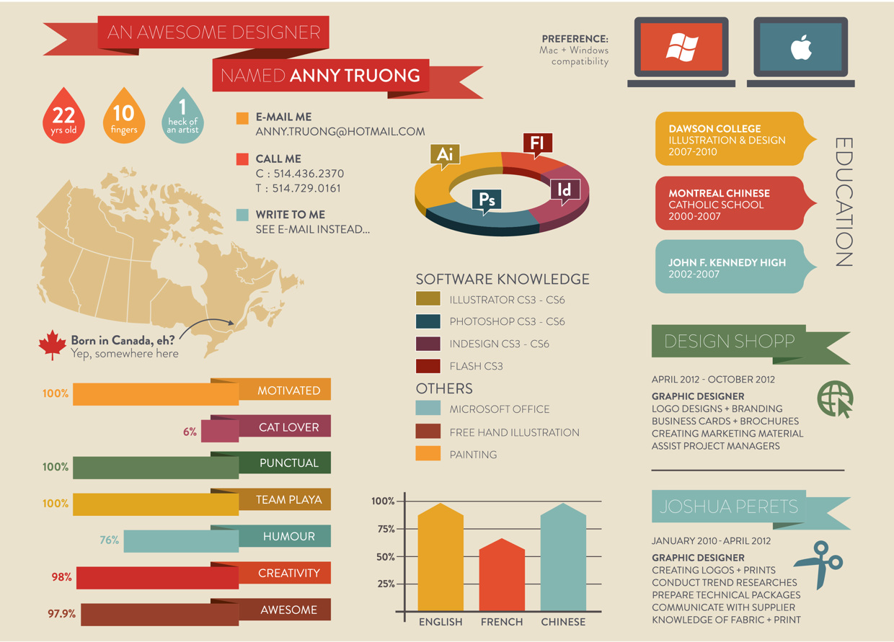
Group Infographic Resume
Notes:
Slide 25
Facilitator Notes:
This section of the module focuses on systems thinking. Make sure you have enough chart paper, markers, colored pencils, and magazines to create an infographic group resume. Divide participants into groups of three to five people.
Say to Participants: “In this section, we want to find out what you as a group know about systems thinking. Head Start has traditionally encouraged systems thinking because that’s how we ensure high-quality programming and service coordination. So, Head Start program leaders like yourself are grounded in systems thinking. In this first learning activity, we want you to determine just how extensive your knowledge, skills, abilities, and background are in this type of thinking.
“A fun way to do this is by creating an infographic group resume. An infographic resume takes a large amount of information and condenses it into images and text. In an infographic resume, you can toot your own horn and take control of telling your story.”
On the slide, review with participants the kind of information they will want to put on their group resume. Each resume should include:
Work experience they have had that required systems thinking
Professional development opportunities related to systems thinking
Any materials they have written or helped develop on systems thinking
Awards they may have won related to systems-oriented accomplishments
Next, direct participants’ attention to the various elements on the slide. Tell the group that the infographics they will create should include:
A visual timeline that shows employment history, key achievements, and career milestones
Quotes or testimonials from current and former managers, clients, or colleagues
Photos or drawings
Headlines, taglines, and other graphic techniques that summarize what they’re trying to convey
Say to Participants: “Remember, this is a group activity, so the resume needs to be inclusive of everyone in your group.”
Tell participants they will have 15 minutes to chat about their experiences, 20 minutes to create the group resume and post it so others can see it, and 10 minutes for a “gallery walk” where all the resumes will be on display.
Once groups complete their infographic resumes, ask them to post them around the room. Invite participants to walk around to see their collective knowledge and experience with systems and systems thinking.
After people have viewed the gallery, lead them in a few minutes of reflection on what stands out about these posters.
Say to Participants: “Now that you have reflected on your knowledge and experience related to systems and systems thinking, we’ll move on to explore the impact that you have on your organization and its systems.”

Slide 26
Seeing Yourself as a System
Personality
Education
Cognitive skills
Life experiences
Emotional makeup
Notes:
Slide 26
Facilitator Notes:
Make sure everyone has the Mirror handout.
Say to Participants: “You are a system as complex as the one you are trying to move forward. Seeing yourself as a system helps you realize your value to the whole.”
Explain to participants that they will be engaging in an activity called “Seeing Yourself as a System.”
Begin the activity by asking participants to make a list of words or phrases that describe them inside the mirror on the handout. Tell them they can ask other people in the room who know them for additional suggestions.
Direct participants to the slide, which shows system categories of personality, education, cognitive skills, life experiences, and emotional makeup.
Invite participants to categorize all of their descriptors into one of the five system categories. Give the group 10 minutes to complete the task, then bring everyone back together.
Going category by category, ask for volunteers to share what they’ve written in their mirrors.
Wrap up by explaining to participants that the confluence of their personalities, education, cognitive skills, life experiences, and emotional makeup define their
personal systems.
Say to Participants: “Now that we have had a chance to look at ourselves as complex systems, it’s easy to see the relationship between the complex systems that exist within us as individuals and those that exist within Head Start. As a leader, it is important to understand how these two systems interact.”
“Review the descriptors you’ve written in your mirrors. What impact do you believe your attributes have on your organization? Let’s process this together. Take five minutes to share your thoughts with the person sitting on your right.”
Ask a few participants to share their insights based on this exercise.
Say to Participants: “Ronald Heifetz, co-author of The Practice of Adaptive Leadership, says the clarity that comes from seeing yourself as a system can give you courage, inspiration, and focus. ¹¹ Understanding yourself as a system, and your role in the larger system, can be very helpful in leading your organization.
“Now we’re going to transition into a deeper discussion about systems thinking.”
¹¹Heifetz, Ronald, Linsky, Marty, and Grashow, Alexander. The Practice of Adaptive Leadership: Tools and Tactics for Changing Your Organization and the World. Cambridge, MA: Cambridge Leadership Associates, 2009.

Slide 27
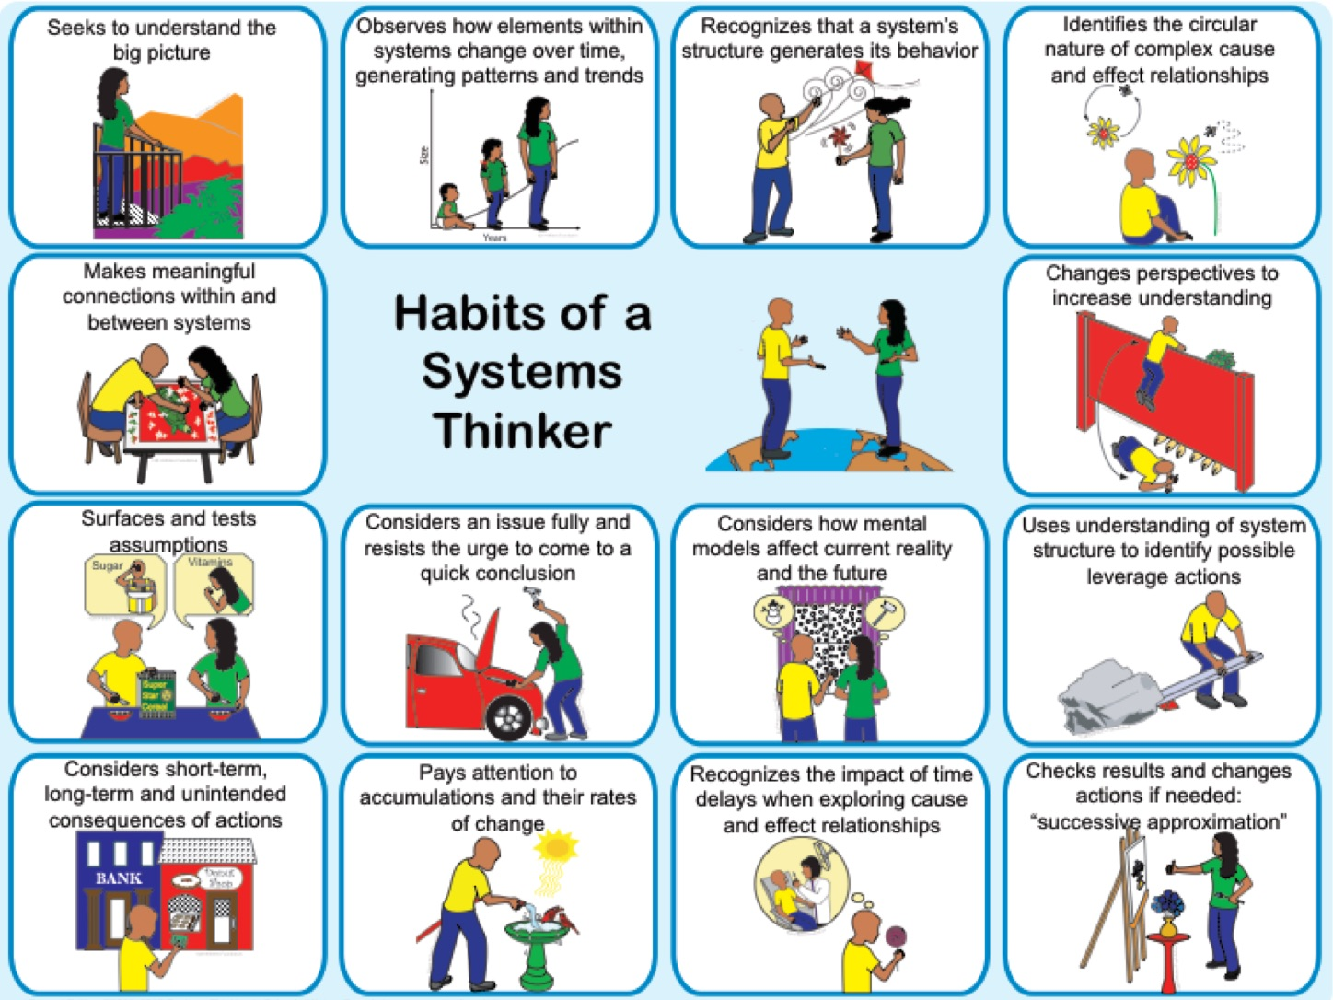
Habits of a Systems Thinker
Notes:
Slide 27
Facilitator Notes:
Distribute the 14 Habits of a Systems Thinker handout. Explain to participants that this activity will give them the opportunity to practice applying systems thinking to Head Start services. Give participants 20 minutes to complete the activity with their tablemates.
Say to Participants: “This handout describes ways of thinking about how systems work and how actions can impact results over time. People who practice systems thinking often report that it sharpens and clarifies their understanding of interrelationships within systems. It helps them find the opportunities or ‘leverage points’ that can take the performance of the entire system to a higher level. The systems-thinking habits described here encourage flexible thinking and appreciation of new insights and multiple perspectives.
“With your group, read through each of the 14 habits and discuss times when you have seen systems thinking demonstrated in your organizations. Consider how practicing a particular habit impacted the situation.”
After 20 minutes, ask for volunteers to share some of the real-life examples their
group discussed.
Say to Participants: “Now that you’ve spent some time thinking about the habits of systems thinkers, how can you see these habits being useful for Head Start leaders?”

Slide 28
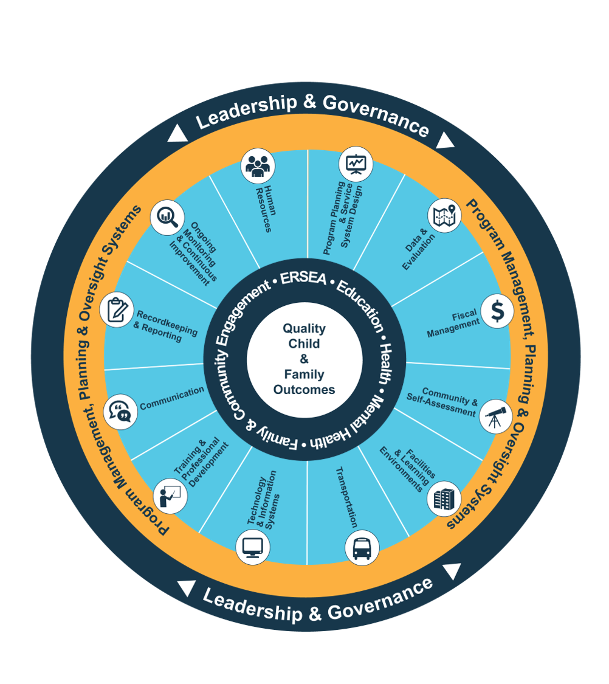
Examining the Head Start Management Systems
Notes:
Slide 28
Facilitator Notes:
Distribute the Head Start Management Systems with Guiding Questions handout.
Briefly call out each of the management systems in the aqua blue areas of the slide. Reiterate some of the earlier comments made by the group about systems. As a tease, ask participants which of the management systems is the most important.
In your own words, explain the graphic on the slide by pointing to its various elements and describing each, basing your descriptions on the bullet points below.
The dark blue outer circle includes the functions of leadership and governance. They are the bedrocks of effective management, encompassing and informing the 12 management systems.
The yellow circle outlines the scope of these systems.
The segmented aqua blue ring outlines each of the 12 management systems. These systems work together to inform and influence the program's service delivery. These services include education, health, mental health, community partnerships, family engagement, and eligibility, recruitment, selection, enrollment, and attendance (ERSEA).
Say to Participants: “In Head Start, all of these systems work together to inform and influence the program's service delivery, which you see in the dark blue inner circle. When innovative leadership, strong management systems, and well-designed services are working together, we produce quality child and family outcomes.”

Slide 29

Elevator Pitch:
The Head Start Management Systems Wheel
Notes:
Slide 29
Facilitator Notes:
Distribute the Elevator Pitch for the Head Start Management Systems Wheel handout to participants.
Say to Participants: “Now, we’re going to use the Head Start Management Systems Wheel to help you reflect on how the management systems are aligned with the HSPPS.
“In this activity, I want you to work with your tablemates and discuss your understanding of the Head Start Management Systems Wheel. Use the questions on the handout to guide your discussion.”
When 10 minutes have passed, call participants to attention.
Say to Participants: “Now we’re going to create an ‘elevator pitch’ that you will use to persuade your stakeholders that the management systems wheel is a really terrific tool for understanding the overall Head Start system.
“Your stakeholders include families, governing board or Tribal Council members, Policy Council members, staff, and your community at large.
“Remember that elevator pitches are short, sweet, and convincing. The length can vary, but ideally, you want to be able to present your elevator pitch comfortably, without rushing, in under one minute. Your goal should be 150–250 words. Read through the Elevator Pitch Template handout before you start writing. You’ll have 10 minutes.”
After 10 minutes, invite the group to come back together.
Ask for a few volunteers to share their elevator pitches and highlight parts of each that were particularly effective. Commend participants on the great jobs they did and ask how many of them will use their pitch immediately.
Say to Participants: “The next activity will help deepen your focus on systems thinking and the Head Start Management Systems Wheel.”

Slide 30
Learning Begins with Questions
Notes:
Slide 30
Facilitator Notes:
Direct participants’ attention to the slide and give a mini-lecture on the topic of leading with questions.
Say to Participants: “According to Michael Marquardt, author of the book Leading with Questions¹², learning begins with asking.
“Three- and 4-year-olds ask a lot of questions, and we see it as a sign of intelligence. Yet when we ask questions as adults, we can see it as just the opposite. Peter Drucker, known as the father of ‘management,’ said that ‘the leader of the past may have been a person who knew how to tell, but the leader of the future will know how to ask.’
“Well, the future is here. Dr. Marquardt tells us how questions can help foster creative thinking and a common vision that empowers people in an organization to share responsibility. He says leaders need to create a ‘questioning culture.’ By that, he means an environment where we give each other time to ask great open-ended questions, and where questions are valued rather than feared.”
Review the reasons that Marquardt says leaders don’t promote this kind of questioning culture. Leaders may have:
Fear and discomfort with inquiry due to a negative experience with asking or answering questions
A lack of skills in asking or answering
A lack of training, and limited or no models
A culture that discourages questions
Say to Participants: “In his book Leading with Questions, Marquardt reminds us of some historical catastrophes that occurred because people didn’t ask the right questions, or sometimes any questions at all. Those disasters include the sinking of the Titanic and the Challenger space shuttle explosion.
“Can you think of a misfortune you experienced in your program, or your life in general, because you didn’t ask enough questions, or the right questions?”
Give participants three minutes to think about it. After time is up, check to see if anyone wants to share an anecdote.
Say to Participants: “To ask great questions, you have to be able to generate great questions. This next activity will provide an opportunity for you to create some questions about the Head Start management systems using IB Key Concepts. IB stands for International Baccalaureate, and IB schools and educational programs are known for promoting inquiry and knowledge-seeking. We’re going to use key concepts of IB to develop questions about the Head Start management systems.”
¹²Marquardt, Michael. Leading with Questions: How Leaders Find the Right Solutions by Knowing What to Ask. San Francisco, CA: Josey-Bass, 2014.

Slide 31
Using International Baccalaureate (IB) Key Concepts with the Head Start Management Systems Wheel
RESPONSIBILITY
What is our responsibility?
PERSPECTIVE
What are the points of view?
REFLECTION
How do
we know?
CHANGE
How is it changing?
FUNCTION
How does
it work?
CONNECTION
What is the link
to other things?
CAUSATION
Why is it
like it is?
FORM
What is it like?
Adapted from wrightstufflearing, 2018.
Notes:
Slide 31
Facilitator Notes:
Distribute the IB Key Concepts handout and guide participants to the Head Start Management Systems: Guiding Questions handout from the last activity.
Make sure you have 12 pieces of chart paper, colored sticky notes (any size), and markers for each table. Hang chart paper around the room and label each sheet with one of the Head Start management systems. Space the sheets far enough apart so groups can congregate near each one to post their questions.
Divide participants into 12 groups, one for each system. If there are fewer than 12 participants in the training, groups may be assigned more than one management system. If there are more than 12 groups, two or more groups may work on the same system.
Say to Participants: “I would like for you to work in groups to generate questions about one (or more, as noted) of the Head Start management systems. Use the IB Key Concepts and Head Start Management Systems: Guiding Questions handouts to help you create your questions.
“You will have 20 minutes to do this. When your group has at least two or three questions, go to the chart paper with your designated Head Start management system, and post your questions using the sticky notes on the table.”
Once every group has posted its questions, suggest participants take a gallery walk.
Say to Participants: “You might want to take some photos so you’ll have a copy of all of the questions. As you read the questions each group generated, think about how you might use this learning activity within your programs to support continuous improvement.”

Slide 32
Closing Reflections
What have
I learned?
Adapted from Professional Development Guides for Implementing PFCE
What excites or concerns me about what I learned?
What will I do with what I've learned?
Notes:
Slide 32
Facilitator Notes:
The final exercise is intended to help participants reflect on and reinforce what they’ve learned.
Say to Participants: “Now, let's take some time to turn inward, to digest and reflect honestly on what we've learned and how we will use this information to benefit our Head Start work after we leave.”
Using the handout, direct participants to take a few minutes to reflect and write down their thoughts about the following questions on the handout:
What have you learned?
What excites or concerns you about what you have learned?
What will you do with what you’ve learned?
If time permits, allow volunteers to share their responses aloud, and process the activity using the following questions:
What themes are emerging?
What insights do you need to remember?
How can you use these insights?

Slide 33
Related ECLKC Resources
About Us
https://eclkc.ohs.acf.hhs.gov/about-us/article/office-head-start-ohs
Head Start Programs
https://eclkc.ohs.acf.hhs.gov/programs/article/head-start-programs
Head Start Act
https://eclkc.ohs.acf.hhs.gov/
policy/head-start-act
Notes:
Slide 33
Facilitator Notes:
Direct participants’ attention to the slide.
Say to Participants: “Here are several resources on the ECLKC that can help you learn more about some of the topics we've discussed in this module. To learn more about leadership and systems thinking, type in those search terms.”

Slide 34



Contact PMFO
pmfo@ecetta.info
https://eclkc.ohs.acf.hhs.gov/ncpmfo
Call us: 888-874-5469
Notes:
Slide 34
Facilitator Notes:
Review the contact information on the slide with participants. Invite them to reach out with questions and delve further into topics discussed in this module.

