Slide 1
Head Start A to Z, 2.0
Ongoing Monitoring and Continuous Improvement
Notes:
Slide 1
Facilitator Notes:
Welcome participants to the session and introduce yourself. If you have co-facilitators, invite them to introduce themselves as well. Begin the session with an introductory activity to create a positive group climate and begin the engagement process. Then explain the following.
Say to Participants: “The National Center on Program Management and Fiscal Operations has updated Head Start A to Z to align with the revised Head Start Program Performance Standards that became effective November 2016. Head Start A to Z was originally designed to support new leaders in their Head Start roles. The term ‘leaders’ ensures that anyone at the management level, or in some cases the governing body, Tribal Council, or Policy Council level, can attend the sessions or use the materials for independent learning.
“The updated Head Start A to Z, 2.0, learning modules provide baseline-level information primarily through a leadership and management systems lens. The presentations are modeled on ‘learning organization’ concepts. In each of the modules, we recognize key characteristics of learning organizations, including a supportive learning environment, openness to new ideas, and time dedicated for reflection.
“Each attendee has an important role to play in the success of this session. Those with experience remind us where we’ve come from and what we must do to maintain our identity and uniqueness. New members bring a fresh perspective and remind us what we must do to prepare for the future. All roles are essential for Head Start to be a learning organization that continues to grow and flourish.
“Head Start A to Z, 2.0, is most successful when it helps us share the best of what we have to offer with a strength-based focus. As you engage in this session, we hope that you will support one another in the learning process by generously sharing your knowledge, experience, and perspective.”

Slide 2
Learning Objectives
In this module, participants will:
Learn how ongoing monitoring and continuous improvement fit into the Head Start Management Systems Wheel
Review what the regulations say about ongoing monitoring and continuous improvement
Identify and analyze essential elements of ongoing monitoring and continuous improvement
Design and implement ongoing monitoring and continuous improvement systems
Notes:
Slide 2
Facilitator Notes:
Distribute the Reflective Practice Tool handout.
Say to Participants: “In this module, participants will:
Learn how ongoing monitoring and continuous improvement fit in the Head Start Management Systems Wheel
Review what the regulations say about ongoing monitoring and continuous improvement
Identify and analyze essential elements of ongoing monitoring and continuous improvement
Design and implement ongoing monitoring and continuous improvement systems”
Guide participants to the Reflective Practice Tool handout.
Say to Participants: “At the end of our session, you will be asked to use this Reflective Practice Tool to write down some key thoughts based on what you’ve learned. We encourage you to jot down some preliminary thoughts as we move through the session.”

Slide 3
Six Guiding Principles for A to Z Trainings
Successful programs are learning organizations.
Sound decision-making is informed by quality data.
Relationship-building is at the heart of transformational leadership.
The effective delivery of services grows out of strong systems.
School readiness for all is our driving goal.
Culturally and linguistically diverse organizations rely on intentional, specific, and coordinated approaches.
Notes:
Slide 3
Facilitator Notes:
Distribute the Head Start A to Z, 2.0, Guiding Principles handout.
Say to Participants: “Head Start A to Z, 2.0, is based on six guiding principles. These guiding principles are foundational to the design of the modules and have been aligned with the HSPPS.
“Head Start directors and managers come from all walks of life with a wealth of employment experiences. However, we all share a commitment to a comprehensive, high-quality early childhood experience. We recognize that, to promote school readiness and be responsive to the needs of our communities, we must engage in ongoing professional development. Head Start A to Z, 2.0, was created to support professional growth and development for the Head Start leaders.”
Guide the participants to the Head Start A to Z Guiding Principles handout. Review the six principles below. You may paraphrase or slightly summarize.
Successful programs are learning organizations. Head Start is a dynamic organization with high expectations, values, and traditions. Programs are constantly responding to changing community needs and evolving best practices. To cultivate a learning organization that thrives in this environment, program leaders must support all staff in becoming life-long learners who embrace challenges as opportunities for collective problem-solving and innovation.
The effective delivery of services grows out of strong systems. Program leaders must regularly refine their program’s management and fiscal systems. To target community needs and deliver comprehensive services, leaders need to understand systems thinking and view their program through a systems lens. They also need to recognize the relationship between systems, services, and child and family outcomes.
Sound decision-making is informed by quality data. Used in planning, evaluating, and communicating information, quality data is integral to cultivating a culture of continuous quality improvement. To this end, it is critical for leaders to establish efficient processes for collecting, aggregating, analyzing, and synthesizing data. This involves training teachers, home visitors, family advocates, health services workers, and other staff how to integrate data management into their day-to-day work.
Relationship-building is at the heart of transformational leadership. Robust Head Start communities build on authentic relationships between all of their stakeholders, from children, families, staff, and managers to governing bodies, Tribal Councils, and Policy Councils. To cultivate these communities, leaders need to communicate effectively, empower others, foster team-building, and nurture collaboration.
School readiness for all is our driving goal. Head Start leaders play an integral role in conceiving and promoting an inclusive vision of school readiness. To support children with diverse abilities and backgrounds to develop the skills, knowledge, and attitudes needed to be successful in school, effective leaders must stay informed on developments in early childhood education. They also must actively collaborate with parents, staff, governing bodies, local education agencies, and community partners in embedding these best practices into services and programming.
Culturally and linguistically diverse organizations rely on intentional, specific, and coordinated approaches. To ensure the full and effective participation of dual language learners and their families, Head Start leaders must coordinate program-wide plans that involve all service areas and multiple staff. This includes staying connected to the communities served, implementing targeted strategies, and articulating how programs and services address specific linguistic and cultural needs.
Say to Participants: “In addition to anchoring the content in Head Start A to Z, 2.0, you will revisit these guiding principles in all of the trainings offered by PMFO.”

Slide 4
Ongoing Monitoring and Continuous Improvement
Notes:
Slide 4
Facilitator Notes:
Begin the overview of this module.
Say to Participants: “Head Start and Early Head Start programs use ongoing monitoring to continually assess progress toward meeting program goals and objectives and compliance with regulatory requirements. Ongoing monitoring measures program performance. It helps programs identify areas of concern, make immediate corrections, and generate reports. It also produces data used in the annual self-assessment process. The continuous improvement process uses ongoing monitoring data and data from other sources to systematically improve programming over time.

Slide 5
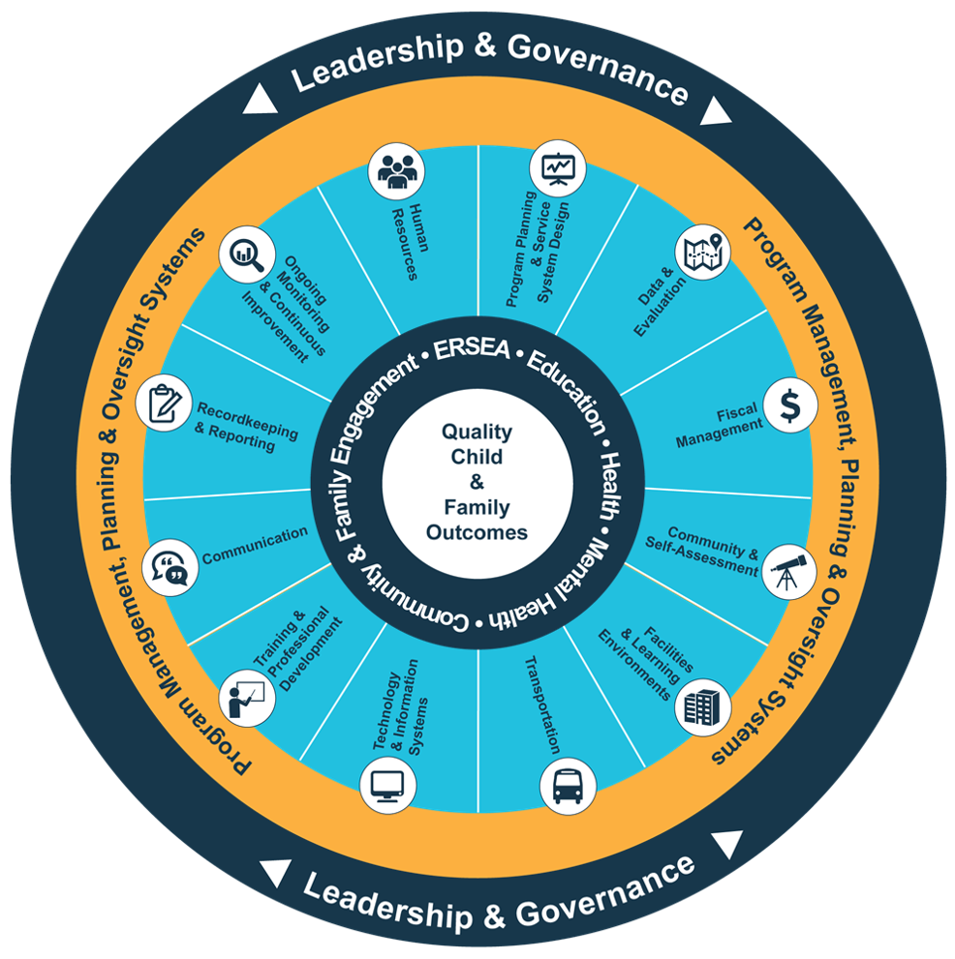
Head Start Management Systems Wheel
Five-Year Project Period
Notes:
Slide 5
Facilitator Notes:
Deliver the following material as a mini-lecture.
Say to Participants: “The Head Start Management Systems Wheel can help us understand how ongoing monitoring and continuous improvement fits into the overall picture.”
In your own words, explain the graphic on the slide by pointing to its various elements and describing each, basing your descriptions on the bullet points below.
The dark blue outer circle includes the functions of leadership and governance. They are the bedrocks of effective management, encompassing and informing the 12 management systems.
The yellow circle outlines the scope of these systems.
The segmented aqua blue ring outlines each of the 12 management systems. These systems work together to inform and influence the program’s service delivery. These services include education, health, mental health, community partnerships, family engagement, and eligibility, recruitment, selection, enrollment, and attendance (ERSEA).
Say to Participants: “You see that one of the aqua blue wedges is labeled ‘ongoing monitoring and continuous improvement.’ That’s the management system we’re looking at in this module. In Head Start, all of these systems work together to inform and influence the program’s service delivery, which you see in the dark blue inner circle. When innovative leadership, strong management systems, and well-designed services are working together, we produce quality child and family outcomes.”

Slide 6
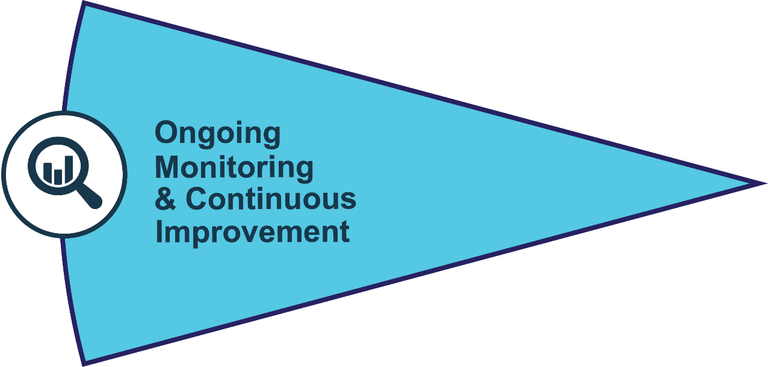
Ongoing Monitoring and Continuous Improvement (Cont’d)
Helps programs adapt to better address goals and objectives
Shares data with staff, Policy Councils, and governing bodies or Tribal Councils to engage all in the program planning process
Notes:
Slide 6
Facilitator Notes:
Direct participants’ attention to the slide.
Say to Participants: “Programs use the system we’re discussing today, ongoing monitoring and continuous improvement, to constantly make adjustments to their programming so they can meet their goals and objectives. Programs share their ongoing monitoring data with staff, Policy Councils, and governing bodies or Tribal Councils.”

Slide 7
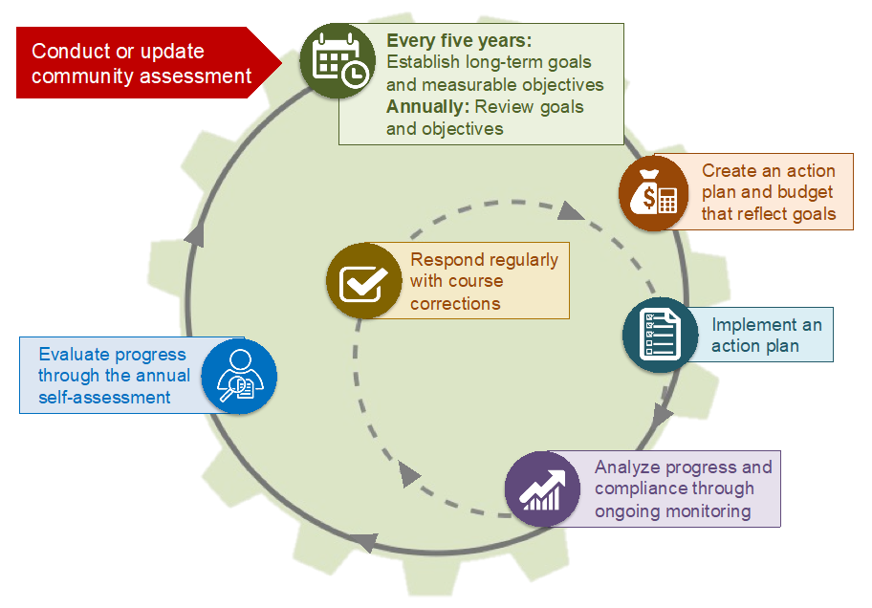
Program Planning Cycle
Notes:
Slide 7
Facilitator Notes:
Direct participants’ attention to the slide.
Say to Participants: “Ongoing monitoring and continuous improvement are an important part of the program planning cycle. Take a close look at the slide, noting how the various activities work together.
“The purple box talks about how we analyze progress and compliance through ongoing monitoring. During this phase, grantees develop ongoing monitoring procedures that include:
Collecting and analyzing data
Responding to problems by making regular course corrections
Working with the Policy Council and governing body or Tribal Council to address issues
Implementing procedures to prevent recurrences of problems”

Slide 8


Linking Planning, Ongoing Monitoring, and Self-Assessment
Program Planning
Ongoing Monitoring
Self-Assessment
Decide on goals:
Collect:
Prepare:
Review and analyze community assessment and other relevant data
Review recommendations from self-assessment report
Develop long-term program goals
Collect data (e.g., PIR, child outcomes data, results of ongoing monitoring for all systems, services, goals, and objectives)
Design self-assessment process
Orient and train self-assessment participants
Analyze:
Analyze:
Analyze information presented (e.g., ongoing monitoring summaries, OHS monitoring results, child assessment data, health records, etc.)
Determine and request additional data, if needed
Review and analyze data with managers
Develop objectives:
Set short-term program and fiscal objectives
Act:
Make course corrections
Determine new data measures
Develop work plan:
Develop action steps for objectives
Identify measures to monitor
Plan for regular progress reports to staff, governing body or Tribal Council, and Policy Council
Develop service plans that reflect new goals and objectives
Ensure:
Evaluate and follow up on course corrections
Verify accuracy of and summarize ongoing monitoring data for review by self-assessment team
Request self-assessment team analyze persistent systems issues
Recommend:
Identify strengths and make recommendations for improvement
Notes:
Slide 8
Facilitator Notes:
Distribute the Linking Planning, Ongoing Monitoring, and Self-Assessment handout.
Say to Participants: “This graphic helps us see how planning, ongoing monitoring, and self-assessment are linked. It also shows how data is the linchpin that brings the three systems together.
“During program planning, you:
Determine goals and objectives
Decide what data you need to collect
Monitor your progress toward goals and objectives
Ensure you are meeting compliance standards”
“The ongoing monitoring data you collect and analyze throughout the year eventually goes to the self-assessment team, which uses it to determine strengths, replicate promising practices, and make course corrections.”

Slide 9
Huddle Activity
Form a Huddle
Choose a Team Captain to Report Out
Listen to Statement
Huddle for 15 Seconds
Choose Thumbs Up/Thumbs Down
Signal Thumbs Up/Thumbs Down
Team Captain Report Out
Notes:
Slide 9
Facilitator Notes:
Ask participants to form “huddles” of between three and six people each and select one person to act as the reporter.
Say to Participants: “Let’s play a game to get oriented to the ongoing monitoring and continuous improvement processes. I’m going to read a statement. If your huddle agrees that the statement describes ongoing monitoring and continuous improvement, ask your reporter to signal thumbs up. If you disagree, signal thumbs down. You will have 15 seconds to decide on your answer to each question.”
Read each statement aloud, then allow participants to huddle and discuss. When reporters have signaled an answer, affirm the responses you see. Then read the actual answer.
Statement A: Ongoing monitoring and continuous improvement are integral parts of the planning cycle. Everyone has a role in these processes.
Answer: Yes. Head Start encourages comprehensive, integrated approaches to service delivery. It is not appropriate to think in terms of isolated service areas with individual goals and responsibilities. Everyone contributes to program quality. When a part of the system is not functioning effectively, everyone needs to support and contribute to the course correction.
Statement B: Ongoing monitoring and continuous improvement can be accomplished by reviewing records.
Answer: No. Checking records, reviewing reports, and sharing data are all important, but ongoing monitoring and continuous improvement also involve observation of daily service delivery and real-time feedback and correction.
Statement C: Office of Head Start (OHS) Monitoring Reviews serve the same purpose as ongoing monitoring and continuous improvement.
Answer: No. Programs use ongoing monitoring and continuous improvement as internal processes that look at progress in implementing plans, accomplishing goals and objectives, and complying with federal requirements. Ongoing monitoring data is analyzed internally to determine issues and make course corrections resulting in continuous improvement. OHS uses the Head Start Monitoring Review to measure the performance and accountability of Head Start programs across the country. The Monitoring Review does not replace a program’s system of ongoing monitoring.
Statement D: Ongoing monitoring and continuous improvement provide data that can help inform the annual self-assessment.
Answer: Yes. The annual self-assessment uses data from ongoing monitoring to take a deeper look at program operations. It sheds light on program effectiveness and answers questions like whether family engagement activities and professional development efforts are supporting positive child outcomes; whether there are systematic compliance issues that must be addressed; and if there are successful innovations that could be replicated.
Statement E: If a grantee has delegates, the delegates’ monitoring process should mirror that of their grantee.
Answer: No. Delegates must have their own monitoring process. That process should ensure that its operations effectively implement the Head Start or Early Head Start program. The contract between the grantee and the delegate should describe the scope, frequency, and resolution process for any identified problems. Grantees and delegate agencies can use ongoing monitoring and continuous improvement as an opportunity to build cooperative relationships and exchange ideas about planned improvements.

Slide 10
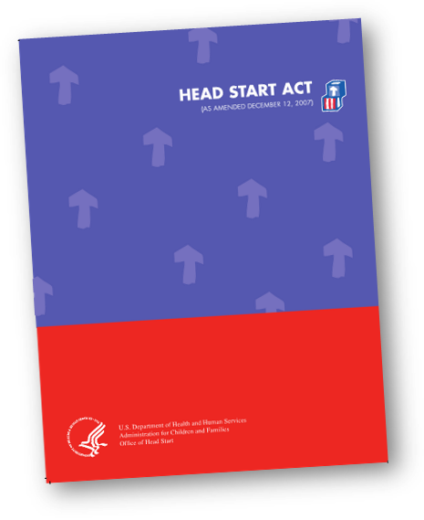
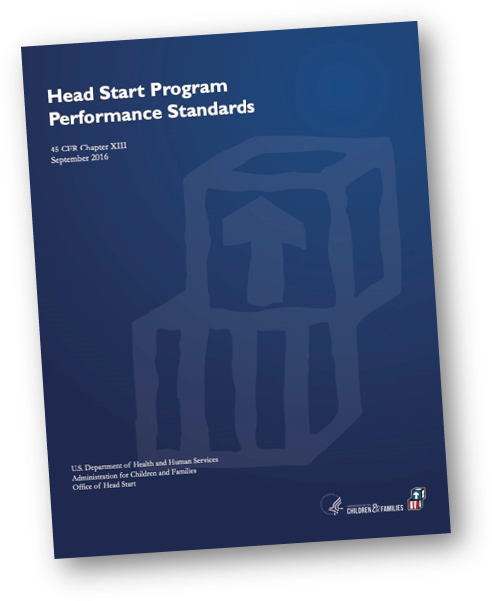
What the Regulations Say
Notes:
Slide 10
Facilitator Notes:
Direct participants’ attention to the slide.
Say to Participants: “Ongoing monitoring and continuous improvement are interrelated processes based in the Head Start Act and further defined by the HSPPS.”

Slide 11
45 CFR §1302 Subpart J
A program must establish and implement procedures, processes, and a system for ensuring effective ongoing oversight and correction.
Notes:
Slide 11
Facilitator Notes:
Distribute the What the Regulations Say: Ongoing Monitoring and Program Management and Quality Improvement, 45 CFR §1302 Subpart J handouts.
Say to Participants: “A key requirement is that each grantee and delegate agency must have a system with processes and procedures for conducting ongoing monitoring and making corrections as needed. The purpose is to ensure that programs are meeting their goals and objectives and complying with standards. These regulations also ensure programs are continuously improving, which they are required to do.”

Slide 12
Monitoring Program Performance
Work with governing body or Tribal Council and Policy Council
Collect and use data to inform
Implement preventative procedures
Implement course corrections
Notes:
Slide 12
Facilitator Notes:
Continue with the mini-lecture on the regulations using the handouts from the previous slide.
Say to Participants: “According to regulations, programs must monitor their performance and continuously improve by:
Collecting data
Using data to inform planning
Making course corrections when data indicate they are necessary
Implementing procedures that will prevent a recurrence of previous quality and compliance issues
Sharing findings with the Policy Council and governing body or Tribal Council so they can perform their oversight roles”

Slide 13
Data and Decision-Making
How are results shared?
Sharing Ongoing Monitoring Results
Policy Council and Governing Body or Tribal Council
Use Results to Conduct Oversight Responsibilities
Notes:
Slide 13
Facilitator Notes:
Finish the mini-lecture on regulations.
Say to Participants: “As we just noted, programs must share their ongoing monitoring data with Policy Councils and governing bodies or Tribal Councils.
“Let’s talk about how you share your ongoing monitoring results. What are the mechanisms you use to share data?” Solicit feedback.
Say to Participants: “Do you feel these mechanisms are effective? Could they be more effective? If so, how?”
Facilitate a brief discussion.

Slide 14
Elements of Effective Ongoing Monitoring
Notes:
Slide 14
Facilitator Notes:
Transition to the next section.
Say to Participants: “Now we’re going to spend a little more time thinking about what goes into creating and implementing an effective ongoing monitoring system.”

Slide 15
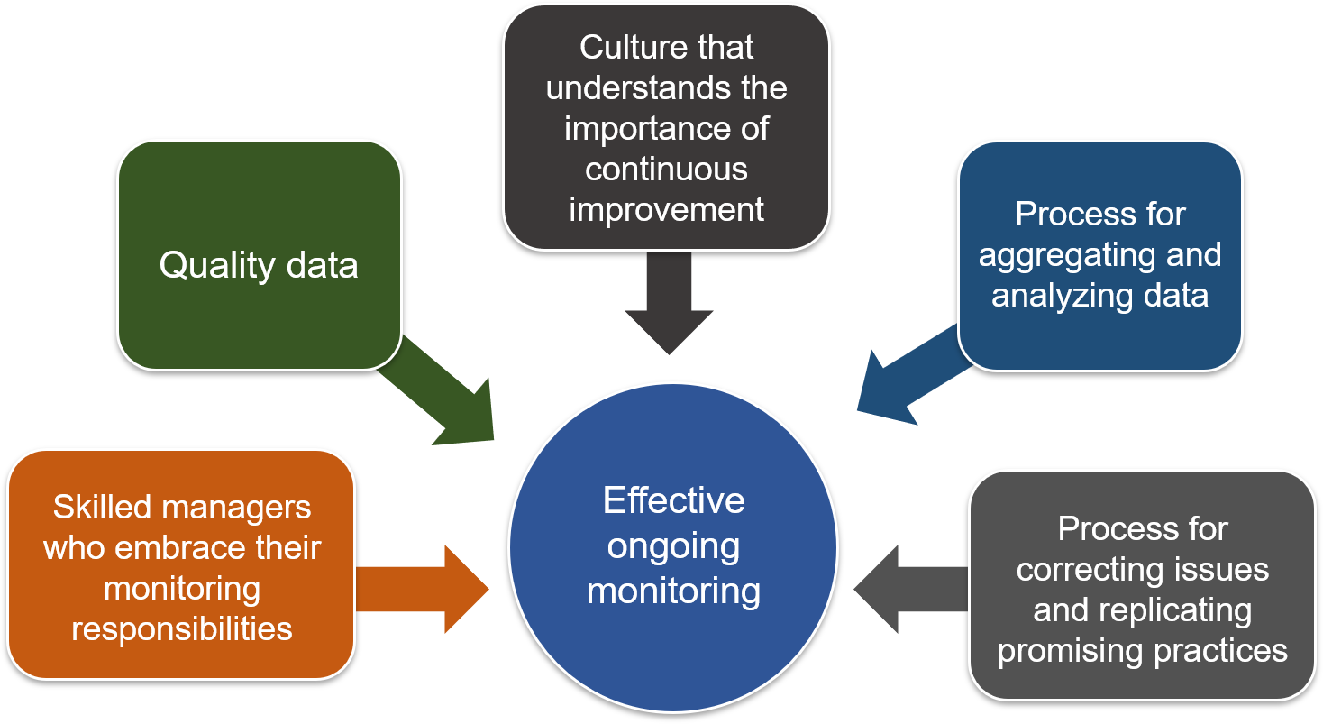
Elements of an Effective Ongoing Monitoring System
Notes:
Slide 15
Facilitator Notes:
Distribute the Elements of an Effective Ongoing Monitoring System handout.
Say to Participants: “Ongoing monitoring systems are locally designed. That means grantees and their delegates must be knowledgeable about the federal regulations that govern Head Start and Early Head Start, and design their systems with those regulations in mind.
“So what are the components of an effective ongoing monitoring system?
“Take a look at the slide. We can all agree that these five elements are important. But what do they actually look like in practice? Let’s review them one by one.”

Slide 16
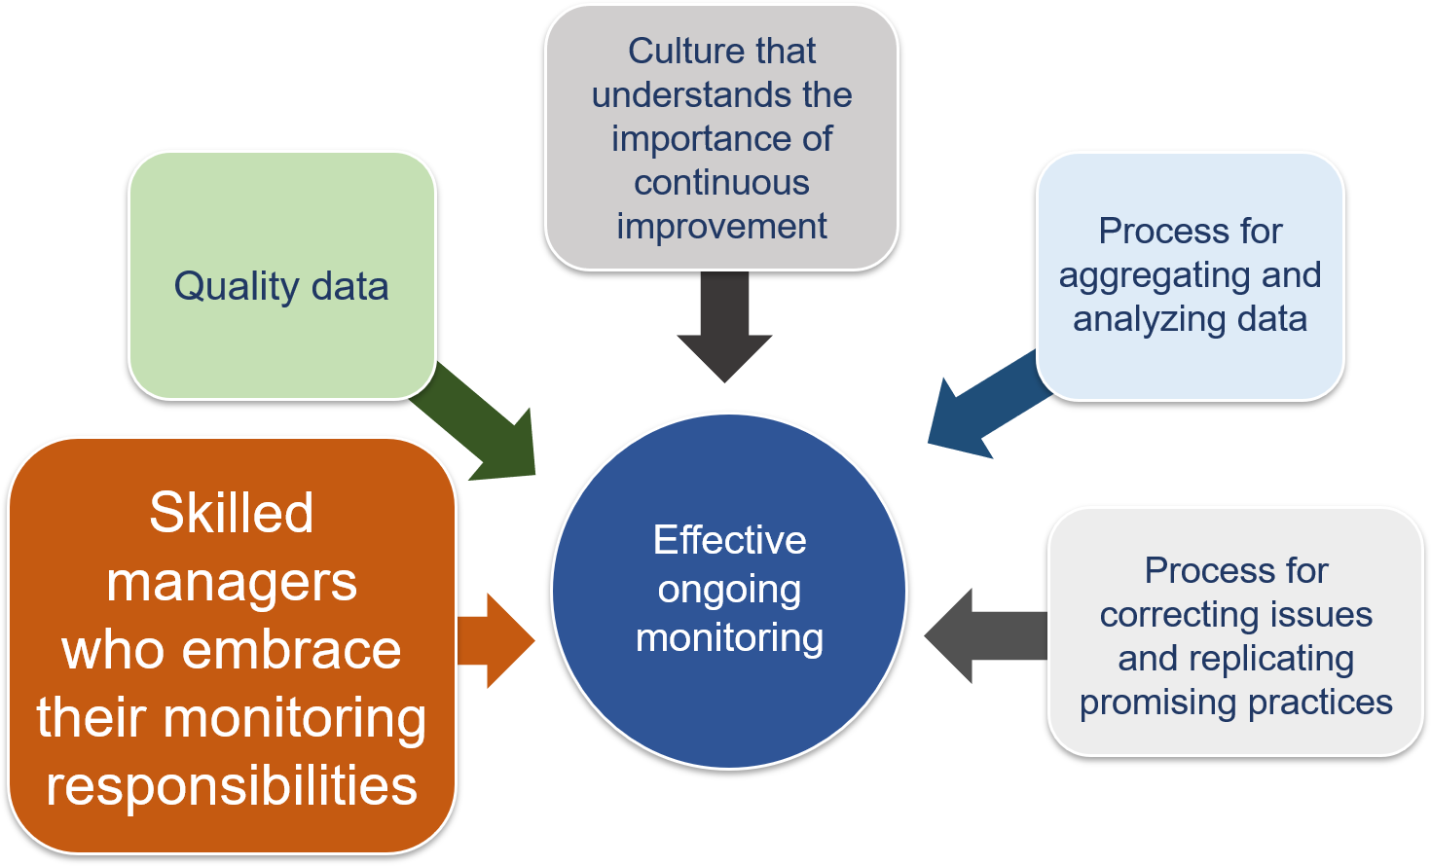
Elements of an Effective Ongoing Monitoring System (Cont’d)
Notes:
Slide 16
Facilitator Notes:
Discuss the first element of an effective ongoing monitoring system.
Say to Participants: “The first element is skilled managers who embrace their monitoring responsibilities. What would a skilled manager do? Who has some thoughts?”
Acknowledge the ideas that surface.
Say to Participants: “Skilled managers:
Implement a system of supervision where staff receive feedback
Hold team debriefing sessions during monitoring activities
Recognize they may not have direct monitoring responsibilities but manage staff who do
Effectively manage conflict”

Slide 17
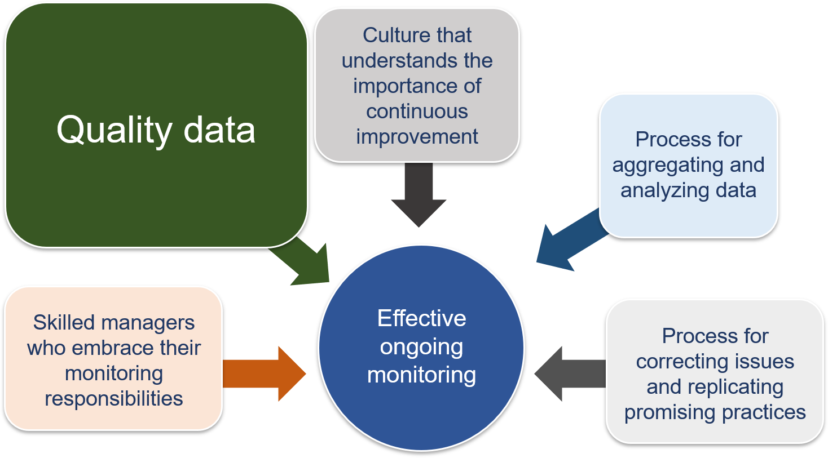
Elements of an Effective Ongoing Monitoring System (Cont’d 1)
Notes:
Slide 17
Facilitator Notes:
Discuss the second element of an effective system.
Say to Participants: “The next element is quality data. What are the characteristics of quality data?”
Acknowledge ideas from participants.
Say to Participants: “Quality data is:
Relevant. It tells you what you need to know.
Timely. It is as current as possible.
Accurate. It represents what’s really happening.
Complete. It’s not full of gaps and holes. Missing information and incomplete records can hurt a program’s ability to see what’s going well and what needs to be improved.”

Slide 18
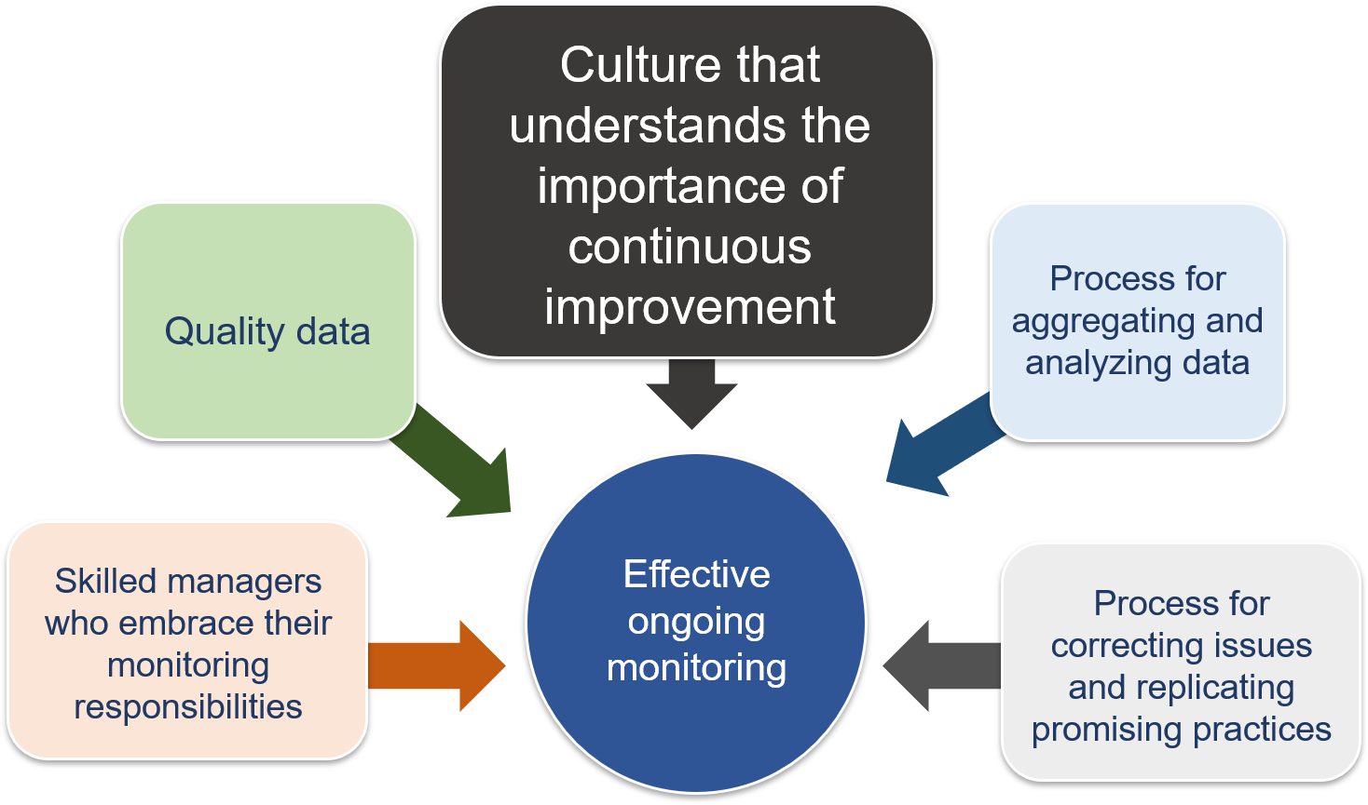
Elements of an Effective Ongoing Monitoring System (Cont’d 2)
Notes:
Slide 18
Facilitator Notes:
Review the third element of an effective system.
Say to Participants: “The third element is a culture that understands the importance of continuous improvement. How do you think that culture looks?”
Acknowledge ideas from participants.
Say to Participants: “This kind of culture:
Embraces accountability
Asks ‘how’ and ‘why’ questions about children and families
Grows, learns, and contributes to the overall goal of the program
Empowers staff
Instills commitment in others
Supports problem-solving”

Slide 19
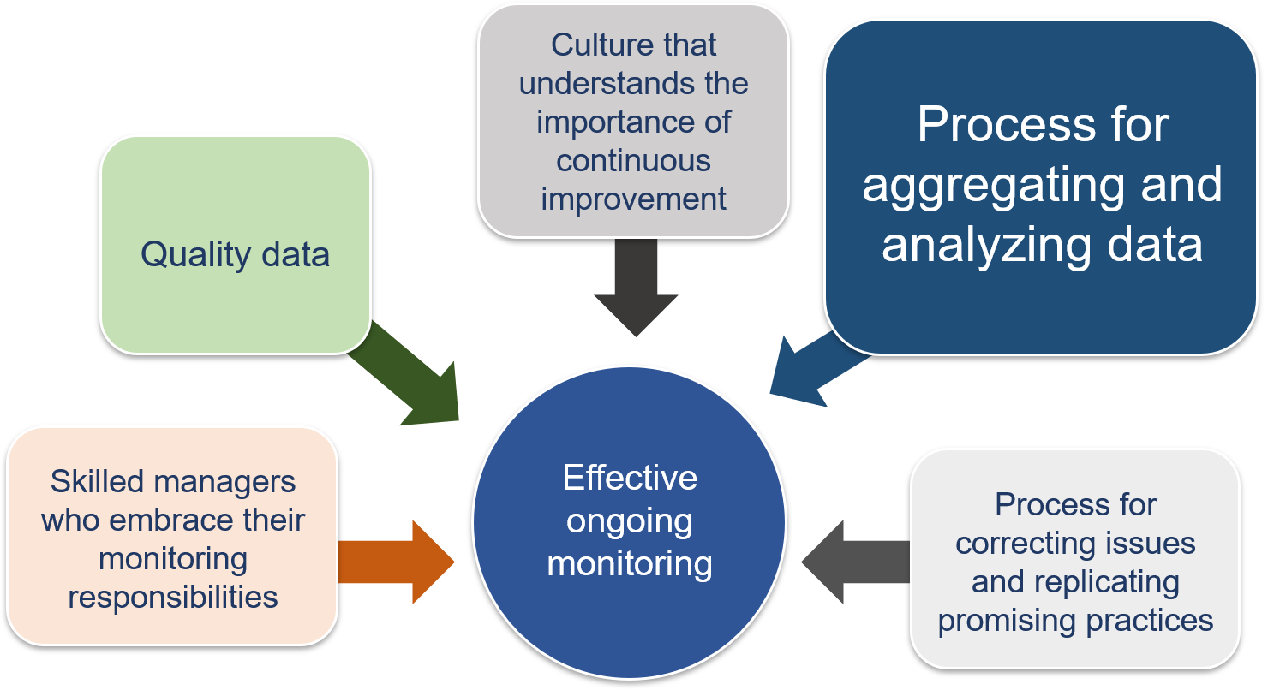
Elements of an Effective Ongoing Monitoring System (Cont’d 3)
Notes:
Slide 19
Facilitator Notes:
Review the fourth element of an effective system.
Say to Participants: “The fourth element is having an efficient process for aggregating and analyzing data. What activities would be part of this process?”
Acknowledge ideas from participants.
Say to Participants: “An efficient process:
Assigns responsibility for gathering data
Focuses on data that helps you see the big picture
Engages with data that can lead to answers”

Slide 20
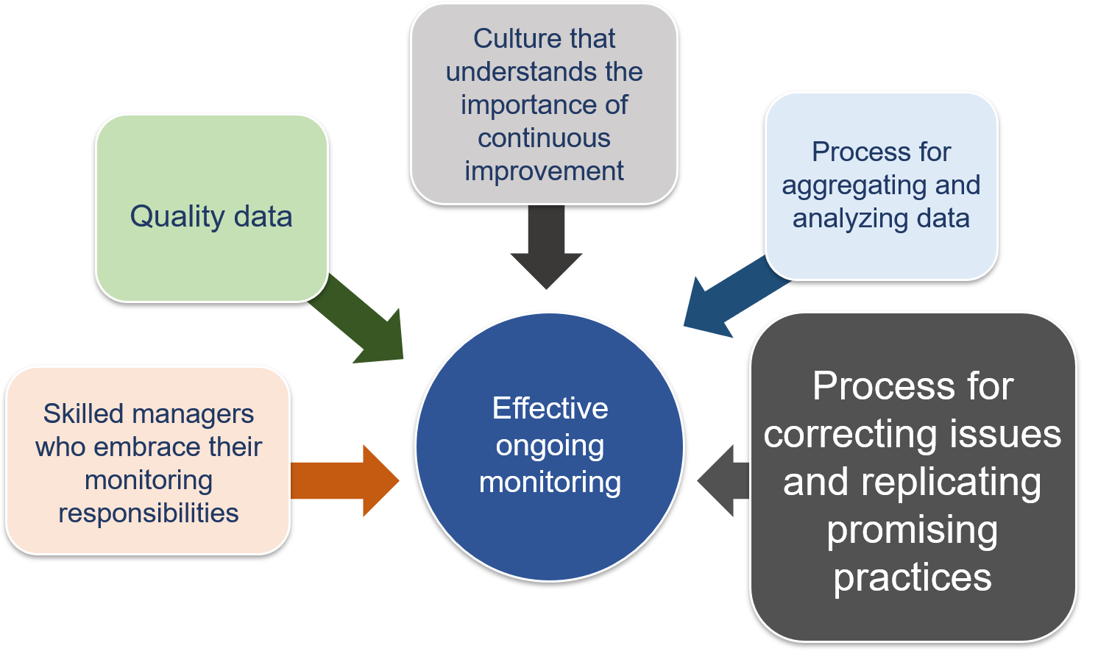
Elements of an Effective Ongoing Monitoring System (Cont’d 4)
Notes:
Slide 20
Facilitator Notes:
Review the last element of an effective system.
Say to Participants: “The last element in the system is having a process for correcting issues and replicating promising practices. What would such a system do?”
Acknowledge ideas from participants.
Say to Participants: “An effective process would:
Include follow-up to determine if a course correction has worked
Adjust the course correction as needed
Determine if new data needs to be collected to ensure the course correction has worked
Identify bright spots in the data that can help pinpoint promising practices”

Slide 21
Recordkeeping and Reporting
Notes:
Slide 21
Facilitator Notes:
Transition to the final part of the section on elements of ongoing monitoring, which focuses on recordkeeping and reporting.
Say to Participants: “The final piece of ongoing monitoring is to report your findings. This is where your recordkeeping and reporting system comes into play.”

Slide 22
Recordkeeping and Reporting (Cont’d)
Recordkeeping and reporting create a solid foundation for ongoing monitoring.
Notes:
Slide 22
Facilitator Notes:
Call participants’ attention to the slide.
Say to Participants: “Recordkeeping and reporting are key to Head Start and Early Head Start programs’ ability to gather and use data effectively.
“They support, facilitate, and document:
Day-to-day program operations
Predictive activities, such as budgeting and planning
Responses to questions about past decisions and activities”
Facilitate a brief discussion with participants on each of the following questions:
How does ongoing monitoring data flow throughout your program?
Who needs to know what and when?
How will you ensure confidentiality?
How will records be stored, retained, and destroyed?
What reports are generated? How often? By whom?

Slide 23
Continuous Improvement
Implementing continuous improvement processes for achieving program goals that ensure child safety and the delivery of effective, high-quality program services
Notes:
Slide 23
Facilitator Notes:
Direct participants back to the What the Regulations Say handout.
Say to Participants: “We’ve spent some time on the ongoing monitoring process. Now let’s focus on continuous improvement. According to regulations, grantees must:
Identify program strengths and performance issues
Develop and implement plans to address performance issues
Continually evaluate compliance with performance standards and program progress toward achieving goals and objectives
“The continuous improvement process is fed by data from these sources:
Child-level assessments, broken down by subpopulations
Family-level needs assessments
Comprehensive services
Staff professional development plans
Ongoing monitoring
Annual self-assessment”

Slide 24
Conceptual Elements of Continuous Quality Improvement
Organizational Characteristics
Commitment of Resources
History of improvements
Program characteristics
Size
Structure
Commit, finance, and sustain technology
Commit leadership time
Commit staff time
Analytic Capacity
Leadership in Data Management
Culture of Collaborative Inquiry
Assess technological capital
Assess human capital
Assess data capital
Quality Child & Family Outcomes
Be transformational
Adopt and lead change strategy
Communicate clearly
Motivate for innovation and creativity
Distribute responsibilities
Be a role model
Promote systems thinking
Share learning
Engage partners
Create safe space
Management of Program Data
Security of data
Usability
Integrity
Availability
Professional Development
Understand data systems
Develop analytic capacity
Integrate knowledge
Environment
Non governmental funders
Government mandates
Accreditation, licensing and professional systems
Time
Source: T. Derrick-Mills, H. Sandstrom, S. Pettijohn, S. Fyffe, and J. Koulish. (2014). Data use for Continuous Quality Improvement: What the Head Start Field Can Learn From Other Disciplines, A Literature Review and Conceptual Framework. OPRE Report # 2014-77. Washington, DC. Office of Planning, Research and Evaluation, Administration for Children and Families. U.S Department of Health and Human Services.
Notes:
Slide 24
Facilitator Notes:
Distribute the Conceptual Elements of Continuous Quality Improvement handout.
Say to Participants: “How many of you are familiar with this graphic? It’s about the building blocks of a culture of continuous improvement.
“The graphic is based on research conducted by the Office of Planning, Research, and Evaluation, also known as OPRE. In their study, researchers identified the organizational factors that support the use of data for continuous quality improvement¹. OPRE’s key findings are on the slide.”
Ask for volunteers to read each of the eight elements aloud from the slide or handout, starting with leadership. The elements are:
Leadership
Commitment of resources
A culture of collaborative inquiry
Professional development
Organizational characteristics
Analytic capacity
Management of program data
Environment
Ask the following questions, pausing to call on volunteers after each one.
Say to Participants: “As you look at this graphic, what comes to mind?
If you were to create a ‘big picture’ message based on the graphic, what would it be?
What words or phrases have special meaning for you?
What questions do you have?
What elements seem most important to you?” Derrick-Mills, T., H. Sandstrom, S. Pettijohn, S. Fyffe, and J. Koulish. Data Use for Continuous Quality Improvement: What the Head Start Field Can Learn From Other Disciplines, A Literature Review and Conceptual Framework. OPRE Report 2014-77. Washington, DC: Office of Planning, Research and Evaluation, Administration for Children and Families. U.S. Department of Health and Human Services. 2014. Retrieved from https://www.acf.hhs.gov/sites/default/files/opre/hsleadslitreview_final_12_8_14_rv2_0.pdf

Slide 25
How Leaders Support Continuous Improvement
Develop strong, committed, inclusive, and participatory processes
Understand analytic capacity is necessary
Prioritize and commit time and resources
Promote organizational culture of learning
Help staff understand data use is continuous
Assess environmental factors and adjust as necessary
Notes:
Slide 25
Facilitator Notes:
Distribute the Understanding the Conceptual Elements of Continuous Quality Improvement handout.
Say to Participants: “Let’s look at this handout and dig into some of OPRE’s findings about the importance of leadership. As you can see, researchers found that in order to create a culture of continuous improvement, leaders must:
Be strong, committed, inclusive, and participatory
Commit time and resources to the data use effort
Invest in professional development of staff
Champion continuous improvement as a basic organizational value
“In addition, OPRE found that:
Analytic capacity is necessary and leaders should not assume it already exists
An organizational culture of learning promotes continuous data use
Sound data management procedures are critical
“Turn to one of your neighbors and spend seven minutes reviewing the section of the handout entitled ‘Implementation of the Conceptual Elements.’ Identify which of the elements of continuous improvement your organization is strongest in and which areas need further development.”
After seven minutes, ask for volunteers to share highlights of their discussion.

Slide 26
Building Blocks of Ongoing Monitoring and Continuous Improvement
Procedure
Who
What
When
Where
Orient
Communicate
Process
Purpose
Strategy
Design
Roles
Actions
Timeline
Accountability
Communicate
System
Embedded
Systemic
Reflective
Evaluative
Follow-up
Ongoing
Replicate
Communicate
Notes:
Slide 26
Facilitator Notes:
Call participants’ attention to the slide.
Say to Participants: “As we saw earlier, the Head Start Act and the HSPPS require programs to develop a system with processes and procedures to ensure ongoing monitoring and continuous improvement. Let’s explore each of these functions, because they’re different.
“First, what are the characteristics of a system?” Read them from the slide, then lead the group in a brief discussion of the ways these characteristics show up in systems.
Say to Participants: “What are the basic components of a process? If you were asked to create a process for doing something, what things would you have to decide?” Read them from the slide, then ask a volunteer to share an example of how processes include these elements.
Say to Participants: “Finally, what are the characteristics of a procedure? What kinds of decision-making is involved in developing a procedure?”
Again, read from the slide, then ask a volunteer to share an example of a procedure that includes these elements.

Slide 27
Defining Processes and Procedures
A process is a series of actions or steps your organization takes to achieve a particular end.
A procedure provides the details about each action or step. Who performs what? How and when? How do you measure effectiveness and capture feedback?
Notes:
Slide 27
Facilitator Notes:
Direct participants’ attention to the slide.
Say to Participants: “As we’ve just seen, a process names a series of actions or steps for achieving a specific end. “A procedure adds information about functional responsibilities and methods. Who performs what action? When? How do you measure effectiveness and capture feedback? Procedures are about details.
“Let’s take a few minutes to think about the processes and procedures that make up ongoing monitoring and continuous improvement.”
Ask participants to team up with their tablemates to discuss the definitions of a process and procedure. Ask teams to take five minutes to write out a process that could support the implementation of an ongoing monitoring system and one or two procedures that support that process.
Each team should record their process and procedures on flipchart paper and be prepared to present them to the whole group. Facilitate a brief discussion, calling on teams to describe their work.

Slide 28
Drafting an Ongoing Monitoring Plan
Notes:
Slide 28
Facilitator Notes:
Distribute the Parts of an Ongoing Monitoring Plan handout.
Say to Participants: “Like every component of your program, your ongoing monitoring and continuous improvement system needs to be planned and refined over time. That’s what we’re going to look at now.
“What does it take to create an ongoing monitoring plan? Who and what is required? What are the elements of a plan? Let’s do an exercise.”
Ask participants to review the handout and begin filling it out, reflecting on their own programs. Encourage them to write at least one response in each row.
Call the group back together in five minutes. Solicit volunteers to say what they found easiest and most challenging about this exercise.

Slide 29
Developing Ongoing Monitoring Plans and Summarizing Data
Notes:
Slide 29
Facilitator Notes:
Distribute the Quarterly Summary of Ongoing Monitoring Results and Ongoing Monitoring Summary handouts.
Say to Participants: “These are sample forms that can help programs summarize their ongoing monitoring data. Has anyone used either of these forms?”
If so, ask participants in what ways they found them helpful.
Say to Participants: “One way to create a plan is to think about the data sources you’ll need to draw upon, how often data should be collected and analyzed, and who should do each of these tasks. Because ongoing monitoring is locally designed, these particular forms aren’t required, but they may helpful for you as begin thinking about creating or refining your process.”

Slide 30
Who Takes the Lead in Ongoing Monitoring?
Ongoing monitoring is generally the responsibility of management staff.
But in another sense, it is a program-wide responsibility that everyone shares.
Notes:
Slide 30
Facilitator Notes:
Review the slide with participants.
Say to Participants: “In one sense, monitoring and accountability is everyone’s job. In another sense, some individual—one or more—needs to be responsible for ensuring this process happens efficiently and effectively.
“Consider the following questions:
Do the staff members responsible for collecting the data know why they need to collect it?
Who is responsible for maintaining the information technology systems that hold the data?
Is T/TA required to teach designated staff how to use the relevant software?”

Slide 31
Mutual Accountability
Notes:
Slide 31
Facilitator Notes:
Review the slide with participants.
Say to Participants: “In ongoing monitoring and continuous improvement, transparency and accountability are the whole point. Everyone wants to achieve success, and therefore, everyone has to be completely committed to doing their part.
“Who is generally responsible for the ongoing monitoring and continuous improvement work in your program?”
Facilitate a brief discussion.
Say to Participants: “Ongoing monitoring and continuous improvement occur at the program level, so management staff are usually responsible for day-to-day operations. Of course, many other staff are also involved. There are all the staff people who collect the data in the first place; this happens in many different parts of the program. There are also the staff people who input the data into your software systems. So in the end, if we want the data to be high-quality, a lot of people have to be involved. It’s really a program-wide responsibility in this sense.”

Slide 32
Assessing and Improving Your System
Ongoing Monitoring System Action Plan
At your table, complete the assessment.
Discuss with others
Write three action steps to take when you return home.
Choose someone to report.
Notes:
Slide 32
Facilitator Notes:
Distribute the Ongoing Monitoring System Assessment and Action Plan handout.
Say to Participants: “At your table, take a look at the action plan handout. We have examined the fundamentals of ongoing monitoring and continuous improvement. Now, let’s create a strategy that you can take home and put into action.”
Ask participants to work together at their tables, reviewing the handout and completing the assessment. Instruct each group to write down three action steps they will work on when they return home. Choose someone from each table to present the steps to the overall group, and have a brief group discussion when all the tables have presented.

Slide 33
Supporting Your System of Ongoing Monitoring
Notes:
Slide 33
Facilitator Notes:
Review the following material with participants.
Say to Participants: “As leaders, you can’t be everywhere. So how will you ensure the ongoing monitoring system in your program is operating effectively?”
Give participants five minutes to discuss at their tables. Then, bring the group back together and ask for responses. Record them on a flipchart. Go over the responses as a group, making sure that the points that follow are included.
To create and maintain an effective ongoing monitoring and continuous improvement system, leaders should:
Model what accountability looks like
Put an oversight committee in place
Provide training and supervision for staff who have monitoring responsibilities
Ensure managers have time to balance their monitoring responsibilities with other duties
Ensure monitoring procedures are written and kept up to date
Make sure follow-up is a routine part of monitoring
Celebrate successes that result from ongoing monitoring

Slide 34
Key Messages
Ongoing monitoring and continuous improvement are interrelated processes integral to Head Start.
The HSPPS describe the requirements for ongoing monitoring and continuous improvement.
Take steps to fine-tune your ongoing monitoring and continuous improvement processes.
Research has identified the essential elements of ongoing monitoring and continuous improvement.
Notes:
Slide 34
Facilitator Notes:
Review the key messages of this session with participants.
Say to Participants: “As we wrap up this module, let’s pause to consider its key messages.
Ongoing monitoring and continuous improvement are interrelated processes integral to Head Start.
The HSPPS describe the requirements for ongoing monitoring and continuous improvement.
Research has identified the essential elements of ongoing monitoring and continuous improvement.
Take steps to fine-tune your ongoing monitoring and continuous improvement processes.
“Are there any last thoughts or questions?”
If so, lead a brief discussion.

Slide 35
Closing Reflections
What have I learned?
*Adapted from: Professional Development Guides for Implementing PFCE
What excites or concerns me about what I have learned?
What will I do with what I have learned?
Notes:
Slide 35
Facilitator Notes:
The final exercise is intended to help participants reflect on and reinforce what they’ve learned. Guide participants to the Reflective Practice Tool handout.
Say to Participants: “Now, let’s take some time to turn inward, to digest and reflect honestly on what we’ve learned and how we will use this information to benefit our Head Start work after we leave.”
Using the handout, direct participants to take a few minutes to reflect and write down their thoughts about the following questions on the handout:
What have you learned?
What excites or concerns you about what you have learned?
What will you do with what you’ve learned?
If time permits, allow volunteers to share their responses aloud, and process the activity using the following questions:
What themes are emerging?
What insights do you need to remember?
How can you use these insights?
Ask Participants: “What themes did you hear? What insights do you need to remember? How can you apply these insights?”

Slide 36
Related ECLKC Resources
About Us
https://eclkc.ohs.acf.hhs.gov/about-us/article/office-head-start-ohs
Head Start Programs
https://eclkc.ohs.acf.hhs.gov/programs/article/head-start-programs
Head Start Act
https://eclkc.ohs.acf.hhs.gov/policy/head-start-act
Notes:
Slide 36
Facilitator Notes:
Discuss additional resources with participants.
Say to Participants: “Looking for more resources focused on building your PMFO knowledge? Be sure to check out these additional resources.
“To learn more about ongoing monitoring and continuous improvement, go to the Early Childhood Learning and Knowledge Center (ECLKC) website and type in those search terms.”

Slide 37






Contact PMFO
pmfo@ecetta.info
https://eclkc.ohs.acf.hhs.gov/ncpmfo
Call us: 888-874-5469
Notes:
Slide 37
Facilitator Notes:
Review PMFO contact information.

